Slide 1
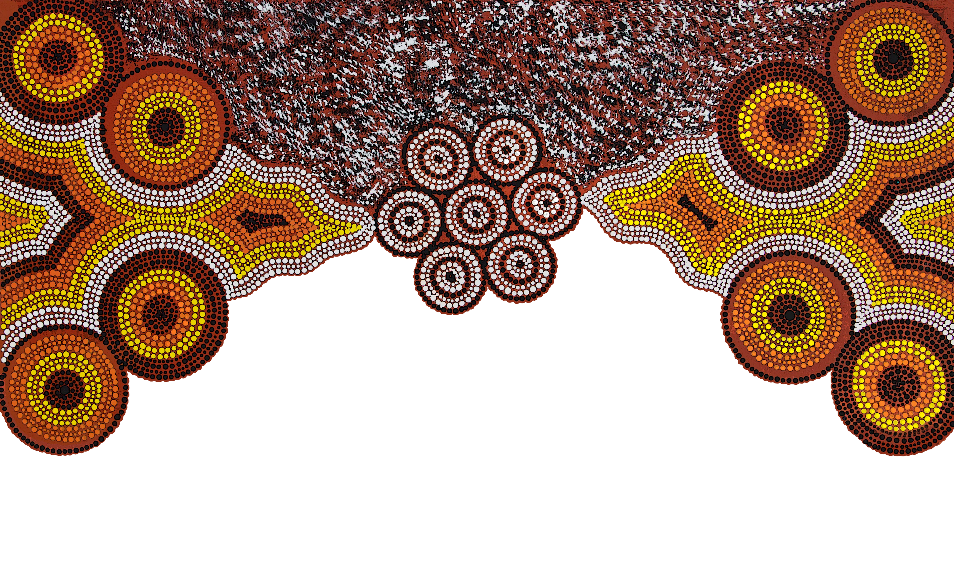
Understanding the impact of trauma on First Nations peoples and in First Nations communities
Some trees need more water than others
Uncle Harry Walker - Bundjalung Elder
Emeritus Professor Judy Atkinson AM PhD
Artist: Kahlia Wayne
‘Wild Berry Dreaming’
Notes:
Professor Atkinson will discuss her current work across Australia and PNG on community based violence-trauma specific recovery programs, and share her expertise on the transgenerational effects of trauma for First Nations people communities, including trauma related issues stemming from the violence of colonisation and the healing and recovery of First Nations people from this trauma. Her knowledge and expertise in trauma care and recovery will provide a unique and powerful insight for community lawyers in working with First Nations clients and communities.

Slide 2
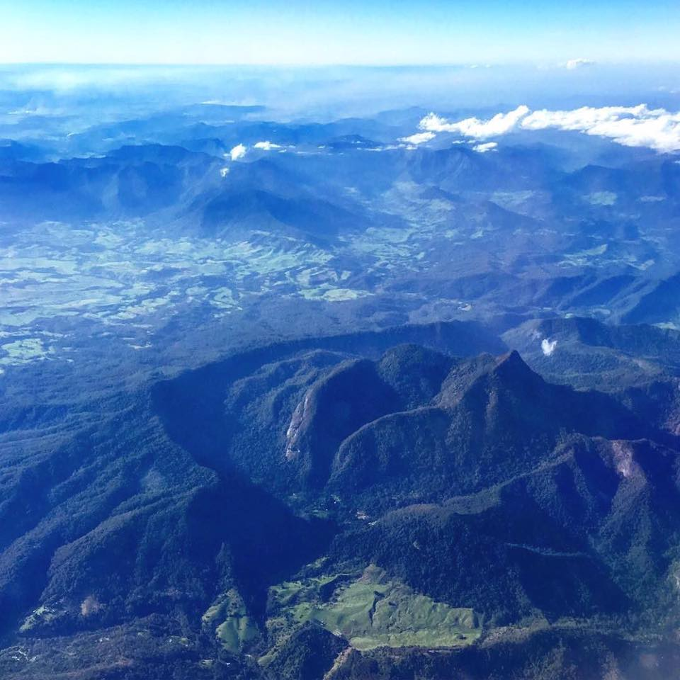
Acknowledging the Ancestors, Elders, Peoples, and Country of each Aboriginal Nation
With greetings from Bundjalung Peoples and Country. Photo: Samantha Power
Notes:
Birthing country – preparation for the ceremony - the ceremony - - closure Language words for listening dadirri

Slide 3
“We live storied lives. We organise experience into stories as we share life interactively with others. The plot, characters, and morals of the stories we hear influence our synatic connections, they change our brains. Stories also live through us. We are born into stories, those of our families, nations, religions and cultures.” (Lewis Mehl-Madrona in Healing the Mind through the Power of Story) * Stories Teach. * Stories are our Law. * Stories are the foundation of Indigenous Healing Practices – Critical Indigenous Pedagogy.

Slide 4
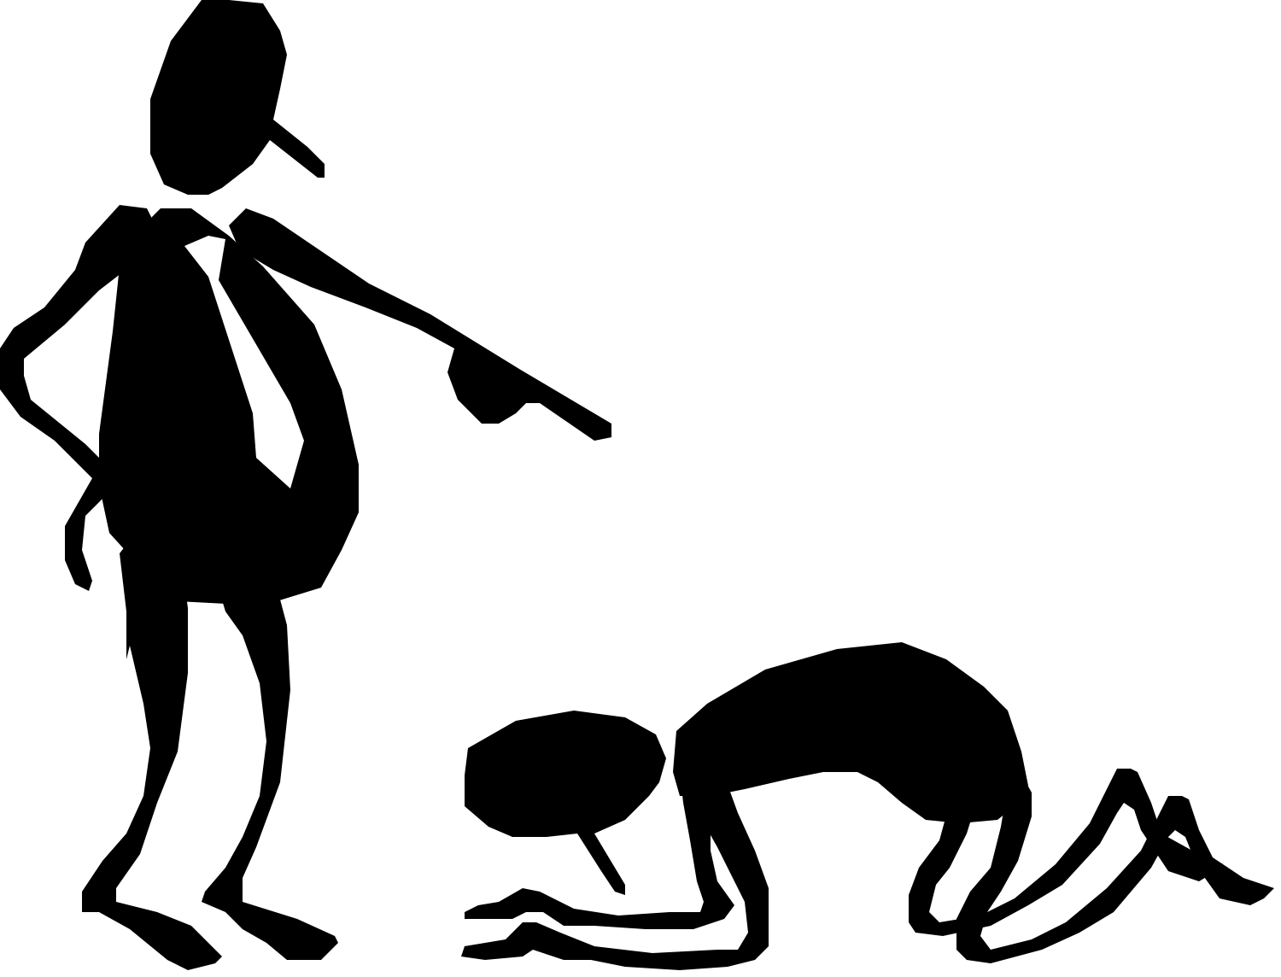
World Wide Colonisations “Symptom as History”
Subjugation of Indigenous peoples - Physical Violence - Structural Violence - Psycho-Social dominance
The creation of culturally unsafe learning and living environments.
Understanding the trauma story
Historic, Cultural, Social, Collective, Complex, Developmental.
Notes:
Structural Violence refers to a form of violence where some social structure or social institution may harm people by preventing them from meeting their basic needs.

Slide 5
Colonisation as Traumatisation

Slide 6
CHILDHOOD TRAUMA … Adverse Childhood Experiences
Childhood trauma including abuse and neglect, is probably the single most important public health challenge … [we face]… a challenge that has the potential to be largely resolved by appropriate prevention and intervention (healing).
Van de Kolk, B (2007) Developmental impact of Childhood Trauma, in Understanding Trauma, integrating biological, clinical and cultural perspectives, Kirmayer, L. Lemelson, R, Barad, M. Cambridge University Press p 224.
CDC-Kaiser Permanente Adverse Childhood Experiences (ACE) Study is one of the largest investigations of childhood abuse and neglect and household challenges and later-life health and well-being.
The original ACE Study was conducted at Kaiser Permanente from 1995 to 1997 with two waves of data collection.

Slide 7
Adverse Childhood Experiences
Children: Violation of child’s sense of safety and trust, of self worth, with a loss of a coherent sense of self, emotional distress, shame, grief, self and other destructive behaviours,
Youth: Un-modulated aggression, difficulty negotiating relationships with caregivers, peers and partners, Clear link between suicide, alcoholism and other drug misuse, sexual promiscuity, physical inactivity, smoking, obesity,
Adults: More likely to develop heart disease, cancer, stroke, diabetes, skeletal fractures, and liver disease,
People with childhood histories of trauma make up almost our entire juvenile detention, criminal justice population.
(van de Kolk 2007 Developmental impact of Childhood Trauma, in Understanding Trauma, integrating biological, clinical and cultural perspectives, Kirmayer, L. Lemelson, R, Barad, M. Cambridge University Press p 224.)

Slide 8
Adverse Childhood Experiences. (ACE’s) 10 questions asked | Yes/No
1: Parent/Carer - swears, abuses, humiliates, where you feel afraid of being physically hurt.
2: Parent or carer hit you so hard you had marks or bruises.
3: An adult, a person 5 years older, forced you to have oral, anal, vaginal sex.
4: You have ever felt no one in your family loved or cared for you.
5: Have you ever been hungry, - your parents unable to care for you. No money for food.
6: Your parents are separated or divorced (or just not there).
7: Domestic - family - community violence including threats by knife or other weapon.
8: Living in a situation where alcohol or other drugs were used.
9: Household – family member depressed or mentally ill – or suicidal.
10: Household member serves time in prison.

Slide 9
The unspeakable can be spoken and needs to be heard
Behaviour is Language

Slide 10
Brains Bodies Trauma
After trauma, the brain and the body react with cells recording memories that become embedded in neuro-pathways which may repeatedly reactivate. Brain areas most relevant and implicated are amygdala, hippocampus and prefrontal cortex.
Amygdala – the doing brain
Hippocampus – the feeling brain
Prefrontal cortex – the thinking brain

Slide 11
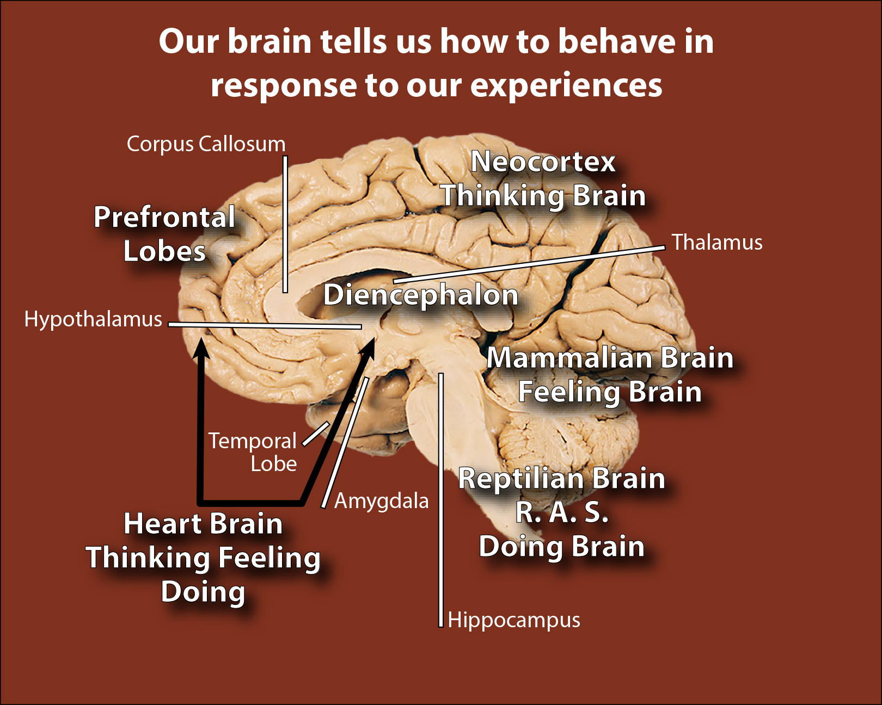
Reptilian - doing - survival brain. Flight Fight Freeze Mammalian - limbic mid brain processes emotions Neo-Cortex – Thinking Centre –cognitive processing, decision making – learning, memory, inhibitory – helping us to plan, problem solve / organize the world around us.

Slide 12
The Thinking Brain
The Neo-Cortex – prefrontal lobes are responsible for cognitive processing, decision-making, learning, memory and inhibitory functions which help us plan, problem solve and organize the world around us. The neo-cortex or prefrontal cortex is known as the “thinking centre” – or the thinking brain.
Notes:
Play video

Slide 13
Brains that have been traumatised look different to non-traumatised brains in 3 ways
The Fear centre is over-activated –
Fight - Flight – Freeze ; fxxx
The emotional brain is under-activated
The thinking brain is under-activated
This has major impacts on physical,
psychological, mental health.

