Slide 1
Show me the Money: Assisting people to resolve disputes that impact their income and finances Community and Health Justice Partnerships
Natasha Ramsay (Financial Counsellor)
Stephen Grace (Managing Lawyer)

Slide 2
LawRight understands the importance of your privacy and is committed to protecting the privacy of your
Acknowledgement of Country
We acknowledge the traditional owners of the land and waters throughout Australia and pay our respect to Elders past, present and emerging.
We benefit from the gifts of First Nations peoples, acknowledge the historical and ongoing injustices they bear and support their call for power over their destiny.

Slide 3
LawRight’s Community and Health Justice Partnerships
LawRight is a not-for-profit, community-based legal organisation that coordinates the provision of pro bono legal services for individuals and community groups.
LawRight leads partnerships at 14 locations, where we collaborate with health and community workers to resolve the complex, intersecting problems of clients.

Slide 4
Today’s session
Today’s session will cover:
the types of issues we commonly see;
practical considerations when enquiring about a person’s financial circumstances and the issues that cause financial stress;
practical options to increase a person’s limited income or access to services; and
practical options to reduce a person’s outgoings, including debt resolution.
We will also provide practical tips for assisting someone with a debt matter.

Slide 5
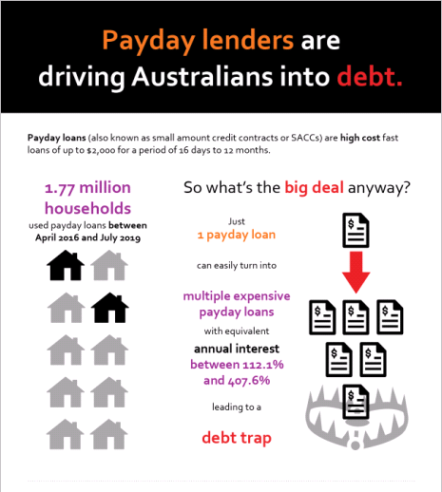
Common experiences
An increase in the cost of living is placing our clients under increased financial pressure.
Many people seek assistance with:
An inability to meet basic living costs on a limited income;
Debts to utility providers or Telcos;
Historic debts, sometimes from many years ago;
Tenancy related debts;
Payday loans and consumer leases;
Concerns about their income, Centrelink Benefit or superannuation; and
Late payments on car loans or other credit agreements.
Some people will present with one issue but many will have multiple.
Stop the Debt Trap Infographic
consumeraction.org.au/stopthedebttrap

Slide 6
Understanding a person’s financial circumstances
How to create a budget or prepare a Statement of Financial Position?
Assisting a person to plan a financial journey.
Talking with people about personal and financial matters.
What type of information is important and what types of things we don’t need?

Slide 7
Increasing limited income
Connecting with community and support agencies.
Home Energy and Emergency Assistance Scheme.
No or low interest loan schemes.
Effectively using Centrelink and other access services.

Slide 8
Reducing outgoings and negotiating debt
Reducing debt through:
Holds on accounts or affordable payment plans;
Hardship variations;
Waiver requests and refunds; and
Other legal remedies.

Slide 9
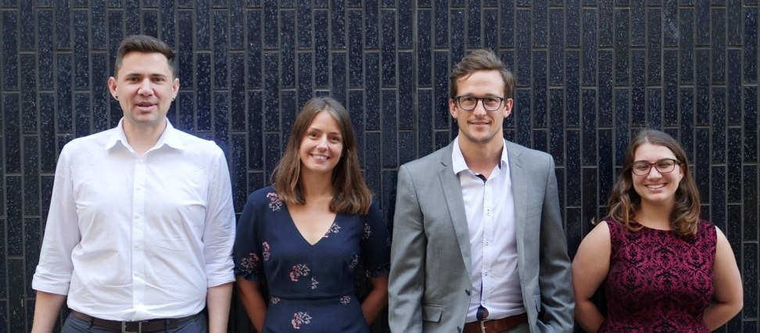
Contacts
Managing Lawyer: Stephen Grace
Email: stephen.grace@lawright.org.au
Financial Counsellor: Natasha Ramsay
Email: Natasha.Ramsay@lawright.org.au
Lawyer: Fleur Hopkins
Email: fleur.hopkins@lawright.org.au
Lawyer: Kate Adnams
Email: kate.adnams@lawright.org.au
Lawyer: Kirra Uren
Email: kirra.uren@lawright.org.au
Project Officer: Kurt Maroske
Email: kurt.maroske@lawright.org.au
Administrators:
Jean Brady & Zoe Rienecker
Email: admin2@lawright.org.au
The client stories and photos used in this presentation are real, and we thank LawRight volunteers and clients for their willingness to have their photos published. The stories are in no way connected to the photos, and do not relate to any person depicted.
The Community and Health Justice Partnerships team
Community and Health Justice Partnerships
www.lawright.org.au
PO Box 12217, George Street QLD 4003

Slide 10
Thank you!

