Slide 1
Towards a triage and demand management framework
CLCQ conference 17 June 2021
Notes:
Rosslyn introduce the project, where it’s come from vis a vis digital strategy, the session and us – 5 minutes

Slide 2
Session overview
What’s this project about?
Questions to get you thinking
What we’ve done so far, and why
A tour of some data - two trial sites
Q&A with trial sites
Notes:
Rachel – handover to Gretchen to get you thinking

Slide 3
Questions for you (round 1)
If you wanted to better manage demand, how helpful would the following data be:
Where your resources go – time spent x priority group x service type
Where your resources go - repeat vs one off clients x priority group x service type
(assume for this question it’s easy to collect this data)
Notes:
Gretchen leads, 10 minutes slides 3-6
How helpful – one finger, not at all, five fingers – very helpful

Slide 4
Questions for you (round 2)
How easily could you get this data from CLASS now:
Where your resources go – time spent x priority group x service type
Where your resources go - repeat vs one off clients x priority group x service type
Notes:
How easily – one finger, not at all, five fingers – very easily

Slide 5
Questions for you (round 3)
Turn to the person sitting beside you and talk about the difference between ‘triage’ and ‘demand management’
Notes:
Now for a change of pace and to get you talking…
call on people for answers

Slide 6
Questions for you (round 4)
What’s the most effective thing you’ve ever done to improve how you manage demand for services?
How did it benefit the community?
If you want to share your experience – write it down on an index card and we’ll collect it
Notes:
Rachel collects index cards and scans them for something to link to PowerBI or later discussion
Gretchen, hand over to rachel for a quick overview of the project to date

Slide 7
Triage – who gets in the door
Demand management – who gets in + what happens next + what does it take?
Notes:
Rachel 7-8 minutes for slides 7-16
So you’ve told us what comes to mind - here’s our take on it

Slide 8
Triage (who gets in)
A subset of demand management
Guides initial ‘sorting’ of clients at intake
think: accident and emergency
Notes:
Rachel
In a CLC context, this might include intake process and prioritisation of clients for advice vs referral or info

Slide 9
Demand management (who gets in the door + what happens next + what does it take?)
Driven by organisational vision and strategy
Broader than the point of intake – considers each stage of the client journey
Considers skill mix and resources available
Can involve service/workforce redesign
think: nurse practitioners stepping into doctors’ scope of practice think: WLS Vic only doing high impact casework
Notes:
Rachel
Managing demand is bigger than sorting who gets through the initial ‘gate’ of a service, it’s deciding who gets repeat services or longer appointments or more complex services, what you do and don’t do, what tasks are best done by different members of the workforce (admin, paralegal, junior lawyer, senior lawyer, volunteer lawyer)

Slide 10
Demand management strategy
Sets out to solve a problem
Is informed by good data –
to define the problem and
test the solution
Notes:
Think about use of advanced physios to run back pain clinics in hospital A&E –
Problem – back pain is a common emergency presentation but only a fraction require acute hospital care (surgery) – so if they’re all seen by an emergency physician or neurosurgeon, it’s a waste of precious resources
Solution – filter out the clients who don’t need urgent medical or surgical review, give them an appropriate referral and immediate pain relief, only let acute surgical cases into the hospital – backed by years of evidence and trialling, requires highly skilled physio

Slide 11
Service pyramid
Resources needed
Number of people assisted
Intensive
Targeted
Universal
Notes:
Walk people through health examples – health information, public health measures like fluoridation, water treatment, primary health care GPs
Targeted – could be by population group e.g. refugee services or by disease group e.g. diabetes services
Intensive – acute hospital care – intensive case management - often statutory responses are at the intensive end
Also conceptualised as prevention, early intervention, crisis response
For you – thinking about organisational vision and strategy, defining what your role is in this system, where do you see yourselves, requires knowing what other services exist, your niche

Slide 12
Value based health care
High-value healthcare occurs when a large amount of health benefit is generated for a relatively small investment of resources
Low-value healthcare confers little or no benefit compared with costs and potentially wastes limited resources
Notes:
In a CLC context, this might be thinking about matter types that have the highest impact for clients – changing lives, preventing more serious consequences

Slide 13
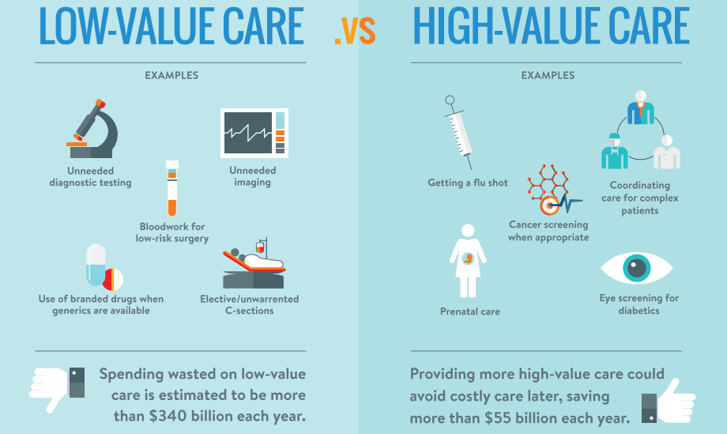
Notes:
Low value care doesn’t mean it’s never valuable – just that it shouldn’t be the first response, still requires professional judgement
Coming back to our back pain example, MRIs for back pain not needed unless other risk factors present like numbness or foot drop – then the imaging is urgent and possibly so is surgery.
Can never replace a skilled practitioner asking the right questions to determine level of risk and decide the best pathway

Slide 14
Project overview
Good data supported by action learning
(Clarity Consortium)
Practical tools and processes
(CLCQ)
Identify a problem or opportunity based on data
Trial new approaches using tools and processes
(4 trial sites supported by 5 buddy sites)
Notes:
So this is what we’re doing, in a nutshell

Slide 15
Project approach
Action learning
Data-driven
Working towards a practical outcome
Incremental approach
Four trial sites – centres retain autonomy and implement locally
Five ‘buddy’ participating sites
Notes:
Learn as we go, sometimes it feels a bit nebulous, can’t quite see the end point – that’s the nature of action learning

Slide 16
Learning and evaluation approach so far
Worked with centres to identify data that could inform decisions about demand management
Used existing data wherever possible, or easily modified data collection
Loaded it into PowerBI to make it easy to analyse (we’ll come back to PowerBI)

Slide 17
Practical tools and processes from CLCQ
Notes:
Sam/Rosslyn
CLCQ 7-8 minutes to talk about toolkit

Slide 18
PowerBI
An interactive platform to look at and analyse data
Readily and cheaply available with Microsoft subscriptions ($10/user/month)
Notes:
Next part of this session
Rachel introduce Olivia and Cherie and explain what they’re doing,

Slide 19
Q&A
Notes:
Gretchen thank them and launch into Q&A moderation with Sam or Rosslyn to help with the moderation
Questions to kick off Q&A
one thing related to demand management that they’ve learned from looking at the PowerBI data that they never would have known without it, then
what’s the one service change they’re considering as a result of this new insight (no one will hold you to it if you decide not to make that service change of course, but we’d like to give the audience a flavour of how the data can drive better informed decision making about managing demand, particularly that idea of scenario-testing the potential impact of service changes by using the PowerBI data).

