Slide 1
justice or just us?
rethinking justice, power & Indigeneity
Associate Professor Chelsea Watego
Aboriginal and Torres Strait Islander Studies Unit
The University of Queensland
T: @drcwatego

Slide 2
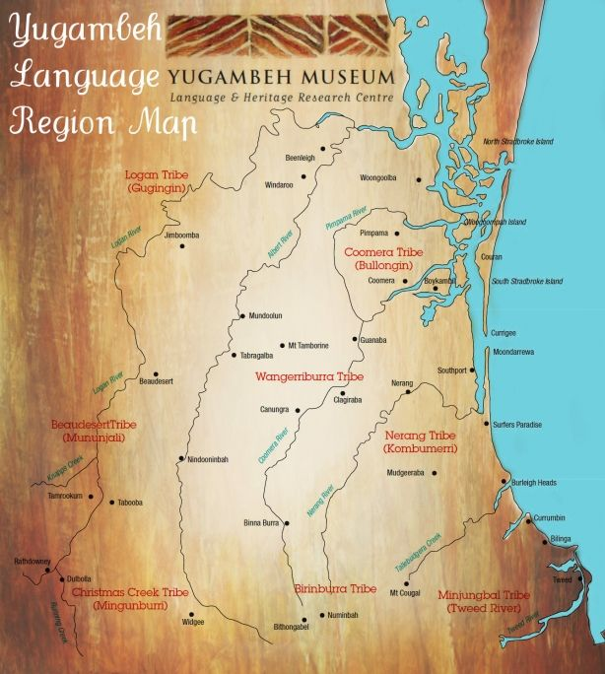
Aboriginal protocol usually links the right to tell a story with a declaration of involvement or connection to the story.
Anderson, Ian. I, the 'hybrid' aborigine: Film and representation [online]. Australian Aboriginal Studies, No. 1, 1997: 4-14.

Slide 3
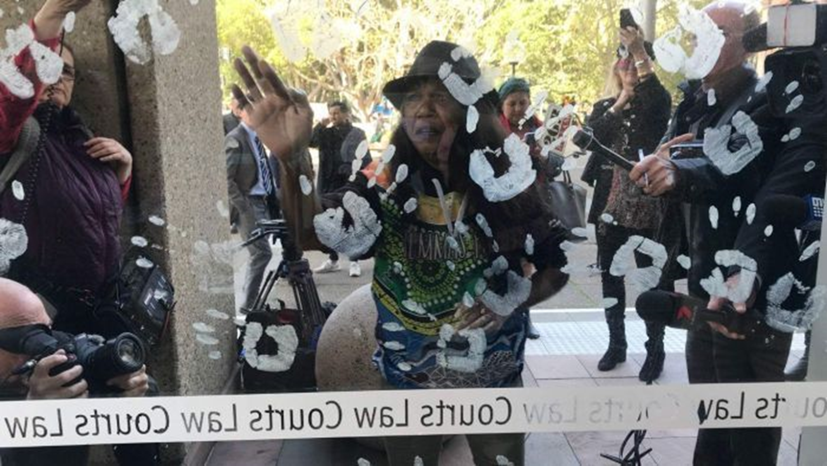

Slide 4
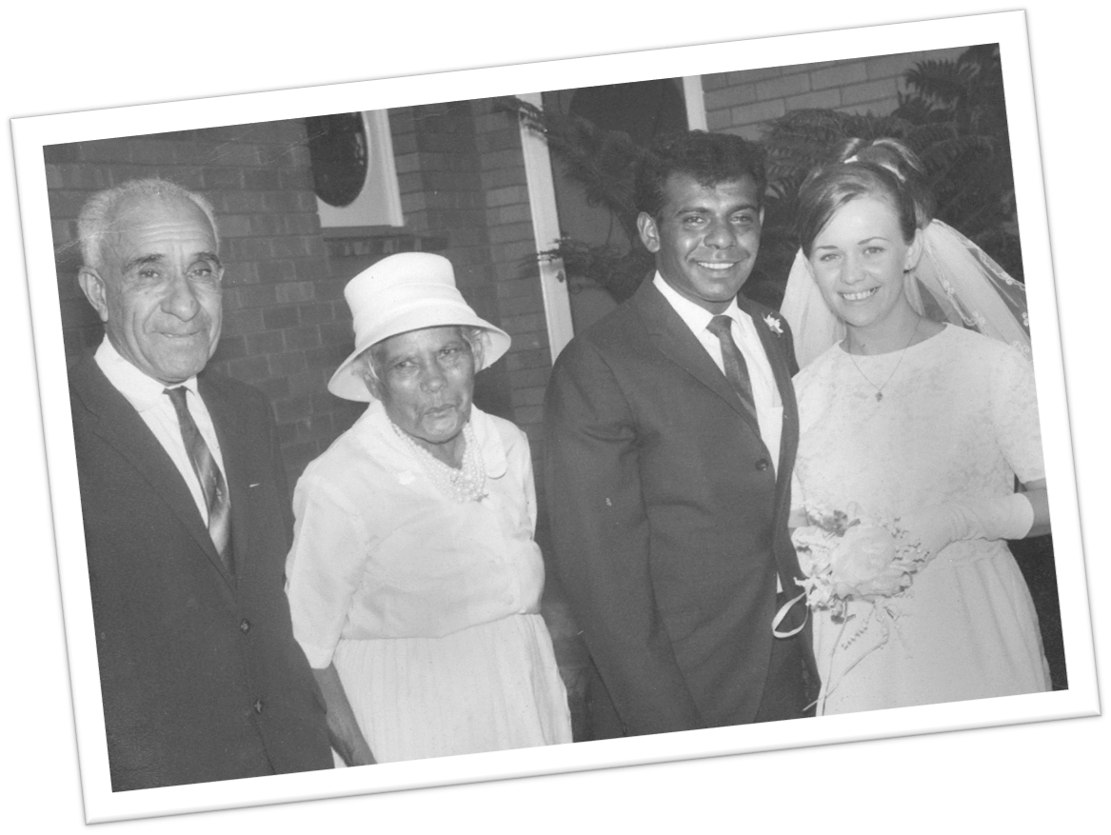

Slide 5
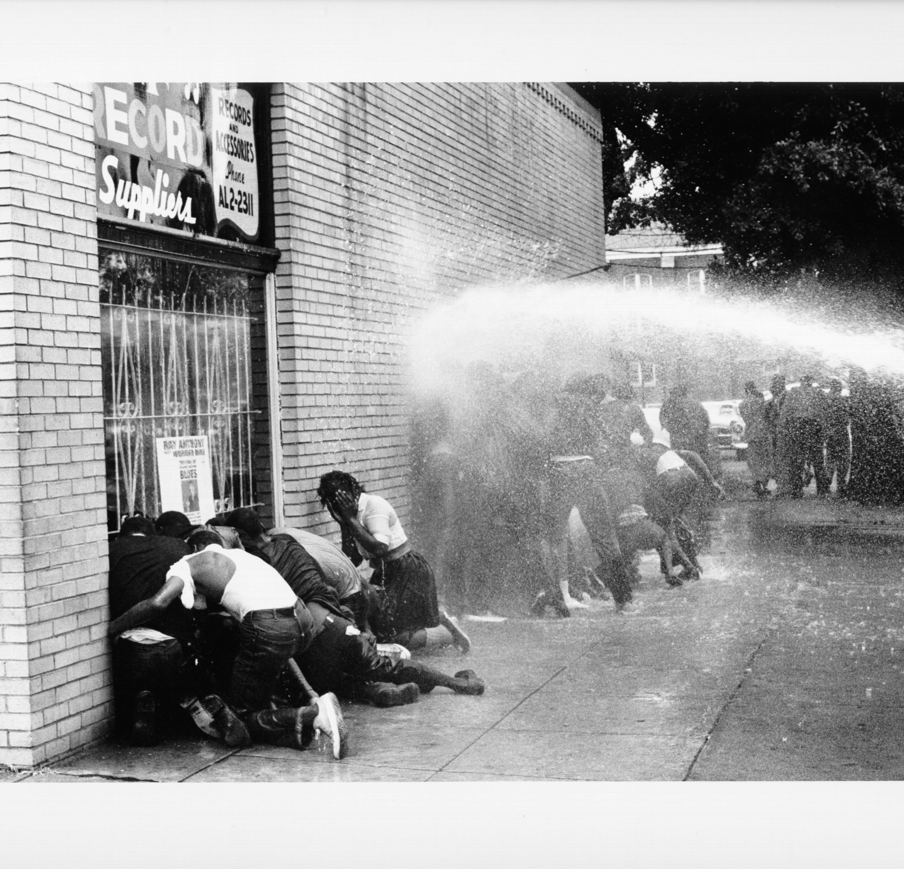

Slide 6
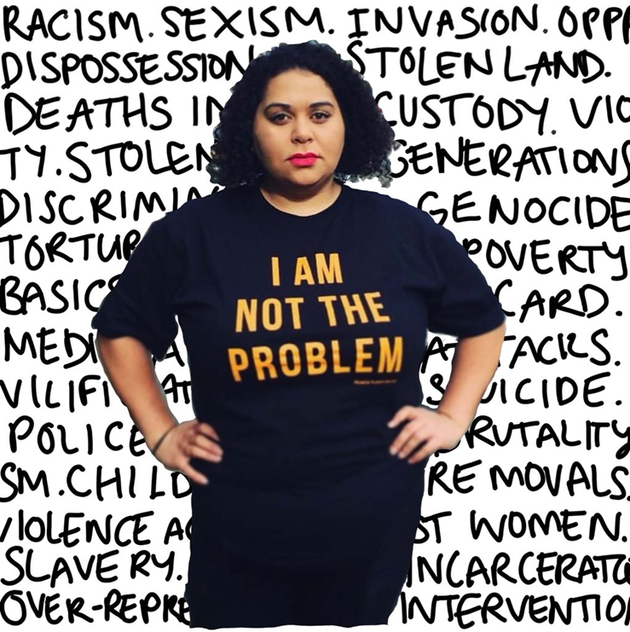

Slide 7
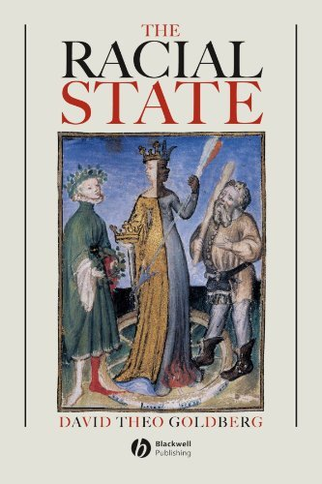

Slide 8
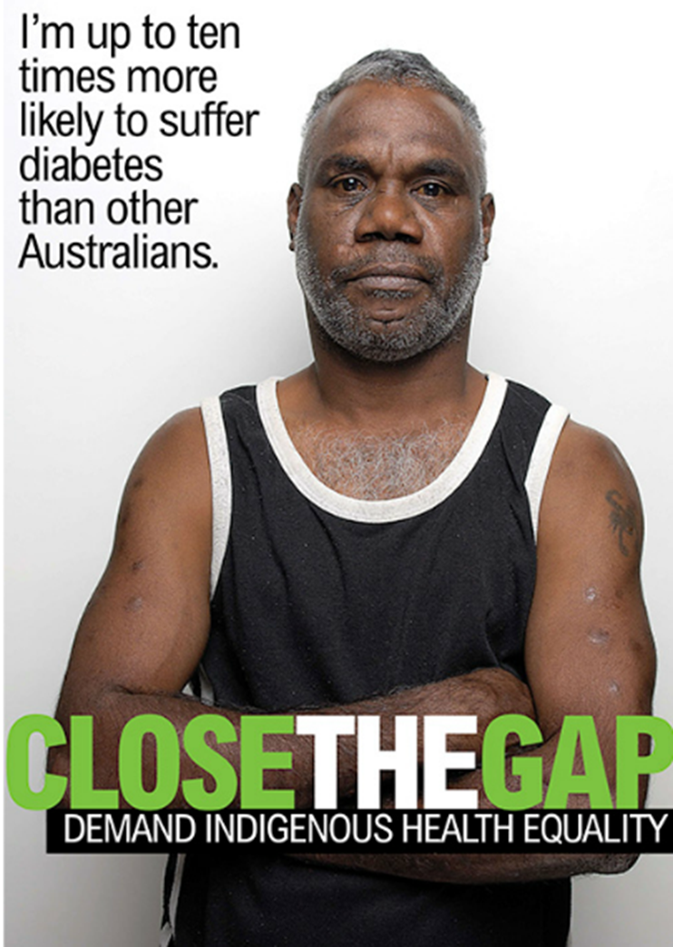

Slide 9
Medical science and concern for one’s health have always been proposed or imposed by the occupying power…In the colonial situation, going to see the doctor, the administrator, the constable or the mayor are identical moves.

Slide 10
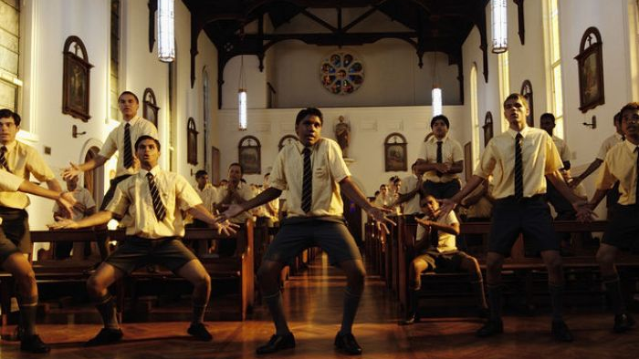
There's nothing I would rather be than to be an Aborigine And dream of just what heaven must be like. Where moth and rust do not corrupt. When I die I know I'll be going up Cos you know that I've had my hell on earth JIMMY CHI

Slide 11
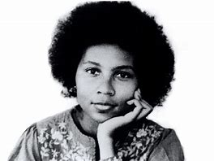
I did listen to my rage, allow(ing) it to motivate me to take pen in hand and write in the heat of that moment. At the end of the day, as I considered why it had been so full of racial incidents, of racist harassment, I thought that they served as harsh reminders compelling me to take a stand, speak out, choose whether I will be complicit or resist. All our silences in the face of racist assault are acts of complicity. What does our rage at injustice mean if it can be silenced, erased by individual material comfort? If aware black folks gladly trade in their critical political consciousness for opportunistic personal advancement then there is no place for rage and no hope that we can ever live to see the end of white supremacy.

Slide 12
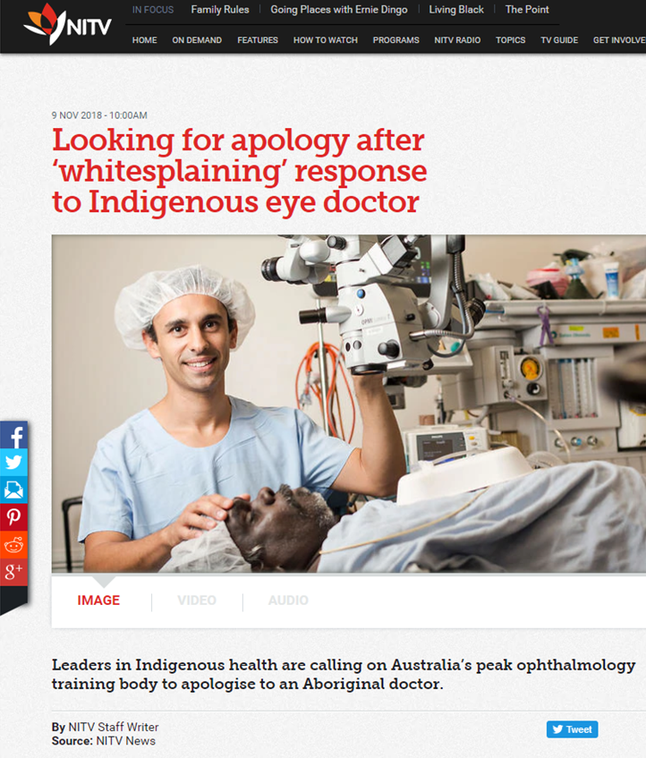
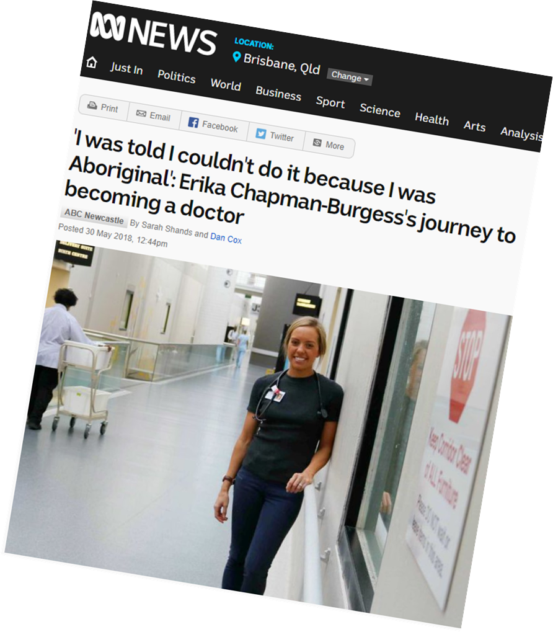
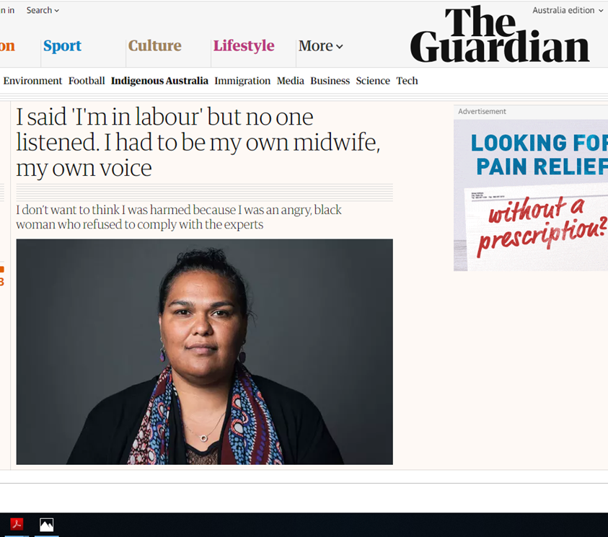

Slide 13
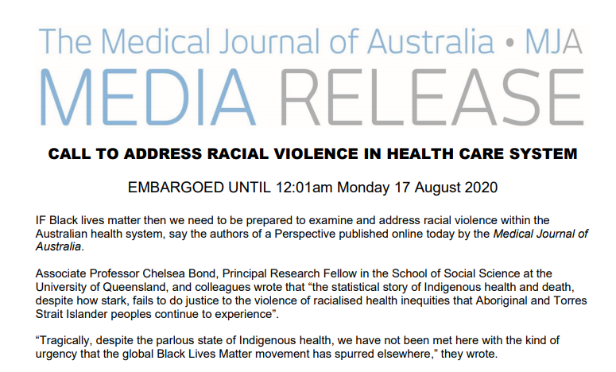

Slide 14
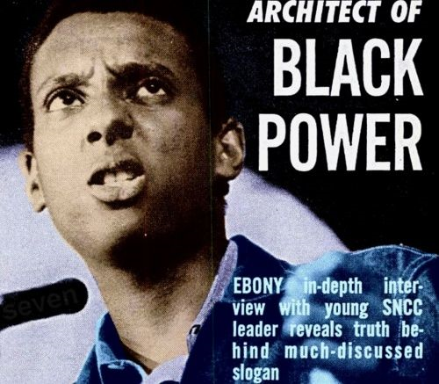
“Our grandfathers had to run, run, run.
My generation’s out of breath.
We aint running no more”
Kwame Ture

Slide 16
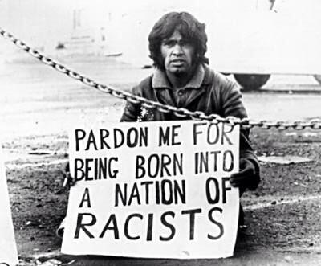

Slide 17
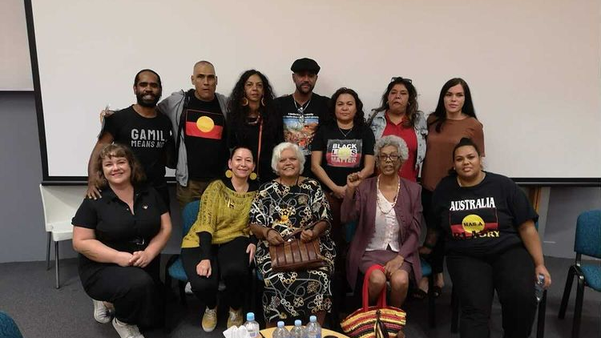

Slide 18
It’s a strange thing justice, I’ve never seen it, never felt it, dunno the dimensions of it, it’s very much like a spiritual being. I know that justice is there somewhere, we haven’t cited it, we haven’t seen it but we know it’s there, and it has just as strong a force as those spirits that kick you up the behind when you’re doing the wrong thing. And it’s something that’s motivated generations of people within our own country, striving for justice for its own sake really.

Slide 19
