Slide 1
Well-being: it’s everyone’s business

Slide 2
We acknowledge and pay respect to the owners of this land, on which we gather today and acknowledge Elders – past, present and emerging.

Slide 3
Women's Legal Service Tasmania
We are a community legal service providing information, advice and legal support, including representation to women across Tasmania.
We have offices in Hobart, Launceston and Burnie. Our Launceston and Burnie offices run as Domestic Violence Units and have financial counsellors and a social worker.
We also provide free and confidential phone line for advice and referrals for any women with legal issues across the state.

Slide 4
AIM
Share my learnings from WLST journey to prioritising wellness

Slide 5
Background
Focus on culture
Intrinsic nature of work
Viewing well-being as a WHS risk to manage
Aim – Build an engaged, values connected,
productive, well, supported team

Slide 6
1
Culture
What we will cover?
2
Strategies to support workplace wellbeing
3
Governance leadership
4
Organisational leadership

Slide 7
Culture
“…the way things are done around here…”
Culture as a Board priority
Change
Building connection to purpose
Open, transparent, accessible
Valuing all staff
Notes:
A

Slide 8
Strategies to support well- being at work
:
MOU RA Tas, supervision
Encouraging use of EAP
Constructive debrief
IWP (clarification of expectations)
Increased supervision of legal work
Team building
Access to training for all staff (mental health, trauma informed)

Slide 9
Governance leadership
Culture as a Board priority
Board updates
External Cultural review completed
Investing in leadership development
MOU with RA Tas supported (bi-monthly)
Board planning and training

Slide 10
Operational governance
Policies : Wellbeing policy
Connection of strategic purpose to work
Constructive debrief, example
Systems and structure to support staff who are struggling
connection to profession & other specialists
Consultation

Slide 11
Opportunities
Covid
Staff policy
Service delivery
Collaboration
Staff connectiveness
Culture around violence against women more broadly

Slide 12
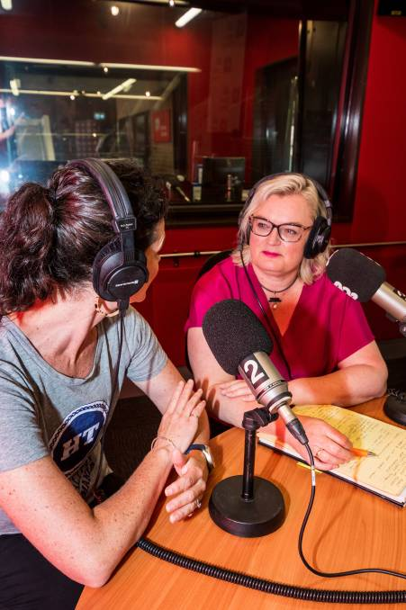
Women's Legal Service Tasmania
The Rule of Thumb podcast highlights the challenges woman face when they come into contact with the legal system in Australia.
The podcast features conversations from women with experience of the system, lawyers who assist and represent women, and counsellors who provide them with support.

Slide 13
Challenges
Loss of staff
Working with/to Board
Trying to do too much at once
Poor work life balance
Self critical
Restructuring in April 2021 for budget reasons

Slide 14
QUESTIONS? COMMENTS?

