Slide 1
Health Decisions in Qld - Whose Decision Is It?
9 November 2021

Slide 2
Acknowledgement of country
Community Legal Centres Queensland acknowledges the traditional owners of the land on which we are holding this presentation, the Turrbul and Jaggara people.
We pay our respects to their elders, past, present and emerging, and acknowledge the important role Aboriginal and Torres Strait Islanders continue to play in our society.
As this presentation is being viewed throughout Queensland, we also pay respect to the traditional owners of the land throughout the country and extend a warm welcome to any First Australians listening to this presentation.

Slide 3
GoToWebinar housekeeping
Facilitator:
Carly Hanson, Sector Sustainability Coordinator, Community Legal Centres Queensland
Recording:
This webinar is being recorded and will be available on the Staff Training page of our website: https://communitylegalqld.org.au/clc-staff/staff-training-and-cle
PowerPoint / webinar materials:
Emailed prior to today’s session
Available to download from Handouts section of GTW control panel
Questions:
Type your questions/comments into question box on GTW control panel OR
Raise your hand and we will unmute your microphone
Questions will be addressed at the end
Technical help:
Email carly@communitylegalqld.org.au or use question box in GTW
Notes:
Presenter will be introduced shortly

Slide 4
Legal disclaimer
This presentation is for professional development and education purposes only. The information provided in this presentation is not legal advice and is designed for lawyers and other staff working and volunteering in a community legal centre setting in Queensland.
This presentation and webinar is not to be published or reproduced for commercial purposes without the express permission of the author.
Information is current as at 9 November 2021. Community Legal Centres Queensland does not accept any liability for the accuracy of the information in the presentation.

Slide 5
Keep safe – content note
Community Legal Centres Queensland wants to ensure that community legal centre workers and others accessing these training materials feel safe, and are able to access appropriate and timely help and support.
Some content in these training materials may be disturbing, upsetting or trigger strong/negative emotions for victims and survivors of violence and trauma, and others.
Community Legal Centres Queensland respects your autonomy. If you feel triggered or upset by any of the content or materials provided here, we encourage you to use your discretion as to whether you should continue reading, watching or listening to the material.
You may also wish to access more information and resources, as well as professional support or advice from one of the free and confidential organisations listed on our Keep Safe website page: http://communitylegalqld.org.au/keepsafe.

Slide 6
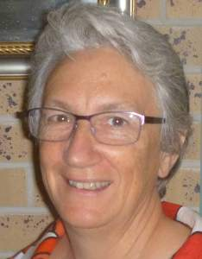
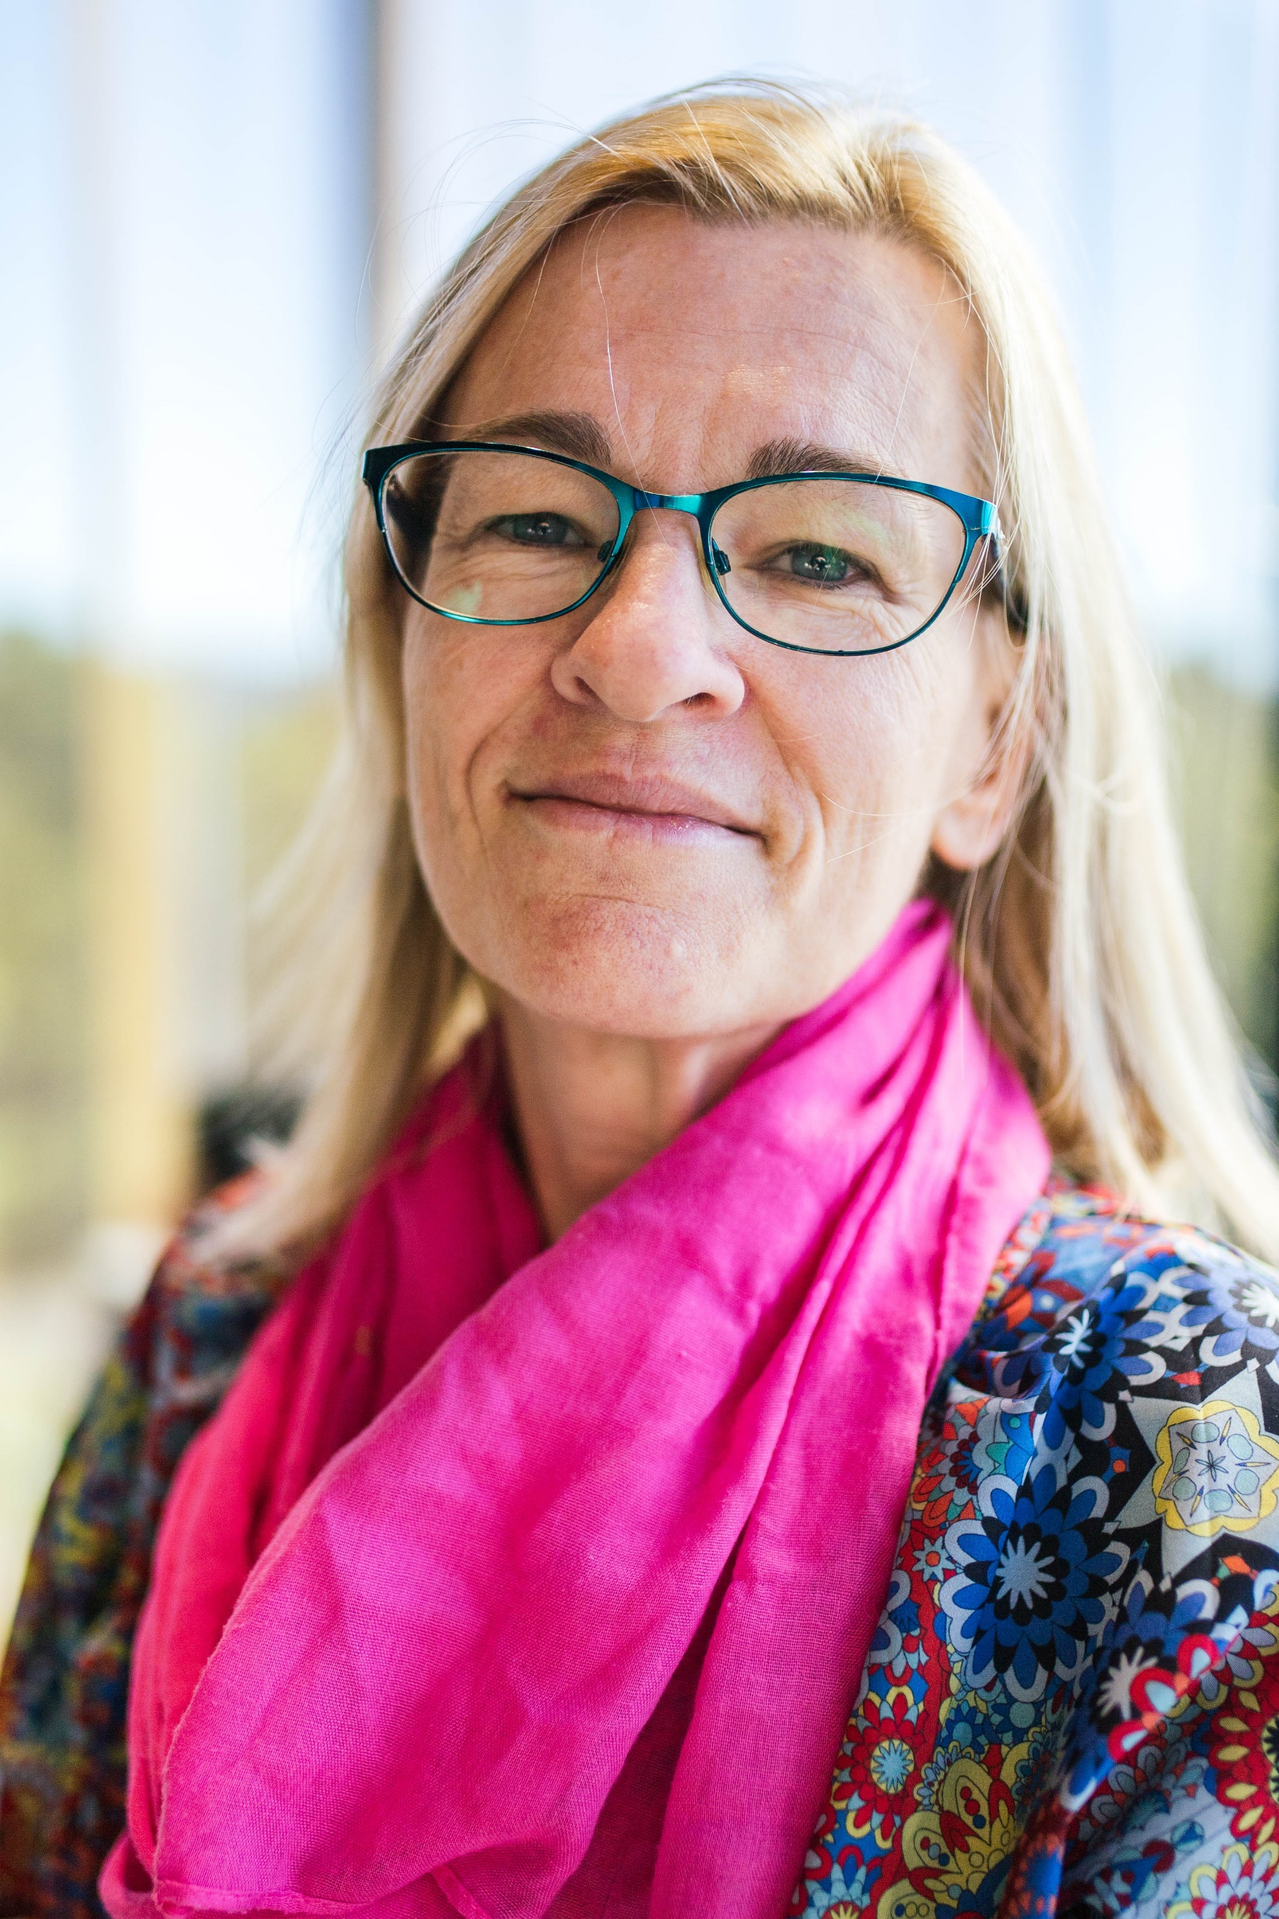
The presenters
Karen Williams
Principal Solicitor, ADA Law
Rebecca Anderson
Solicitor, ADA Law
Mandy Shircore
Director, UQ Pro Bono Centre
ADA Law assists and represents adults with questioned capacity in QCAT, EPOA and some MHRT matters.
UQ Pro Bono Centre develops, promotes and provides student pro bono legal services through partnerships with the NFP sector.

Slide 7
Poll
Are you a:
Lawyer
Health Professional
Advocate
Community Worker
Student
Other

Slide 8
Aim of this webinar
This webinar has 2 purposes –
Discuss new easy-use resources that are available to health consumers, legal and health practitioners, and decision makers, which display the health decision-making regime in Qld and provide improved certainty for decision-making.
Recent Research (Sellars et al “Public Knowledge, Preferences & Experiences about Medical Substitute Decision Making: A National Cross-Sectional Survey” BMJ Supportive and Palliative Care 2021) found that 33% of Australian adults knew about the decision making laws and only 13% reported having acted in the role.
2. Showcase how organisations can work with the UQ Pro Bono Centre to develop CLE resources, benefitting both community, practitioners and law students

Slide 9
What this webinar covers
The recent Qld introduction of the Human Rights Act 2019 and passing of the Voluntary Assisted Dying Act 2021 brought about discussions in relation to health or medical decision-making. Such as:
Who can consent – to what and when?
Why, when and how does a practitioner conduct a capacity assessment?
What if the consumer doesn’t appear to understand sufficiently?
What if the consumer wasn’t able to consent last time?
It highlighted that both health and legal practitioners were unclear of the current laws in relation to healthcare decision making, relying on out-of-date practices and concepts (e.g. who is the next of kin?)
It also showed what health consumers and their supporters were struggling to understand.
It showed that this complex space was about to get more complicated.

Slide 10
QLD’s legislation is multiple and complex
Qld’s legislation is also gradually recognising and applying Australia’s obligations to the UNCRPD.
These rights include a least-restrictive approach to decision-making, and a recognition of the right to autonomy, including in healthcare.
This can bring a question of balance –autonomy and dignity of risk v duty of care
There are already multiple pieces of legislation and policy at play for Qld health consumers, eg
Guardianship and Administration Act 2000
Qld Capacity Assessment guidelines 2020
Powers of Attorney Act 1998
Mental Health Act 2016
Civil Liability Act
Human Rights Act
Transplant and Anatomy Act
Public Health Act

Slide 11
Poll: What is your level of understanding of Health Care Decision Making
A lot
A bit
None
Other

Slide 12
The project
Create usable resources which help to demystify health decision-making in Qld
Utilise the resources of the UQ Pro Bono Law Centre
Provides students with practical learning –
law, collaboration, legal interpretation and application
Delivers resources with less financial burden for CLCs
Supports the legal sector by project being targeted to identified areas of need
Collaboration between ADA Law and UQ Pro Bono
ADA Law devised the project parameters
UQ Pro Bono advertised and vetted suitable students
ADA Law supervised the students re content and deliverables
UQ Pro Bono maintained regular contact with the students to provide further guidance and support
Students worked remotely, having regular Zoom meetings with supervisors
Two semesters of students (5 overall) from idea to deliverable

Slide 13
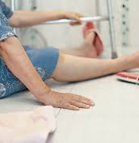
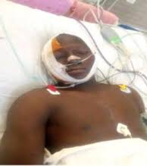
The scenarios
The students were given 3 scenarios, based on common hospital presentations where decision-making is called into question.
Maria, an older woman who had a fall and is now in Emergency Department (ED), confused
Abraham, a young man who was involved in a car accident, unconscious in ED, possibly with brain injury
Elizabeth, a long-term kidney dialysis patient, who is now refusing further treatment

Slide 14
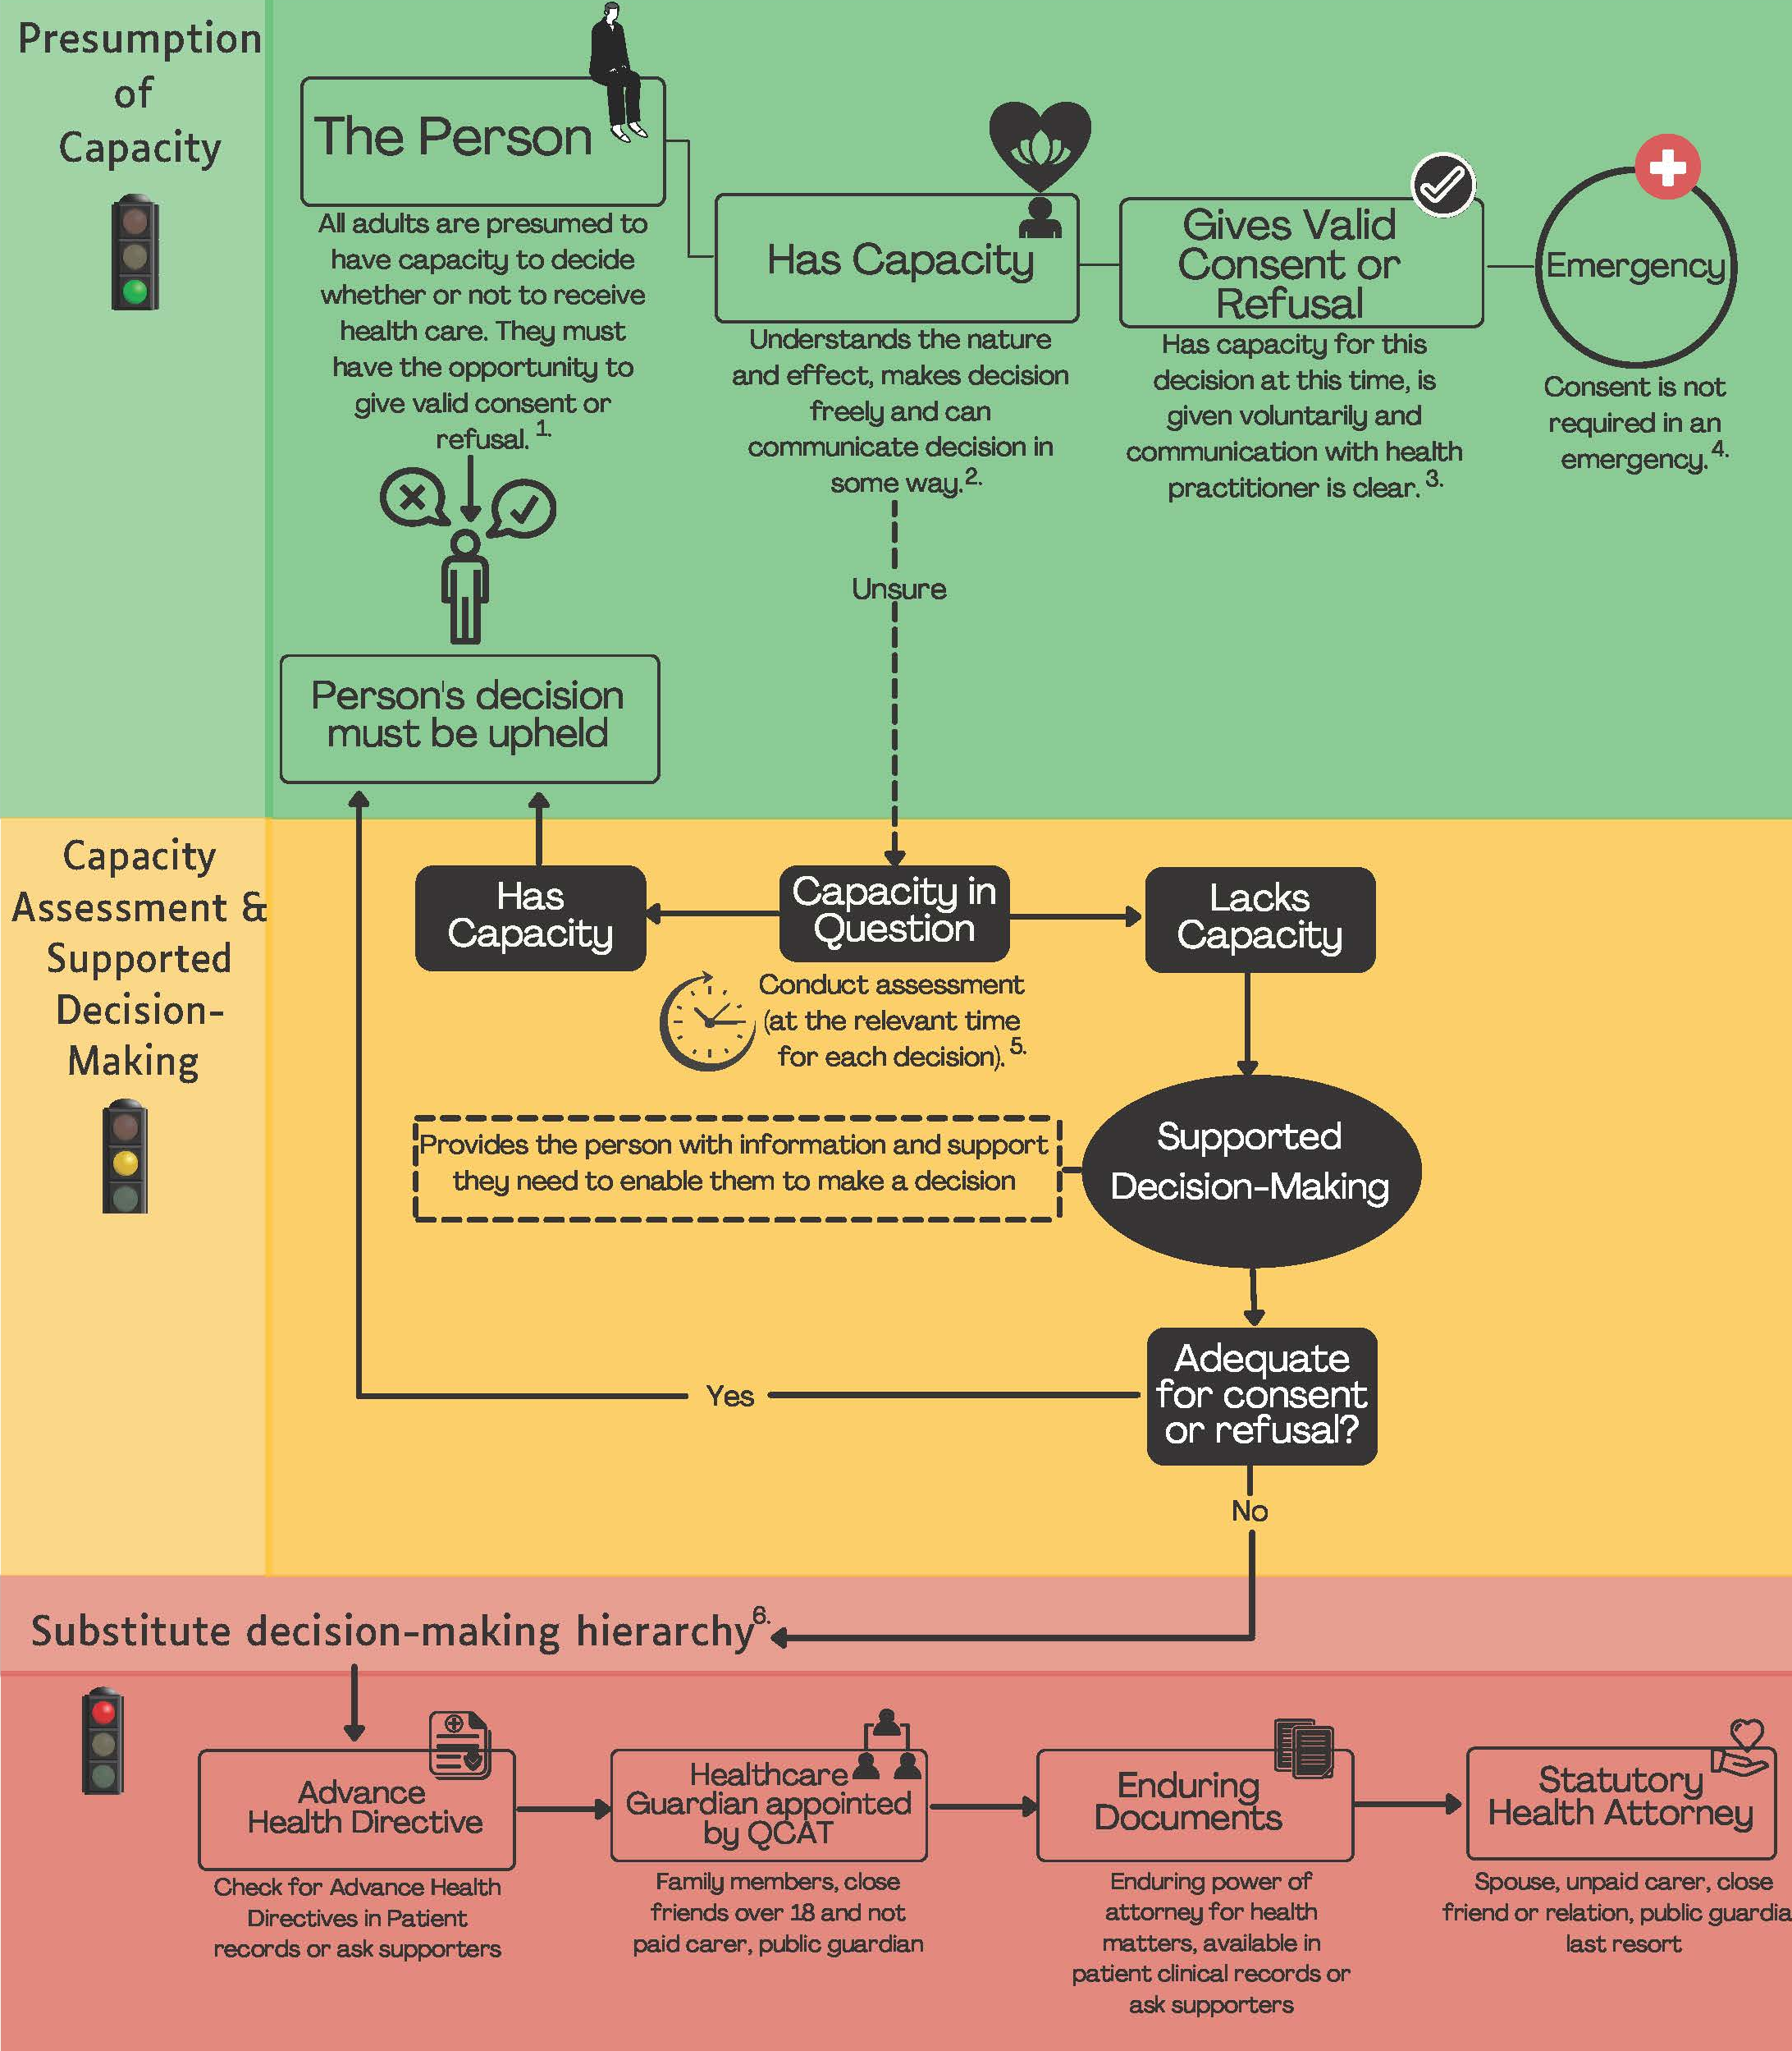
Easy to use Resources
Flow charts with icons were effective ways to deliver information to both professionals and health consumers alike.
Health practitioners’ legal literacy in acknowledging rights of patients in the context of questions about capacity is emerging.
Sinclair et al “Professionals Views & Experiences in Supporting Decision Making Involvement for People Living with Dementia”, Dementia, 2021

Slide 15
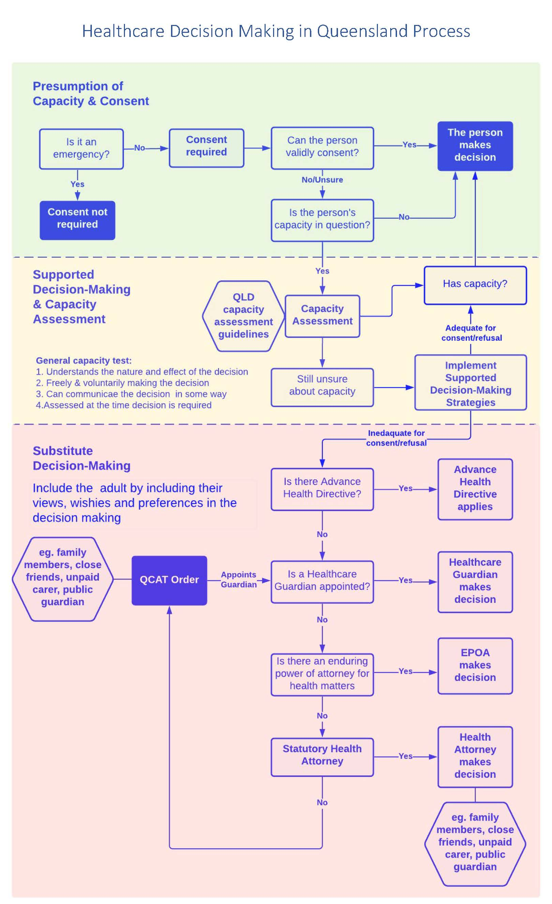
Focus on legal requirements & rights framework
This requires a better understanding of:
Supported Decision Making
Focus on inclusion
How is necessary support being provided?
Capacity assessments
are to be positive (not deficit) focussed
what decisions can the person make?
Under what circumstances
When to review this?
Statutory Health Attorney (default) role
who, what, how, when

Slide 16
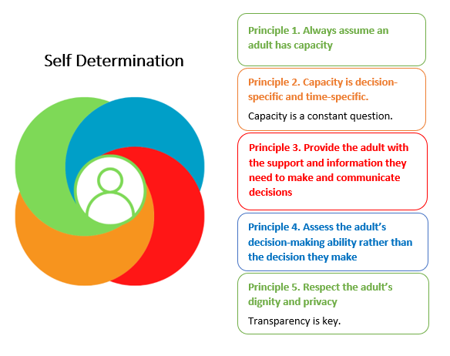
Recognising Autonomy
When it comes to making decisions about health, whether in an emergency situation or regarding an ongoing health issue, it is everyone’s right to have the opportunity to consent to or refuse treatments.
The person must remain at the centre of health decisions

Slide 17
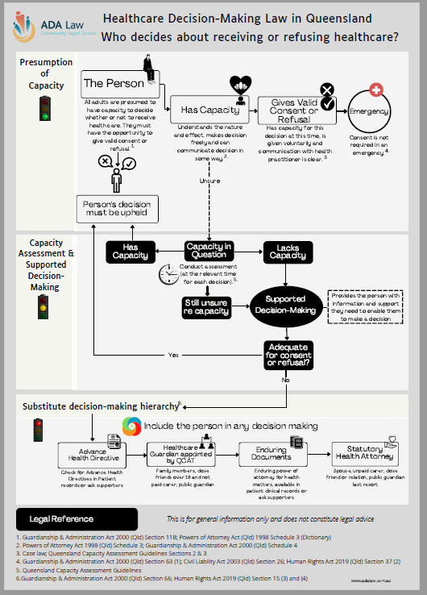
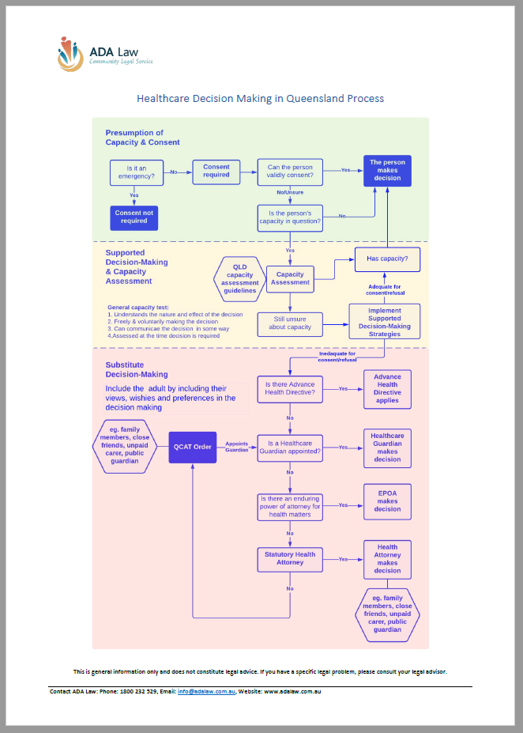
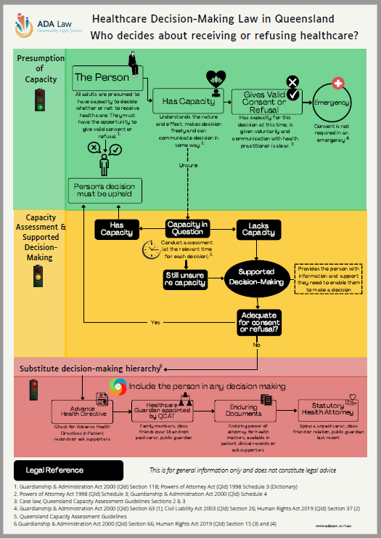
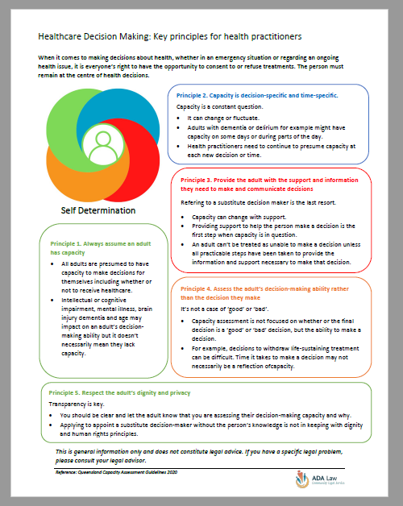
Resources for Consumers, Lawyers, Health Practitioners and Decision-Makers

Slide 18
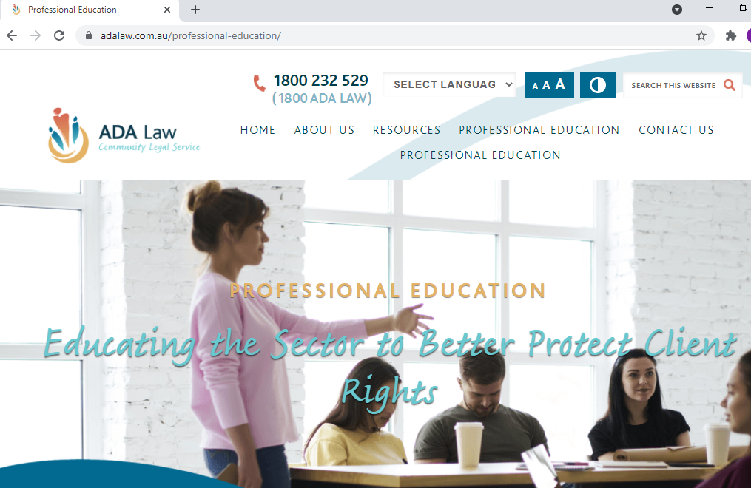
More resources for Lawyers, Health Practitioners and Researchers
ADA Law Website will house the research conducted by the students.
This resource provides a detailed and comprehensive level of source information for further analysis and research
This project analysed WHO can make the decision
Future projects may explore WHAT decisions they can make

Slide 19
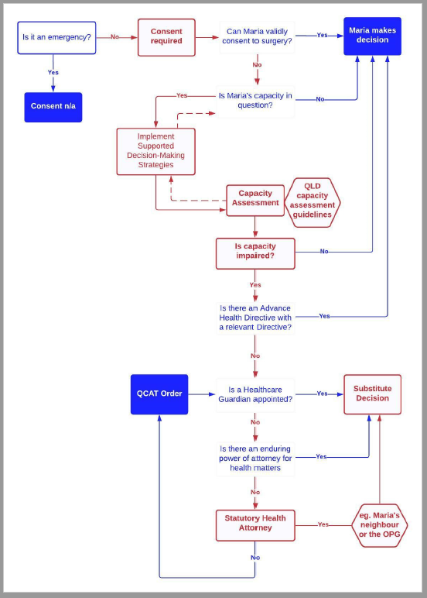
Case study –Maria
Facts:
Not an emergency.
The TT are considering a hip replacement may be appropriate in a week’s time or so.
The TT believe Maria has children but does not have their contact details.
The neighbour Hua, has been friends with Maria for a number of years and reports that Maria has not spoken with her daughters for many years.
Maria has moments of increasing clarity over coming days.

Slide 20
Using the flowchart
Poll Questions:
Is consent / refusal required?
Yes
No

Slide 21
Using the flowchart
Poll Questions:
Who should be the decision maker if Maria is too confused?
Any of her children
Maria
Her neighbour
Public Guardian (because we can’t find her children)
The Doctor
Nobody, consent is not necessary
Don’t know

Slide 22
Using the flowchart
Poll Questions:
When does the decision need to be made?
While Maria is in the emergency department before she is transferred into a ward.
On her first day in the orthopaedic ward
On the morning of her planned operation
As she is waiting for the operation to commence

Slide 23
Using the flowchart
Poll Questions:
When does Maria’s capacity need to be assessed?
Only when she is admitted to the hospital
Once the TT has decided she will need the operation
Throughout Maria’s admission, including before all procedures are done
No need, her operation is an emergency
I’m not sure

Slide 24
Important points from this webinar
Lawyers, Health Professionals and public and private Decision Makers need to know the law in Queensland for health decision making.
We all need to better understand the human rights focus on supported decision making, and always include the person in their decisions.
This can be a difficult concept for lawyers and other professionals.
We never know when we will be needed to step in and make decisions for others.

Slide 25
Useful contacts/additional resources
Website: www.adalaw.com.au
Monday to Friday 9am – 5pm
FREECALL: 1800 232 529
Human Rights Commission – Health Rights factsheet
https://www.qhrc.qld.gov.au/__data/assets/pdf_file/0007/19906/QHRC_factsheet_HRA_s37.pdf
Office of the Public Guardian – Statutory Health Attorney factsheet
https://www.publicguardian.qld.gov.au/__data/assets/pdf_file/0011/490565/opg-factsheet-statutory-health-attorney.pdf

Slide 26
UQ Pro Bono Centre
Mandy Shircore: m.shircore@uq.edu.au
Centre Contact: probono@law.uq.edu.au
Website: https://law.uq.edu.au/pro-bono/about-uq-pro-bono-centre

