Slide 2
Overview

Slide 4
Vision and strategy

Slide 5
Theory of Change
If people have access to high-quality, reliable legal advice, and this advice is partnered with a holistic support program, then they are likely to lead healthier, happier lives where they can exercise self-determination and actively participate in our society.

Slide 6
Objectives
Positively influence social policy to improve client lives
Increase sector funding
Hold face-to-face meetings with at least 50 Federal MPs
Hold face-to-face meetings with at least 20 Federal Senators
Develop an activist base with at least 20 activists nation-wide

Slide 7
Campaign Branding

Slide 9
Key messages
Our key messages reinforce our concept; #handsupforjustice.
The way we express ourselves supports our mission to empower those in our society experiencing disadvantage.
We use language such as support, raise, hands up, teamwork, help, improve, community and assist to support the campaign journey ahead.
Our focus is to create opportunities, open doors and foster relationships and connections.

Slide 10
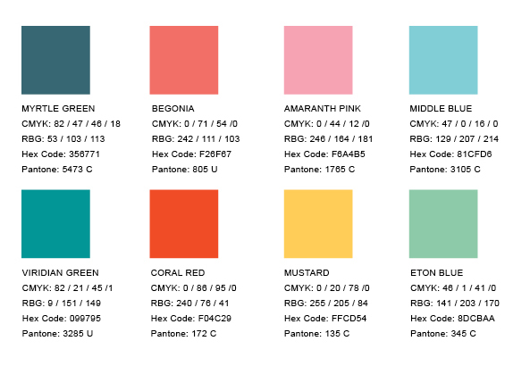
Colour palette
Our vibrant range of colours derived from CLCA’s core branding has been chosen to capture attention and add impact to marketing material.
You don’t have to use them all together! Limit your choice to a small selection of colours that complement each other when producing publications or presentations.
Tints may also be used behind copy to highlight information, for example in tabled information.
Please ensure that there is a high level of contrast so the text is clearly legible.

Slide 11
Graphical elements
A complimentary graphic can be used in various visual mediums.

Slide 12
Typeface
Arial should be used as this is a font commonly available to audiences: for example, internally produced PowerPoint presentations or any email communication.
We can also use Arial for body copy on our websites, to maximise load speeds.

Slide 13
Social media tiles

Slide 14
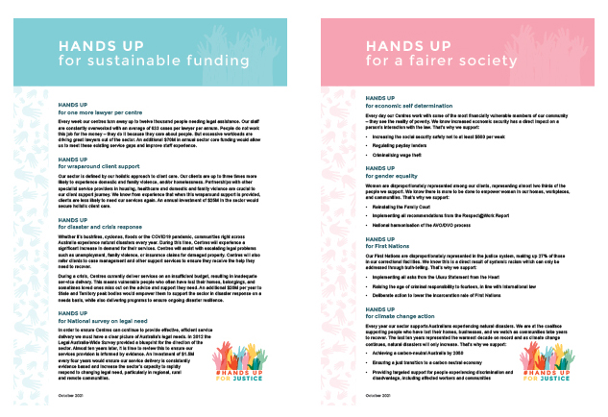
Campaign materials

Slide 15
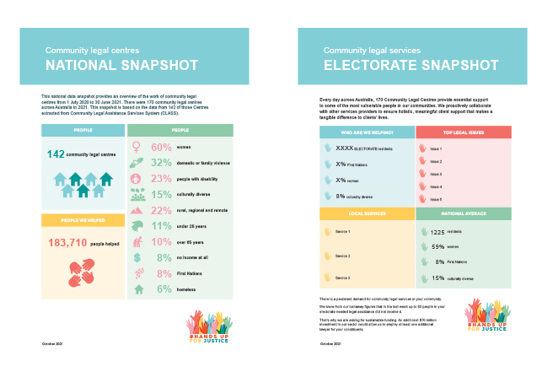

Slide 16
Virtual Canberra Advocacy Visit

Slide 17
What we did
20 virtual MP and Senator meetings with peaks and centres
5 from Queensland
Terry Young MP – Member for Longman
Milton Dick MP – Member for Oxley
Graham Perrett MP – Member for Moreton
Karen Andrews MP – Member for McPherson and Minister for Home Affairs
Senator Larissa Waters – Greens Leader in the Senate
Local centres talked about local issues

Slide 18
Feedback and Outcomes
Parliamentarians gave us mostly positive feedback about our campaign materials and asks
Labor and Greens were broadly more supportive of our policy asks and the Liberals were interested in discussing the detail of our funding asks

Slide 19
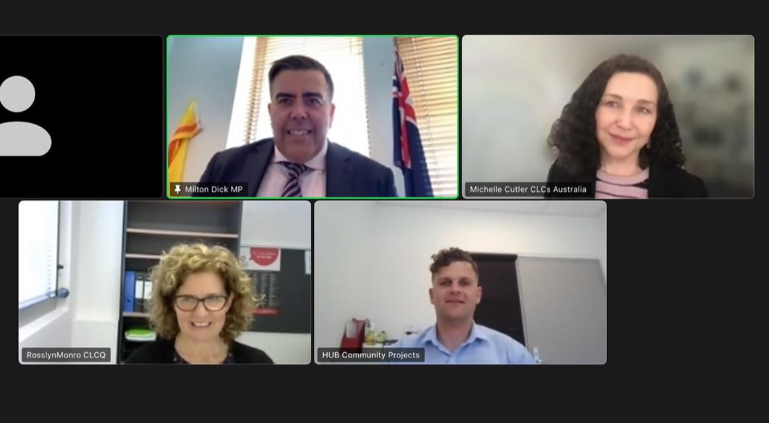
Most of them were particularly interested in what is happening at a local level with centres and numbers of turnaways due to limited resources
MPs and Senators made various commitments to visit their local centres, writing to the attorney general on behalf of the sector and putting us in touch with ministers and shadow ministers
Meeting with Milton Dick MP

Slide 20
Queensland’s Plan
What can we do together to build campaign engagement in the lead up to the federal election?
Some ideas:
State or local launch – morning tea, session at a sector event, guest speaker
Meet with local candidates
Centre discussion at your staff meeting
Local media engagement
Social media posts
Gather client stories

Slide 21
Call to action
Stay tuned in the new year for information about opportunities for the official launch and activism in your local community.
Fill out our short feedback survey.

