Slide 1
Demand Management Project
Supporting the development, trial and evaluation of a demand management framework for the community legal sector

Slide 2
Acknowledgement of Country
Community Legal Centres Queensland acknowledges the traditional owners of the land on which we are holding this presentation, the Turrbul and Jaggara people.
We pay our respects to their elders, past, present and emerging, and acknowledge the important role Aboriginal and Torres Strait Islanders continue to play in our society.

Slide 3
Session overview
What’s this project about and what did we do?
Q&A with trial sites and CLCQ
Small table discussions with trial sites

Slide 4
CLCQ – Key Messages
Whole of organisation response
Change management is critical
Retention of autonomy – CLCs are the experts of their communities
What next?
Notes:
CLCQ key messages :
Demand Management requires whole of organisation response
Cannot be forced down the line from leadership without thoughtful and deliberate consultation
Cannot be pushed back up the hill from the front-line staff to the executive team without support
Change management is critical – incremental change and evaluation, rather than one big change to service delivery and processes. Focus on staff wellbeing and buy in.
Retention of autonomy for CLCs is critical, centres are the experts of their community and the legal needs of that community – ATSIWLS example as a specialist service
Report coming in Nov with recommendations. Reasonable prediction is good data resources and analysis. Potentially another round of CLCs involved in some form of a phase 2. Reach out if you’re keen. Could you let us know your key messages so we line up and don’t duplicate. Would be good to look seamless for this group.

Slide 5
What’s this project about?
Triage – who gets in the door
Demand management – who gets in + what happens next + what does it take?
Notes:
Rachel kick off
Triage
A subset of demand management
Guides initial ‘sorting’ of clients at intake
think: accident and emergency
Demand management
Driven by organisational vision and strategy
Broader than the point of intake – considers each stage of the client journey
Considers skill mix and resources available
Can involve service/workforce redesign
think: nurse practitioners stepping into doctors’ scope of practice, delegating tasks to admin or paralegals to free up time of solicitors think: WLS Vic only doing high impact casework

Slide 6
Demand management project at a glance
Meaningful data supported by action learning
(Clarity Consortium)
Practical tools and processes
(CLCQ)
Identify a problem or opportunity to support better demand management – informed by data
Trial new approaches using tools and processes
(4 trial sites supported by 5 buddy sites)
Notes:
Demand management strategy
Sets out to solve a problem related to demand for services in alignment with an organisation’s vision and purpose
It’s informed by good data
(client feedback + where do our resources go, for whom, for which services and legal matters?)
And it involves:
defining the problem and testing the solution…
…with active staff involvement
A lot of work went into developing good baseline data so centres could explore their own data and get a better understanding of where their resources are going now PowerBI – can analyse by multiple variables SIMULTANEOUSLY and get a picture of time spent and client characteristics and repeat vs one off and matter type and service type – limited only by quality of data you collect, uses data you’re already collecting on CLASS
plus sites started collecting extra data about time spent, reasons for referral, reasons for repeat appointments, and data that tells us about system churn - number of other services approached first, did you get advice from another centre about this matter

Slide 7
Impact measurement
Problem statement
e.g. preventable repeat appointments being made due to clients being ill prepared
Measurable objectives
e.g. reduce # of preventable repeat appointments
Evidence sources
e.g. new data collection - reason for repeat appointment
Impact measures
e.g. # and % of repeat appointments booked because client ill prepared
Collect evidence and review
e.g. did we succeed?
Notes:
Once centres decided what problem they were trying to fix, and how, we worked with them to set up modest but tailored evaluation frameworks for each centre, making best use of CLASS data and working with centres to settle realistic additional data they could collect. Also capturing human story, not just numbers e.g. staff feedback session at beginning and end of changes to measure how staff confidence, perceptions and job satisfaction change over time, client surveys

Slide 8
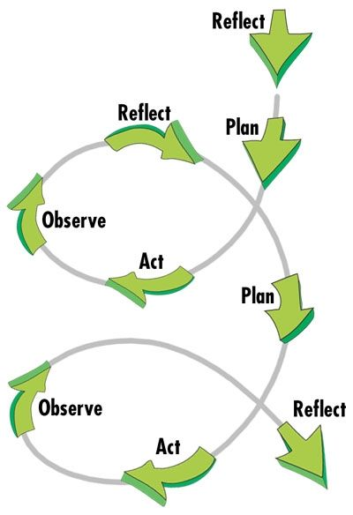
Collaborative action learning
Learning by doing
Work on real problems and implement solutions
Collective learning through collective experience
Pursue change and understanding simultaneously
Iterative: plan, act, observe, reflect, plan…
Problem solving in context
Shared power, shared problem solving
Notes:
At four major milestones in project, facilitated action learning groups – start, lot of work to agree on baseline data everyone was able and willing to collect- mostly existing but some additional e.g. time spent, sharing ideas and dilemmas but each centre had autonomy to decide what it wanted to pursue

Slide 9
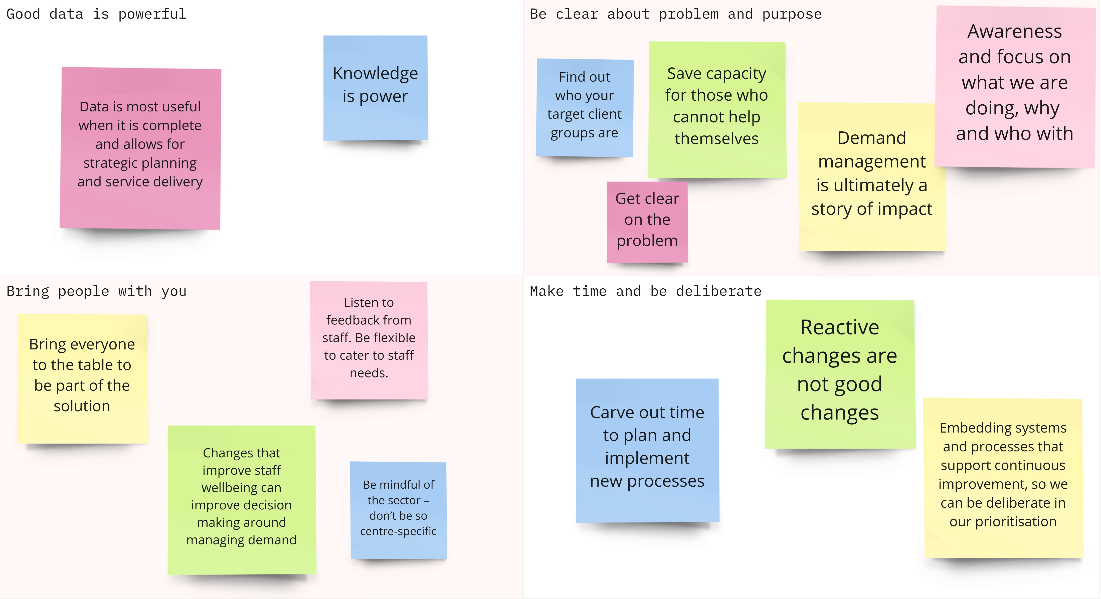
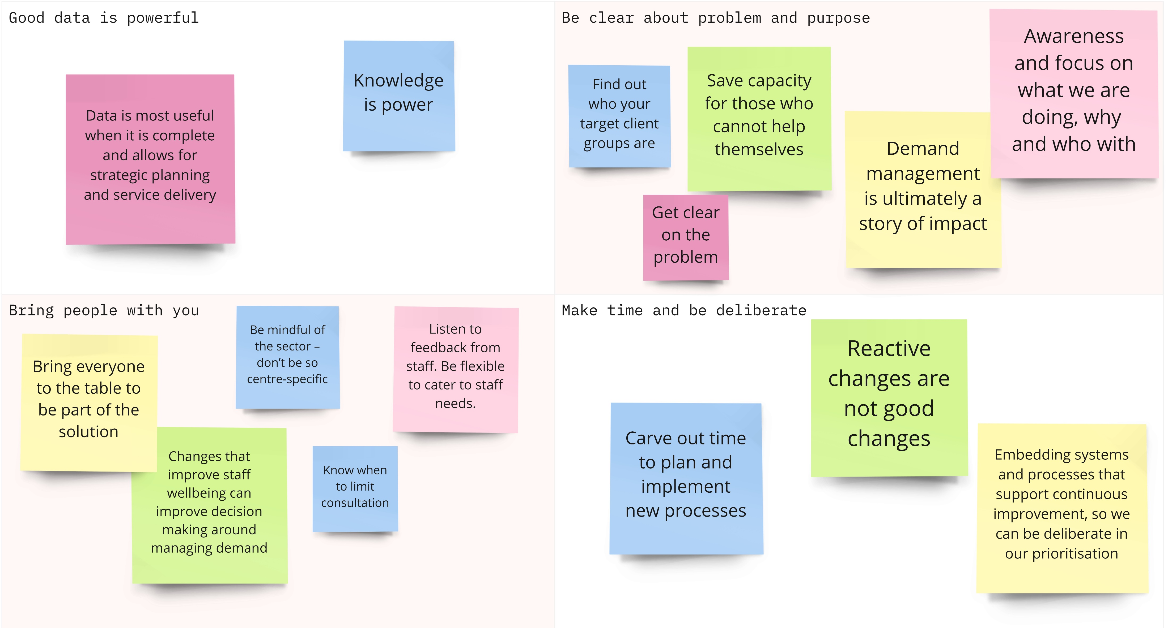
Notes:
At last action learning group meeting, asked people to tell a story about the most significant change they’d observed or experienced as result of project, and to formulate the take home message from their story of change

Slide 10
Q&A
Notes:
Gretchen thank them and launch into Q&A moderation with Sam or Rosslyn to help with the moderation
Questions to kick off Q&A
one thing related to demand management that they’ve learned from looking at the PowerBI data that they never would have known without it, then
what’s the one service change they’re considering as a result of this new insight (no one will hold you to it if you decide not to make that service change of course, but we’d like to give the audience a flavour of how the data can drive better informed decision making about managing demand, particularly that idea of scenario-testing the potential impact of service changes by using the PowerBI data).

Slide 11
Notes:
Display during Q&A

