Slide 1

Strategic Indigenous Awareness – Leadership and Cultural Awareness
“To understand our present, we must understand our past.”
Grant Sarra Consultancy Services
Email: gsarra@bigpond.net.au
Mobile: 0417 502 049

Slide 2
Objectives
SESSION ONE
Aboriginal Australia - beyond fear, denial, guilt or blame.
Increase awareness and understanding of Aboriginal history, culture and society.
Psychology and Sociology - what influences our Thinking, Feeling and Behavior.
SESSION TWO
Cultural Leadership in the Community Legal Centre Space - Why, How and What?
Culturalising future Community Legal Centre Strategic Objectives:
Strengths
Weaknesses
Threats
Opportunities

Slide 3
Acknowledgement
First Nations people of Australia are a diverse peoples. Out of respect for this diversity, I as a First Nations Gurang Gurang man, acknowledge that I do not have the right, responsibility and nor am I obligated to speak on behalf of ALL First Nations peoples or custodian groups.
When I am on another First Nations people’s country, I embrace my lore and act with cultural honour and integrity and behave with cultural dignity and humility while in their presence.
Like a small child on their country, I recognise that I must first Sit, Listen and Learn from the local people about their language, culture, stories, customs and practices, acknowledge their trauma, pain and suffering - as well as their aspirations - as critical prerequisites to building the trust required to establish, build, nurture, sustain and value mutually respectful and collaborative relationships.

Slide 4
Truth Telling
Beyond Fear, Denial, Guilt or Blame
We will never achieve any form of Reconciliation until it is preceded by the absolute truth of our shared history.
Reconciliation is bringing again into unity, harmony, or agreement what has been alienated.
https://www.biblegateway.com/resources/encyclopedia-of-the-bible/Reconciliation
Key Questions: What needs to be brought again into unity, harmony, or agreement and what has been alienated?

Slide 5
Cognitive Dissonance
The term cognitive dissonance is used to describe the mental discomfort that results from holding two conflicting beliefs, values, or attitudes. People tend to seek consistency in their attitudes and perceptions, so this conflict causes feelings of unease or discomfort.
This inconsistency between what people believe and how they behave motivates people to engage in actions that will help minimize feelings of discomfort. People attempt to relieve this tension in different ways, such as by rejecting, explaining away, or avoiding new information.
https://www.verywellmind.com/what-is-cognitive-dissonance-2795012

Slide 6
You will not get a right from two wrongs!
As current generation Australians, you did not create the problems that have evolved from our past, you are however, part of the solution!
All people are just like YOU. They are unique and special, but NOT PERFECT – no one person has the right to judge another.
We all Think with our brain, Feel with our heart and Behave through our actions, attitudes and behaviours.
We all become socialised to Think, Feel and Behave based on where we have come from – our upbringing and experiences (good or bad) in life.

Slide 7
What do we know about Aboriginal or Torres Strait Islander people, history, culture and society?
From a Community Legal Centre perspective – what are the problems, issues or challenges you face when dealing with Aboriginal or Torres Strait Islander clients and their families?

Slide 8
Australian Culture and Identity
Psychology and Sociology - Who are we, what has influenced our Thinking, Feeling and Behaviour?

Slide 9
Australian Culture & Identity in Perspective - Who are we are in the bigger picture of humanity?
10,000
20,000
30,000
40,000
5,000
15,000
25,000
35,000
45,000+
Australia’s FIRST PEOPLE - one of the world’s oldest continuous living cultures – PROVEN SURVIVAL - 2000+ generations.
MODERN-DAY AUSTRALIA - socialised to THINK, FEEL and BEHAVE over a 233years – 10+ Generations.
Australian Culture and Society
1788 – 2021
233 Years

Slide 10
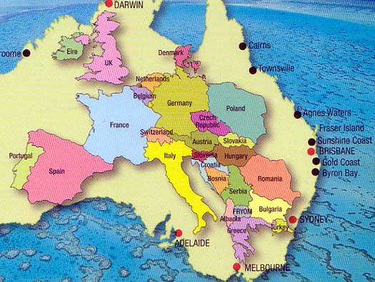
Source: www.ginakingcampers

Slide 11
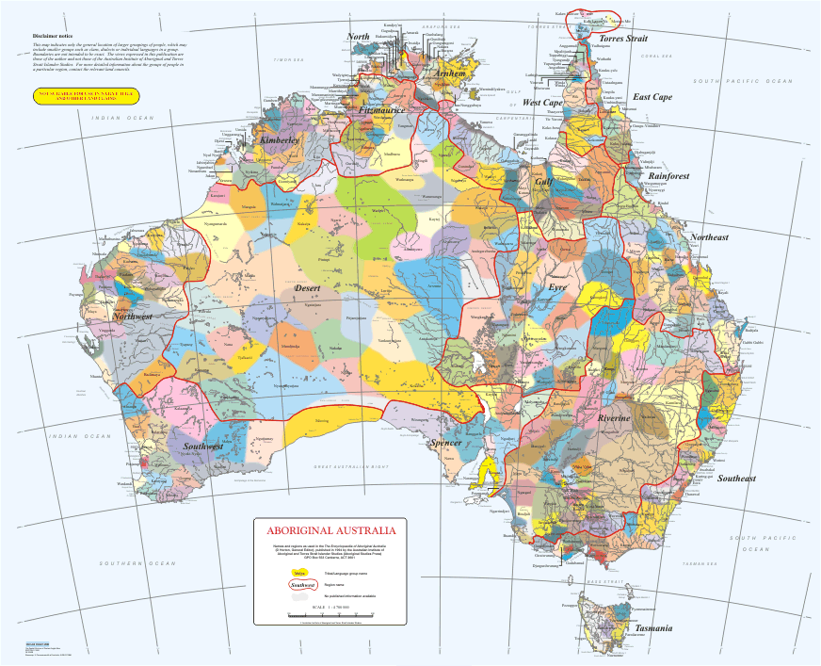
Source: livingknowledge.anu.edu.au

Slide 12
Myth of Homogeneity
Prior to 1770, the original inhabitants of the land lived in different sized groups across the entire land. This was determined and managed through the kinship system. Post 1770, the original inhabitants, considered to be Stone Age or "primitive beings” by the new settlers, were eventually named Aborigines and identified as all belonging to one group.
The ”Aborigines” were further categorised as follows:
  "… the reality is that for thousands of years the original inhabitants of Australia maintained important cultural distinctions. Indeed never in Australia has there been a single cultural identity; never has there been a single generic name. It was the Europeans who imposed their pseudo-scientific latinised word Aborigine on the total population of the original inhabitants. This has the unfortunate effect of classifying them all as one cultural group. Certainly, traditional Aboriginal people do not accept this concept.

Slide 13
Tjukurpa – Aboriginal Time of Creation - Beliefs
Tjukurpa is the foundation of Anangu culture. It provides a spiritual basis of Anangu culture, rules for behavior and knowledge of the environment. It is the law for caring for one another and for the land that supports people’s existence.
Tjukurpa refers to the time of creation as well as the present time. Tjukurpa defines the relationship between people, plants, animals and physical features of the land. Knowledge of how these relationships came to be, what they mean and how they must be maintained, is explained in the Tjukurpa.
Other Aboriginal people use different words for Tjukurpa. Throughout the Great Victoria Desert, the term used is djuguba or djugurba; in the Rawlinson Range, duma; in the Balgo area, djumanggani; in the eastern Kimberleys, ngarunnganni and so on. It is usually translated as ‘Creative Period’, ‘Ancestral Times’, ‘Dreaming’, ‘Dreamtime’, ‘Eternal Dreamtime’, and so on.
http://prevos.net/uluru/

Slide 14
http://prevos.net/uluru/

Slide 15
Grand Sons, Grand Daughters + Grand Nieces and Nephews
Grand Mothers + Grand Fathers
Kinship Circle of Life
Sons, Daughters + Nephews and Nieces
Mother + Father
Me, You + Siblings

Slide 16
Aboriginal Traditional Society and Culture
Our story is in the land… it is written in those sacred places. My children will look after those places, that is law. Dreaming place…you can’t change it, no matter who you are, No matter you rich man, no matter you king, You can’t change it.’
Those trees…they grow. That grass…no matter it burn. When it drink, it grow again. When you cut tree, it pump life away, all same as blood in my arm.
This earth…I never damage, I look after. Fire is nothing, just clean up. When you burn, new grass coming up, that mean good animal soon…might be goose, long neck turtle, goanna, possum. Burn him off…new grass coming up, new life start all over.
Land got to stay, always stay same. No matter little track…grass still grow, bush can grow.

Slide 17
Law never change…always stay same. Maybe it hard but proper one for all people. Not like white European law…always changing. You don’t like it, you change it.
My children got to hang onto this story. This important story. I hang onto this story all my life. My father tell me this story. My children can’t lose it.
Skin can be different, but blood same. Blood and bone… all same. Man can’t split himself. White European can’t say ‘Oh that Aborigine no good’ Might be that Aborigine alright. Man can’t growl at Aborigine, Aborigine can’t growl at white European… Might both be good men, might both be no good…you never know. So you should get understand yourself. No matter Aborigine or white European. Bill Neidjie 1983.
Extracts from Kakadu Man - Bill Neidjie, Big Bill Neidjie, Stephen Davis and Allan Fox, Mybrood P/L Inc in NSW (Allan Fox and Associates), 1986.

Slide 18
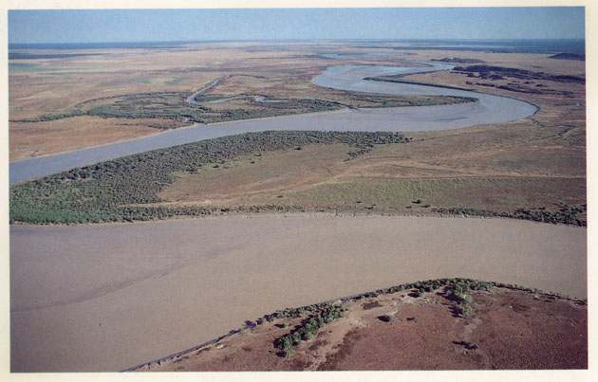

Slide 19
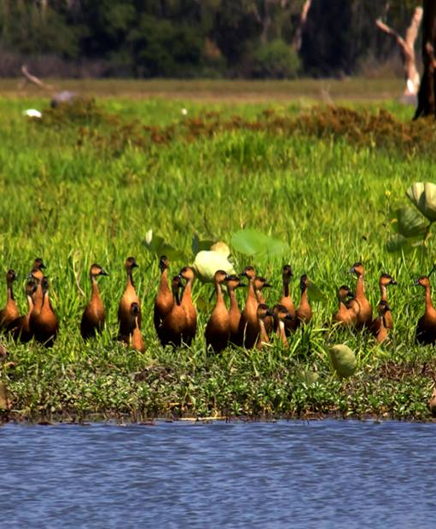
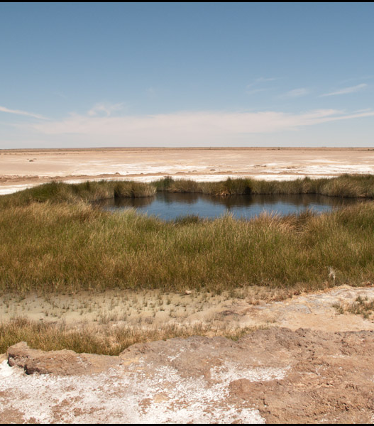
Value of fire and water.

Slide 20
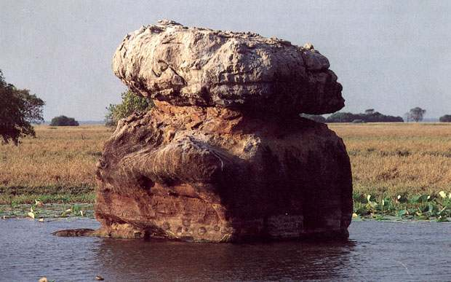

Slide 21
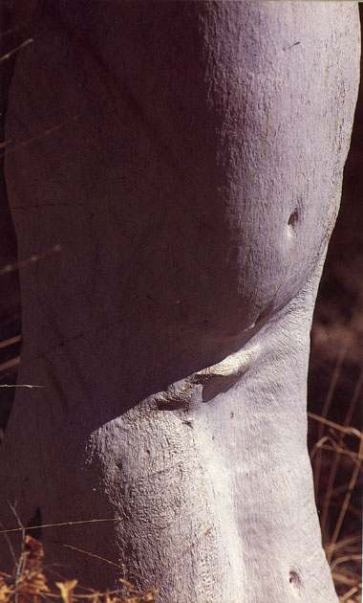

Slide 22

Images from Kakadu Man - Bill Neidjie, Big Bill Neidjie, Stephen Davis and Allan Fox, Mybrood P/L Inc in NSW (Allan Fox and Associates), 1986.

Slide 23
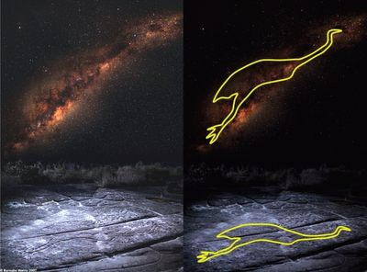
Images The "Emu in the Sky" engraving, as seen from Elvina Track, Kuringai Chase National Park, north of Sydney. Image by Barnaby Norris.

Slide 24
Workshop Symbols
Women’s Place | ♀
Men’s Place | ♂
Burial Site | Ø
Meeting Places | ●
Trading Routes
Birthing Site | ☼
Art Site | ▲
Ancestral Being Resting Place | ∞

Slide 25
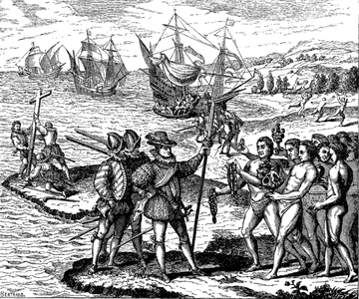
Doctrine of Discovery - 1493
The Papal Bull "Inter Caetera," issued by Pope Alexander VI on May 4, 1493, played a central role in the Spanish conquest of the New World.
The Bull stated that any land not inhabited by Christians was available to be "discovered," claimed, and exploited by Christian rulers and declared that "the Catholic faith and the Christian religion be exalted and be everywhere increased and spread, that the health of souls be cared for and that barbarous nations be overthrown and brought to the faith itself.
https://www.gilderlehrman.org/history-resources/spotlight-primary-source/doctrine-discovery-1493

Slide 26
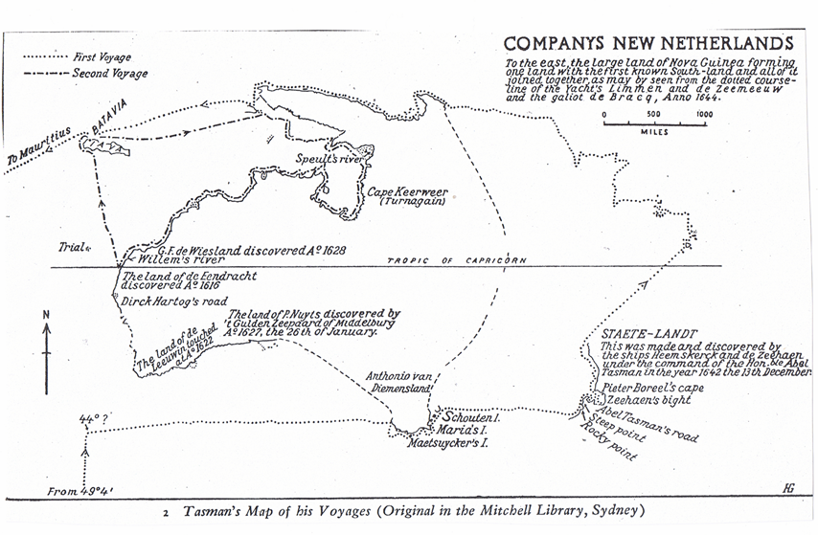
Settlement, Colonisation, Invasion, Arrival?
Images from A History of Australia, Vol 1, From the Earliest Times to the Age of Macquarie C.M.H. Clarke, Melbourne University Press 1977.

Slide 27
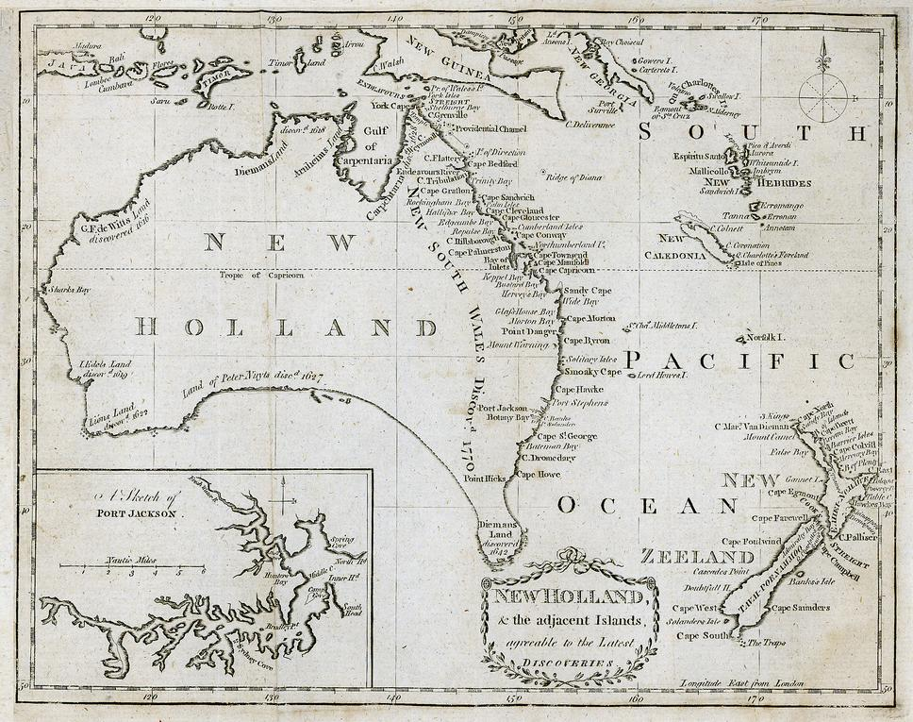
British Colony of New South Wales
Images from australianempire.webs.com
.

Slide 28
Early methods, laws and government policy
Doctrine of Terra Nullius
Smallpox
Massacre/Genocide
Flora and Fauna Act
White Australia Policy
Aborigines

Slide 29
Doctrine of Terra Nullius
No Man’s Land - Settle, Cede or Move On
Concept of empty land
Inhabitants viewed as barbaric
New use of land – farming
Only European law seen as legitimate

Slide 30
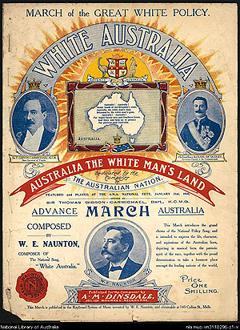
White Australia Policy - 1850

Slide 31
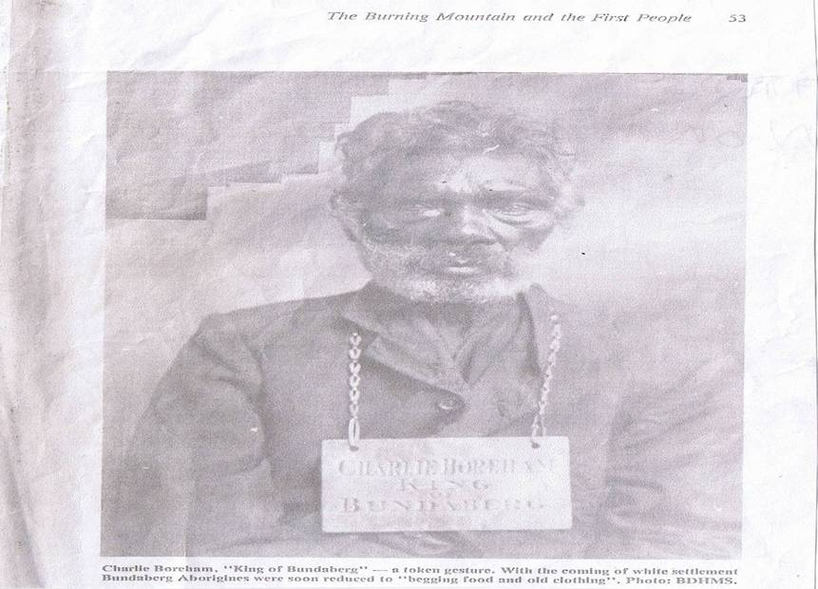

Slide 32
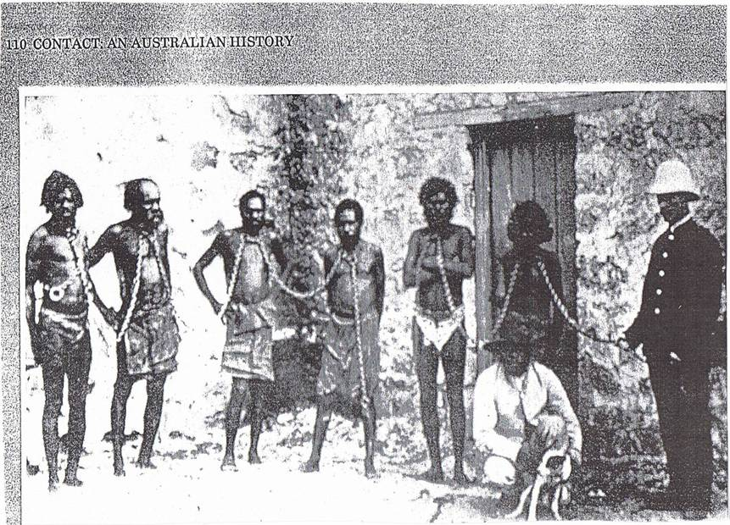

Slide 33
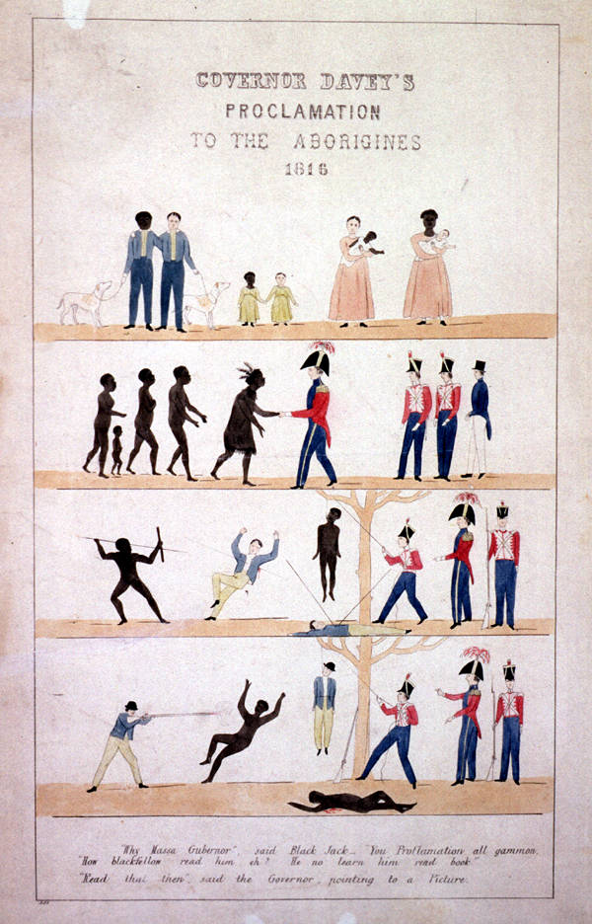

Slide 34
For the Aboriginal communities living along Tasmania’s northern shores, the presence of the economic pioneers was catastrophic. The sealers not only depleted traditional Aboriginal food sources, but in time, triggered a total dislocation of indigenous social life.
Skilled in the techniques of seal catching, the Aboriginal women were eventually regarded by the sealers as an essential part of their operation. Violence, sometimes of the most brutal kind, became endemic in their relations. A group of sealers, for example, was recorded to have punished one runaway female by tying her to a tree, cutting off her ear and the flesh from one thigh and then, forcing her to eat them.
Another confessed that he would ‘as leave, shoot them as so many sparrows’. … a man called Lemon was accustomed to use them as target practice, while others confessed to feeding their dogs on Aborigines shot specifically for that purpose. Their relish for murdering the men was more than equalled by their sexual appetite for the women, and a bushranger called Carrot found a way of satisfying both urges almost simultaneously. After slaughtering a Tasmanian man, he then abducted and raped his widow and forced her to carry her husband’s severed head around her neck ‘as a play-thing’.
Extracts From Rivers Of Blood Rivers of Gold –Europe’s Conflicts with Tribal Peoples (pp134, 136)

Slide 35
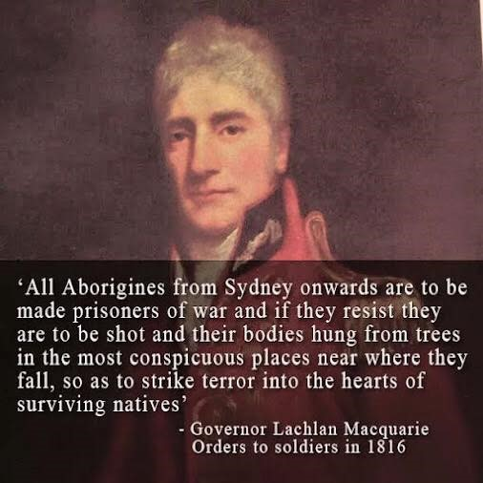

Slide 36
Categorisation of Aboriginal people
In his essay introducing the section on contemporary issues, Basil Sansom stresses that, since the Aboriginal population is so heavily sub-divided into distinct types of communities, it is no longer possible to think about Aborigines as if that word stood for a set of people who are all alike.
The categories are important because they are lasting. He quotes Professor C.D Rowely’s categorisation of Aboriginal people into different social contexts, as follows:
  Aborigines of the settlements established either by missions or governments.
  Aborigines working on cattle stations forming small station communities.
  Aborigines of small town Australia, usually living in fringe camps and social separation from the local whites.
  Aborigines of the cities who may be either
    fringe dwellers, or
    suburban householders"
Office of the Commissioner of Community Relations, Lets end the slander, 1979, p.37

Slide 37
Government Policies – Protection Act
In the late 1800’s, Governments had started to introduce legislation for
the protection of the Aborigines.
Under Protection Acts, Indigenous people were not allowed to:
  marry unless it was agreed by the Chief Protector,
  conduct ceremonies,
  practice culture,
  speak language,
  mix with whites.
The Acts were designed to assist and protect Aboriginal people who had
become oppressed and disadvantaged.
Exemption certificates were given to Indigenous people of mixed racial
percentage so that they could mix with white people and have access to
employment and housing.
APARTHEID
The three things colonisers do!

Slide 38
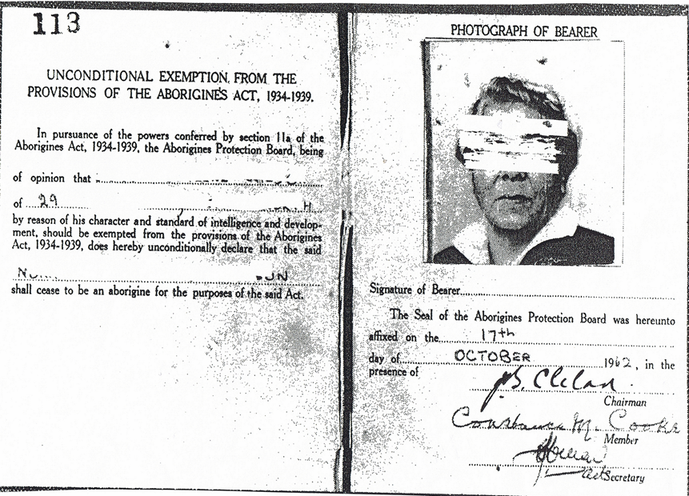
Protection Act – Exemption Certificate

Slide 39
Assimilation Act
Let them die out –
breed the
the black out
of them!
In 1951 the Federal Government convened a Australian Council for Native Welfare composed of various responsible Ministers and their advisors.
The policy of Assimilation was formulated as follows:
That all Aborigines “shall attain the same manner of living as other Australians, enjoying the same rights and privileges, accepting the same responsibilities, observing the same customs and being influenced by the same beliefs, hopes and loyalties as other Australians ".
Race and Racism in Australia, McConnochie, Hollingsworth & Pettman,1988, p 111

Slide 40
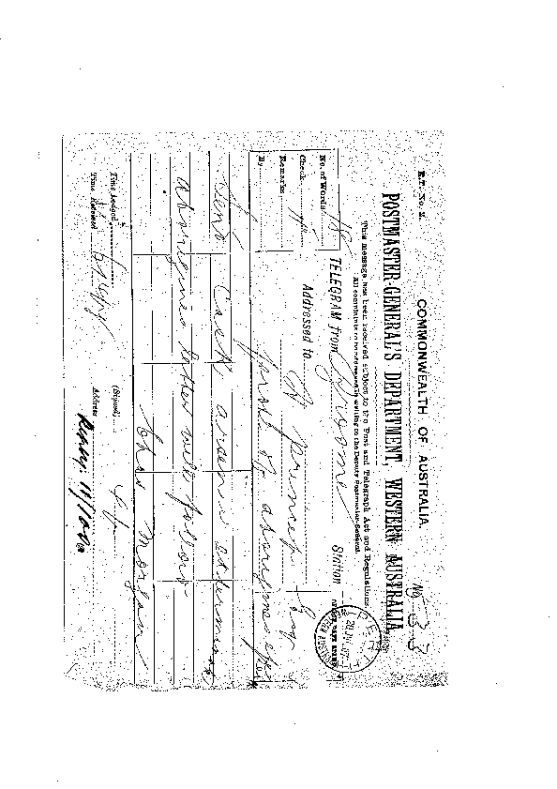
Post Master-General Department, Western Australia

Slide 41
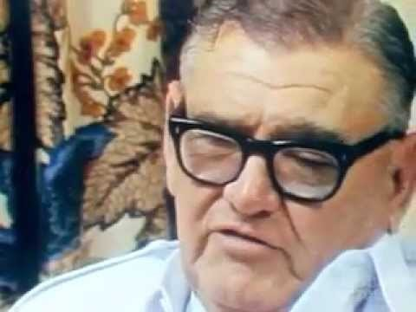
Lang Hancock's solution to the 'Aboriginal problem' (1984)
Source: You Tubehttps://www.youtube.com/watch?v=pMaRuk6pGOc

Slide 42


Slide 43
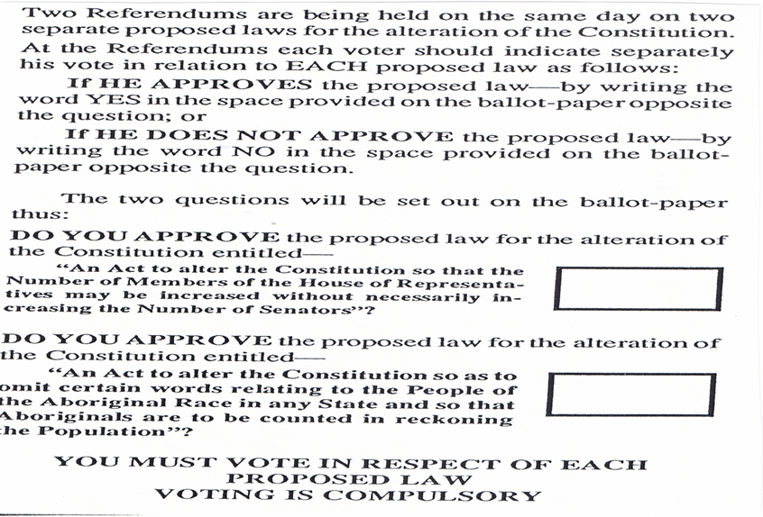
1967 Referendum

Slide 44
Beyond 1967
Self Determination and Self Management
Mabo, Native Title 1 then Native Title 2
Reconciliation
Sorry
Closing the Gap?
Constitutional Recognition?
United Nations Declaration on the Rights of Indigenous Peoples?
Uluru Statement form the Heart. Voice to Parliament?
Black Lives Matter?

Slide 45
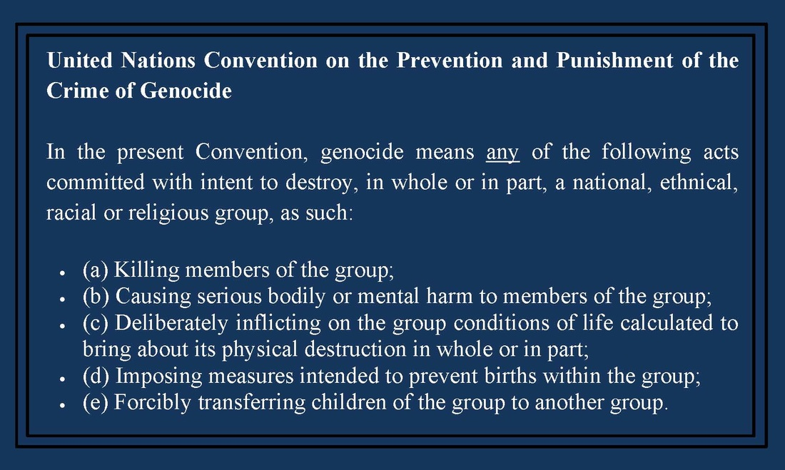
Genocide
https://www.google.com/url

Slide 46
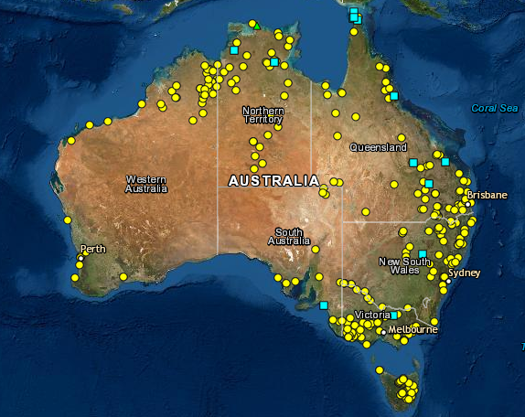
Aboriginal massacres
Source:https://www.google.com/url?sa=i&url=https%3A%2F%2Fquadrant.org.au%2Fmagazine%2F2020%2F10%2Fthe-shoddy-research-behind-the-massacre-maps

Slide 47
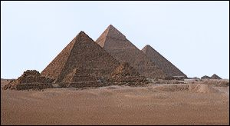

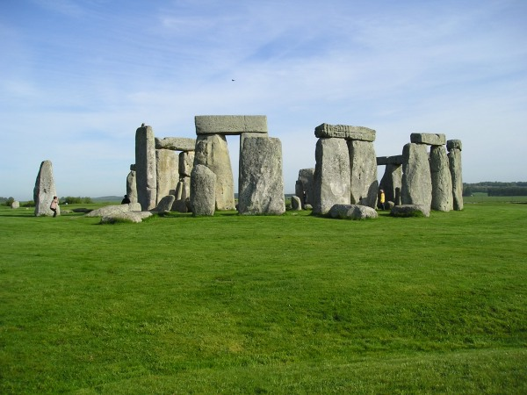

Cultural Heritage - Diversity and Inclusion
In Australia we easily identify, understand and appreciate the significance and value of the following…,
The same cannot always be said when it comes to identifying, understanding, valuing and appreciating the richness of Aboriginal peoples Culture and Heritage!

Slide 48

Authentic Recognition - Diversity and Inclusion?
Australia Day, Advance Australia Fair and Symbolism of Australia’s Flag?
BUTCHER’S APRON
http://www.sbs.com.au/nitv/article/2017/01/31/10-things-you-should-know-about-advance-australia-fair
http://nationalunitygovernment.org/content/was-advance-australia-fair-written-white-people#1
http://www.no-deportations.org.uk/Media-1/ButchersApron.html

Slide 49
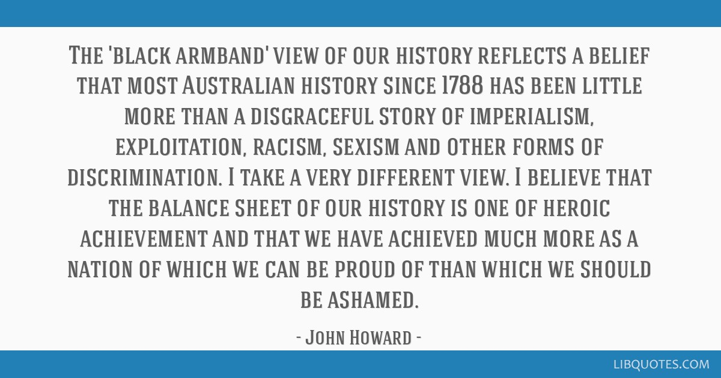
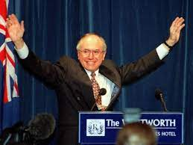
The Black Armband View of History

Slide 50
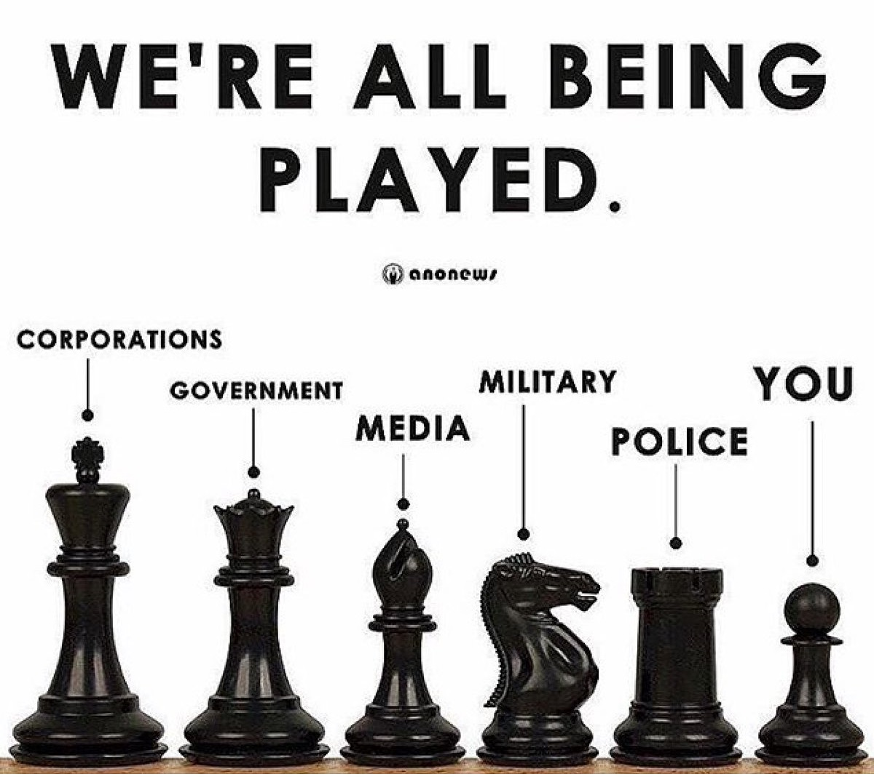
Religious Institutions
Education System
https://wakeup-world.com/wp-content/uploads/2017/08/Played-By-The-System-It’s-Time-For-a-New-Paradigm-.jpg

Slide 51
Cultural Leadership in the Community Legal Centre Space - Why, How and What?
Session Two
Culturalising Community Legal Centre Strategic Objectives:
Strengths
Weaknesses
Threats
Opportunities

Slide 52
Session One - Debrief and Questions

Slide 53
Personal Leadership - beyond conflict
“Today’s leader is not someone who knows all the answers because in this world that is impossible. He or she is not someone who makes decisions and gives orders in the old military model of leadership.
… the new leader is someone who can assess a situation, bring people together, build consensus, and discover solutions, drawing on the talents of everyone involved.
The new leader is a facilitator, a communicator, a team builder, who realises that our greatest natural resources are our minds and hearts, together with those around us.
They work to create community, transcending conflict with cooperation, transferring problems into solutions”
Page 5, The Tao of personal Leadership, Dianne Dreher, 1997

Slide 54
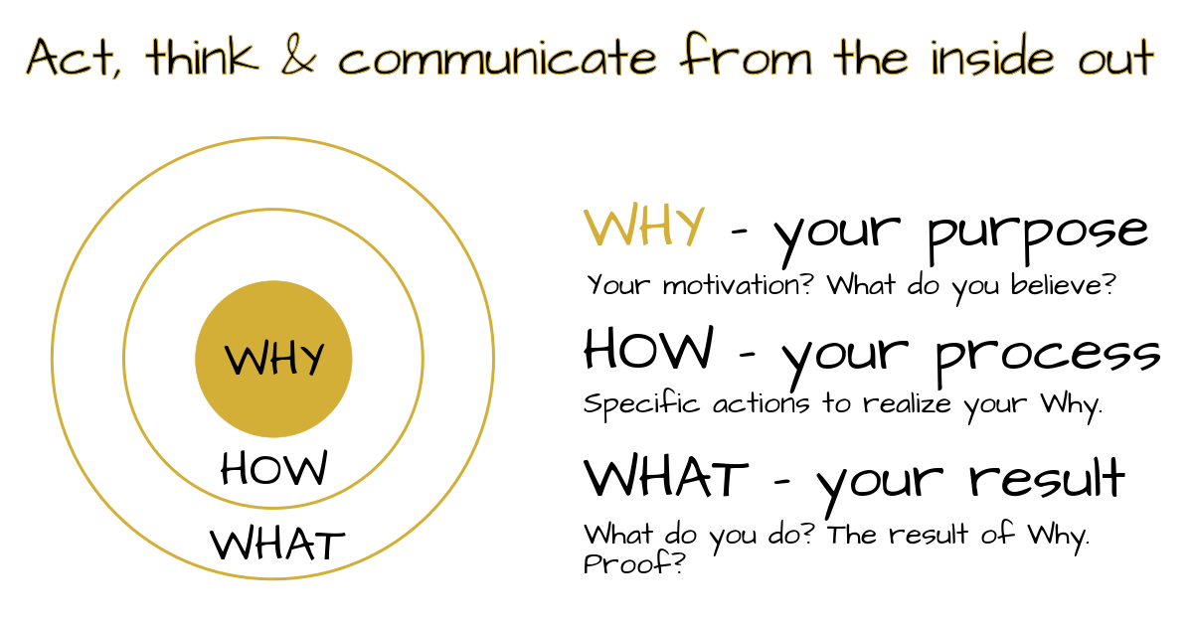
https://www.google Simon Sinek, Golden Circles

Slide 55
Community Legal Centres Queensland
Our Vision
A Fair and Just Queensland.
Our Mission
To be a voice for the sector.
To lead and support Queensland community legal centres to deliver quality and accessible services to vulnerable and disadvantaged people and bring about ??? change for individuals and communities.
.

Slide 56
Objective 1
Work with Queensland community legal centres (CLCs) to continually improve organisational sustainability and service quality.
Improve systems and practices across the sector.
Support and develop the sector workforce.
Model good practice as a peak organisation.
Sustainability and or Capability?
.

Slide 57
Objective 2
Work with Queensland CLCs to increase the accessibility, profile and resourcing of the sector.
Foster relationships and pursue successful partnerships to grow and diversify sector resources.
Build profile and recognition of the Queensland CLC sector.
Support Local/Regional CLCs client advocacy linked to increased funding increases to address local/regional specific challenges?
.

Slide 58
Objective 3
Work with Queensland CLCs to unite around common objectives to bring about change.
Build data, insights and knowledge.
Coordinating advocacy for change.
Against all three objectives – what local/regional cultural- specific demographic factors need to be considered?
.

Slide 59
Local/Regional CLCs
What local/regional challenges/issues/priorities (if any) do you feel need to be considered/included/addressed in the Community Legal Centres Queensland 2022-2023 Strategic Plan – to improve local/regional performance, capability and service delivery outcomes?
Against all three objectives – what local/regional cultural- specific demographic factors need to be considered?
.

Slide 60
Understand the environment

Slide 61
Cultural Sensitivity
Environmental Factors and Influences
Cultural Diversity
Accountability, Deaths in Custody, Psychological Scarring, Intergenerational Trauma, Anger, Bitterness, Mistrust, Apathy, Ignorance, Fear, Insecurity, Discrimination, Racism, Paternalism, Fractured Kinship Systems, Government Policy, Cultural Values, Identity, Dignity, Pride.
Funerals.
Humbug, Income Management, Native Title, Communication Barriers, Court Systems, Police, Limited Resources, Western Law, Customary Lore, Technology, Wealth Generation, Geographical Isolation, Access, Equity, Participation, Capacity, Stolen Wages,
Strong Leadership and Management
Accountable
Transparent
Responsible
Effective
Efficient
Community Legal Centre
Purpose, Vision, Values
Culturally Appropriate, Relevant and Community Sensitive
Aboriginal People’s Requirements
Welfare, Substance Abuse, Domestic Violence, Corporate Governance, Colonisation, Dispossession, Stolen Generations, Child Abuse, Community Factions, Confusion.

Slide 62
United Nations – Good Governance
Good governance has 8 major characteristics.
It is participatory, consensus oriented, accountable, transparent, responsive, effective and efficient, equitable and inclusive and follows the rule of law. It assures that corruption is minimized, the views of minorities are taken into account and that the voices of the most vulnerable in society are heard in decision-making.
It is also responsive to the present and future needs of society.

Slide 63
Cultural (Shared/Reciprocal) Governance
Historical Trauma

Slide 64
Cultural diversity + inclusion + integrity + safety = CULTURAL LEADERSHIP
Problem | Issues | Solutions | Action
Clearly define the problem. | What are the issues which surround the problem. | What are the possible solutions based on time, quality, cost, accountability, effectiveness and efficiency. | What is the most appropriate action to take.
Cultural Leadership Shared Governance Root Cause Analysis Trauma Informed Healing Focused = Balance and Harmony

Slide 65
Strengths, Weaknesses, Opportunities and Threats
Build
What are our Strengths?
(Internal)
What are our Weaknesses?
(Internal)
Reduce
Maximise
What are our Opportunities?
(External)
What are our Threats?
(External)
Minimise
Once identified develop strategies/actions to
achieve the desired outcomes

Slide 66
Key stages in engagement
  Establish the Relationship
  Know who you are dealing with – whose country, history, issues, challenges and aspirations
  Build the Relationship
  Be clear about Why, How, What you are doing and When things will get done – and be genuine and authentic in everything you do.
  Nurture the Relationship
  Work through factions, maintain project management focus and assess and respond to your own SWOT.
  Sustain the Relationship
  Be you, be real, focused, committed, honest and don’t promise what you can’t deliver.
  Value the Relationship
  Walk away knowing that you have done the very best you can, by the community and by you – this is where your credibility and reputation really means something.

Slide 67
Rules of Engagement
  Embrace your Honour - possess or be characterised by high principle and honourable intentions.
  Embrace your Integrity - be honest and have strong moral principles and values.
  Embrace your Dignity - be worthy of honour and respect the dignity of others.
  Embrace your Humility - achieve quality outcomes but stay humble in the presence of others.
  Have a sense of Humour - Laugh with each other, not at each other
  Embrace your Vulnerability - The moment you think or feel you are invulnerable is the moment you are most vulnerable

Slide 68
Styles of Communication and Behaviour
Communication Style | Verbal Component | Non-Verbal Component | Effectiveness
ASSERTIVE | Clear dialogue Active Listening Calm and respectful | Non-threatening Open and relaxed Mirror and confirm | Most effective Two way process Win-Win outcome
AGGRESSIVE | Abrupt and loud Not listening Own interests | Threatening Stand over/ close Intimidate | Aggressor usually wins Others wounded
PASSIVE | Stay silent Unsure how to talk Always agree | Retreat, arms crossed Avoid eye contact Intimidated | Passive looses Avoids the fight Self wounded

Slide 69
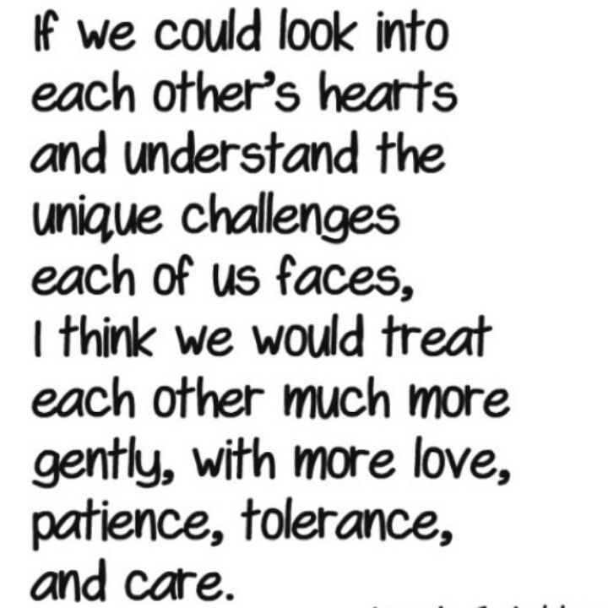
Empathy???
https://www.google.com/url?sa=i&url=https%3A%2F%2Fwww.pinterest.com

Slide 70
Embrace and Celebrate Diversity and Inclusion in the CLC workplace
Diversity and Inclusion are about giving value to every human being no matter our differences.

Slide 71
Cultural Safety in the CLC Workplace
A culturally safe workplace has a defined set of values and principles, and demonstrates behaviours, attitudes, policies, and structures that enable all workers to work effectively cross-culturally.
In a culturally safe workplace all workers feel comfortable, supported and respected

Slide 72
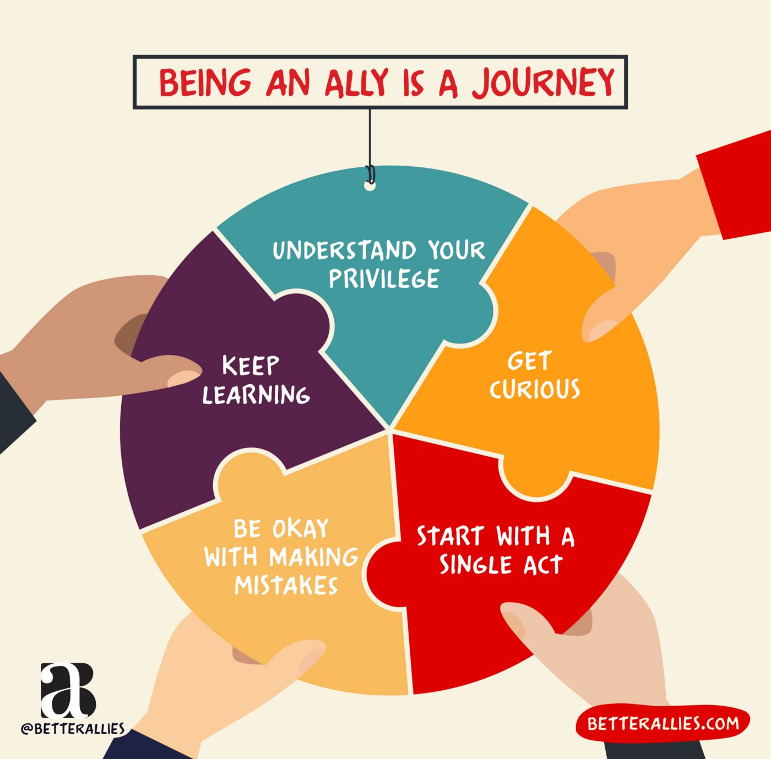
Being a good Ally in the Compass Diversity and Inclusion space
https://code.likeagirl.io/being-an-ally-is-a-journey

Slide 73
DESIDERATA
Go placidly amid the noise and haste, and remember what peace there may be in silence.
As far as possible, without surrender, be on good terms with all persons.
Speak your truth quietly and clearly; and listen to others, even to the dull and ignorant; they too have their story.
Avoid loud and aggressive persons; they are vexations to the spirit.
If you compare yourself with others, you may become vain or bitter, for always there will be greater and lesser persons than yourself.
Enjoy your achievements as well as your plans.
Keep interested in your own career, however humble, it's a real possession in the changing fortunes of time.
Exercise caution in your business affairs, for the world is full of trickery.
But let this not blind you to what virtue there is; many persons strive for high ideals, and everywhere life is full of heroism.
Be yourself.
Especially do not feign affection. Neither be cynical about love; for in the face of all aridity and disenchantment, it is as perennial as the grass.
.

Slide 74
Take kindly the counsel of the years, gracefully surrendering the things of youth.
Nurture strength of spirit to shield you in sudden misfortune
But do not distress yourself with dark imaginings
Many fears are born of fatigue and loneliness.
Beyond a wholesome discipline, be gentle with yourself.
You are a child of the universe no less than the trees and the stars; you have a right to be here.
And whether or not it is clear to you, no doubt the universe is unfolding as it should.
Therefore be at peace with God, whatever you conceive him to be.
And whatever your labors and aspirations, in the noisy confusion of life, keep peace in your soul.
With all its sham, drudgery and broken dreams, it is still a beautiful world.
Be cheerful. Strive to be happy.
Max Ehrmann was an attorney turned philosopher-poet who live in Terre Haute, Ind. He spent his life wrestling with the realities of making a living and following his personal calling to a life of poetry, literature, and thought. He wrote A Prayer, which became a message of hope for thousands, but he is best known for Desiderata, which he wrote for himself, "because it counsels those virtues I felt myself most in need of." Max included this work as part of a personal Christmas greeting in 1933, and Desiderata's power and appeal have continued to reach out to and significantly affect readers ever since. He died in 1945.

Slide 75
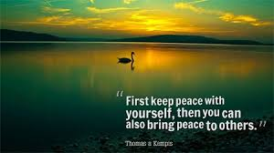
Closing thoughts
We are all unique and special - none of us are perfect!
We should never feel we have a right to judge others!

Slide 76
Further Reading
The Secret Country (Book or Video), John Pilger.
Kakadu Man - Bill Neidjie, Big Bill Neidjie, Stephen Davis and Allan Fox, Mybrood P/L Inc in NSW (Allan Fox and Associates), 1986.
A History of Australia Vol 1-5, C.M.H. Clark, Melbourne University Press, 1977.
A Documentary History of Queensland, from reminiscences, diaries, parliamentary papers, newspapers, letters and photographs, W. Ross. Johnson.
The Way of The Owl, Succeeding with Integrity in a Conflicted World, Frank Rivers, 1964.
Blood on the Wattle, Massacres and Maltreatment of Aboriginal Australians since 1788, Bruce Elder, 1988.
The Tao of Personal Leadership, Harper Collins publishers, Dreher, Diane, 1946.
Being Whitefella, Fremantle Arts Centre Press, Edited by Duncan Graham, 1994.
Common Sense Leadership, A Handbook for Success, Ten Speed Press, Berkley California 1995..

