Slide 1
Sector update
Sarah Chase
Principal Project Officer
Legal Assistance Strategy and Funding
Department of Justice and Attorney-General

Slide 2
Acknowledgement of country
Notes:
I would like to acknowledge the Traditional Owners of the land on which we meet and pay my respect to the Elders past, present and emerging.
I ask that the Elders provide guidance and knowledge during our time on their lands, and thank them for the safe journey as we cross.

Slide 3
Notes:
Firstly, I’d like to thank Rosslyn and her incredible team at CLCQ for providing DJAG with the opportunity to attend this event and talk with you. It’s great to see so many of you here in person.
Secondly, I’d like to thank all of you for the valuable work you do, for the services you provide to those who need them the most. Thank you for working with DJAG to help inform Government.
I know over the past few years that the administration of funding seems to have become increasingly complex. It’s made both DJAG and our program managers at LAQ really value our relationships with the sector and that ability to be able to reach to you when we need. And hopefully vice versa. REPORTING??
Welcome to Therese. We’ll be staying for the morning tea.

Slide 4
NLAP: Additional funding
Notes:
2021-22 Federal Budget – additional $350 million of funding nationally.
Funding provided to Queensland through an amendment to the Bilateral Schedule to the NLAP.
Amended Bilateral Schedule executed at the end of October. Published online.
Provides an additional $74.44 million to Queensland over 2021-25.
AG as the decision maker.
LAIC meeting – December 2021.

Slide 5
Family Advocacy and Support Services (FASS)
LAQ
A further $19.478 M for the delivery and expansion of FASS over 2022-25
From 1 July 2022 expansion of FASS: Rockhampton Family Law Courts Registry and Bundaberg, Hervey Bay, Ipswich, Mackay, Maroochydore, Southport and Toowoomba Family Law Court Circuits
Dedicated mental health support workers at each FASS location to work with clients to deliver appropriate mental health supports
Notes:
FASS was established in 2016 through the Third Action Plan of the National Plan to Reduce Violence against Women and their Children 2010-22. The Turnbull Coalition Government allocated $18.190 million to LACs for the delivery of integrated duty lawyer and support services in family law courts.
Queensland’s current Bilateral Schedule allocates $2.838 million over 2020-22 for the delivery of FASS in the Brisbane, Cairns and Townsville Family Law Court Registries.
The Commonwealth has now allocated a further $19.478 million for the delivery and expansion of FASS over 2022-25, which will be directly allocated to LAQ.

Slide 6
DVUs/HJPs
LAQ
WLSQ
An additional $3.531 M for the currently funded legal assistance providers for the delivery of enhanced DVUs and/or HJPs
NQWLS
Each existing specialist DVU and/or HJP will receive additional funding to provide dedicated mental health support to clients
At least one specialist DVU and/or HJP receives additional funding to provide outreach to women in regional and/or remote areas
Direct allocation
Amount TBC
Allocation method TBC
Amount TBC
Notes:
Prior to the commencement of the NLAP, AGD directly allocated funding to service providers for the provision of five DVUs/HJPs in Queensland:
LAQ operates a DVU in Rockhampton;
North Queensland Women’s Legal Service (NQWLS) operates a DVU in Townsville; and
Women’s Legal Service Queensland (WLSQ) operates a DVU/HJP (combined model) in Brisbane and DVUs in Gold Coast and Caboolture.
The NLAP allocated $12.234 million to Queensland for the continuation of the existing DVUs/HJPs.
Clause E3-22 – dedicated mental health support
Clause E3-23 – outreach to women in regional and/or remote areas

Slide 7
Vulnerable women
$27.116 M
$2.749 M - ATSIWLSNQ
$11.835 M - NQWLS
$11.094 M - WLSQ
$1.2 M set aside for a select tender process open to AFLSSQ and QIFVLS
Notes:
Commonwealth allocated $27.116 M over 2021-25 to Queensland for the delivery of dedicated legal assistance services to women, with a focus on women experiencing, or at risk of, family violence.
1. Based on WLSA submission to the Commonwealth – Queensland AG allocated the funding in line with the women’s legal centres’ contributions to the submission (direct allocation).
2. While it is acknowledged that all CLCs in Queensland deliver services to vulnerable women, to maximise the impact of the funding the AG decided to set aside $1.2 M which will be allocated through a select tender process with only AFLSSQ and QIFVLS eligible to apply. Tender opening imminently.
3. Small amount left over.

Slide 8
Mental health
$12.658 M
CLCs
LAQ
ATSILS
Notes:
$12.658 M over 2021-25 has been provided for the delivery of legal assistance services to people with mental health conditions.
This funding needs to be administered to each of the sub-sectors i.e. LAQ, CLCs and ATSILS.
Consultation is underway.
Need to determine how the funding will be shared among the sector.
AG the decision maker.

Slide 9
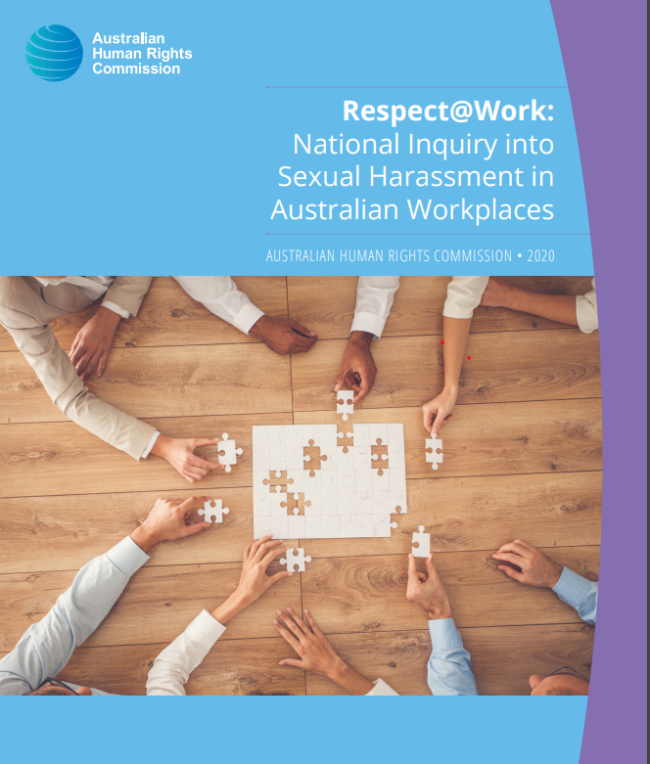
CLCs
$9.962 M
LAQ
ATSILS
Notes:
$9.962 M over 2021-25 for the delivery of legal assistance services to people experiencing workplace sexual harassment or discrimination.
In response to recommendation 53 of the Respect@Work Report (National Inquiry into Sexual Harassment in Australian Workplaces).
Each of the sub-sectors need to receive some of this funding.
Consultation is underway.
Need to determine how the funding will be shared among the sector.
AG the decision maker.

Slide 10
Child sexual abuse prosecutions
$1.498 M
ATSILS
LAQ
Notes:
$1.498 M over 2021-25 has been provided for the delivery of legal assistance services to people accused of, and charged with, Commonwealth child sexual abuse offences.
Funding for LAQ and ATSILS.

Slide 11
Notes:
As hopefully many of you are aware, under the NLAP we are required to develop a Legal Assistance Strategy and Action Plan.
This is a new requirement.
Strategy due – 1 July 2022
Action Plan due – 30 September 2022
Clause C3 – the Commonwealth has made it clear that the estimated financial contribution to the State will not be reduced if our strategy and action plan does not achieve its stated or intended aim or meet its target.
The advice provided by the Commonwealth on how these documents should be developed and what they should look like is very very high level. This is to provide jurisdictions with the opportunity to reflect their inherently unique needs and experiences. I think this also reflects the Commonwealth’s approach to this work – they are very flexible about what is developed and the outputs are not tied to payment or funding amounts etc.
Here in Queensland, we want to create something that is useful and meaningful to our sector. We’ve engaged an external consultant to undertake the development of the strategy and action plan. This will enable the sector and the Queensland Government to work together and contribute to the development of the Strategy and Action Plan collaboratively.
I’m sure that many of you will have had an opportunity to talk with Jackson from Grant Thornton at one of the LAFs. We’ve been very encouraged by the sector’s active engagement and participation at the LAFs. People have really engaged and discussed what’s important to them in their local areas.
These discussions along with the resources we already have available will inform the strategy and action plan. I’m sure you’re all familiar with the Evidence and Analysis of Legal Need which CLCQ published an updated version of in August 2019.

Slide 12
Notes:
As well as the discussions and resources, stakeholders are also being given an opportunity to provide a written submission by Tuesday 30 November 2021.
Not intended to be onerous. Not compulsory.
Timeframes:
Sector scoping report will be provided to DJAG in mid-December which will provide an opportunity to see where GT is positioning itself and to be able to provide feedback and refine, if necessary.

Slide 13
Strategy and Action Plan Contacts

Slide 14
Questions?
Notes:
Reminder that Therese and I will be staying for morning tea.
Any questions relating to the funding or the strategy? Or anything?

