Slide 1

Leading To Excellence! Presented for Community Legal Centres Queensland
With Joan Wilson-Jones
JwJ Consulting
Brisbane
www.jwjconsulting.com Joan@jwjconsulting.com, 0402 473 173
Notes:
Leading To Excellence!
17th November 2021
Presented for Community Legal Centres Queensland
By Joan Wilson-Jones
JwJ Consulting Brisbane
www.jwjconsulting.com
Joan@jwjconsulting.com
0402 473 173

Slide 2

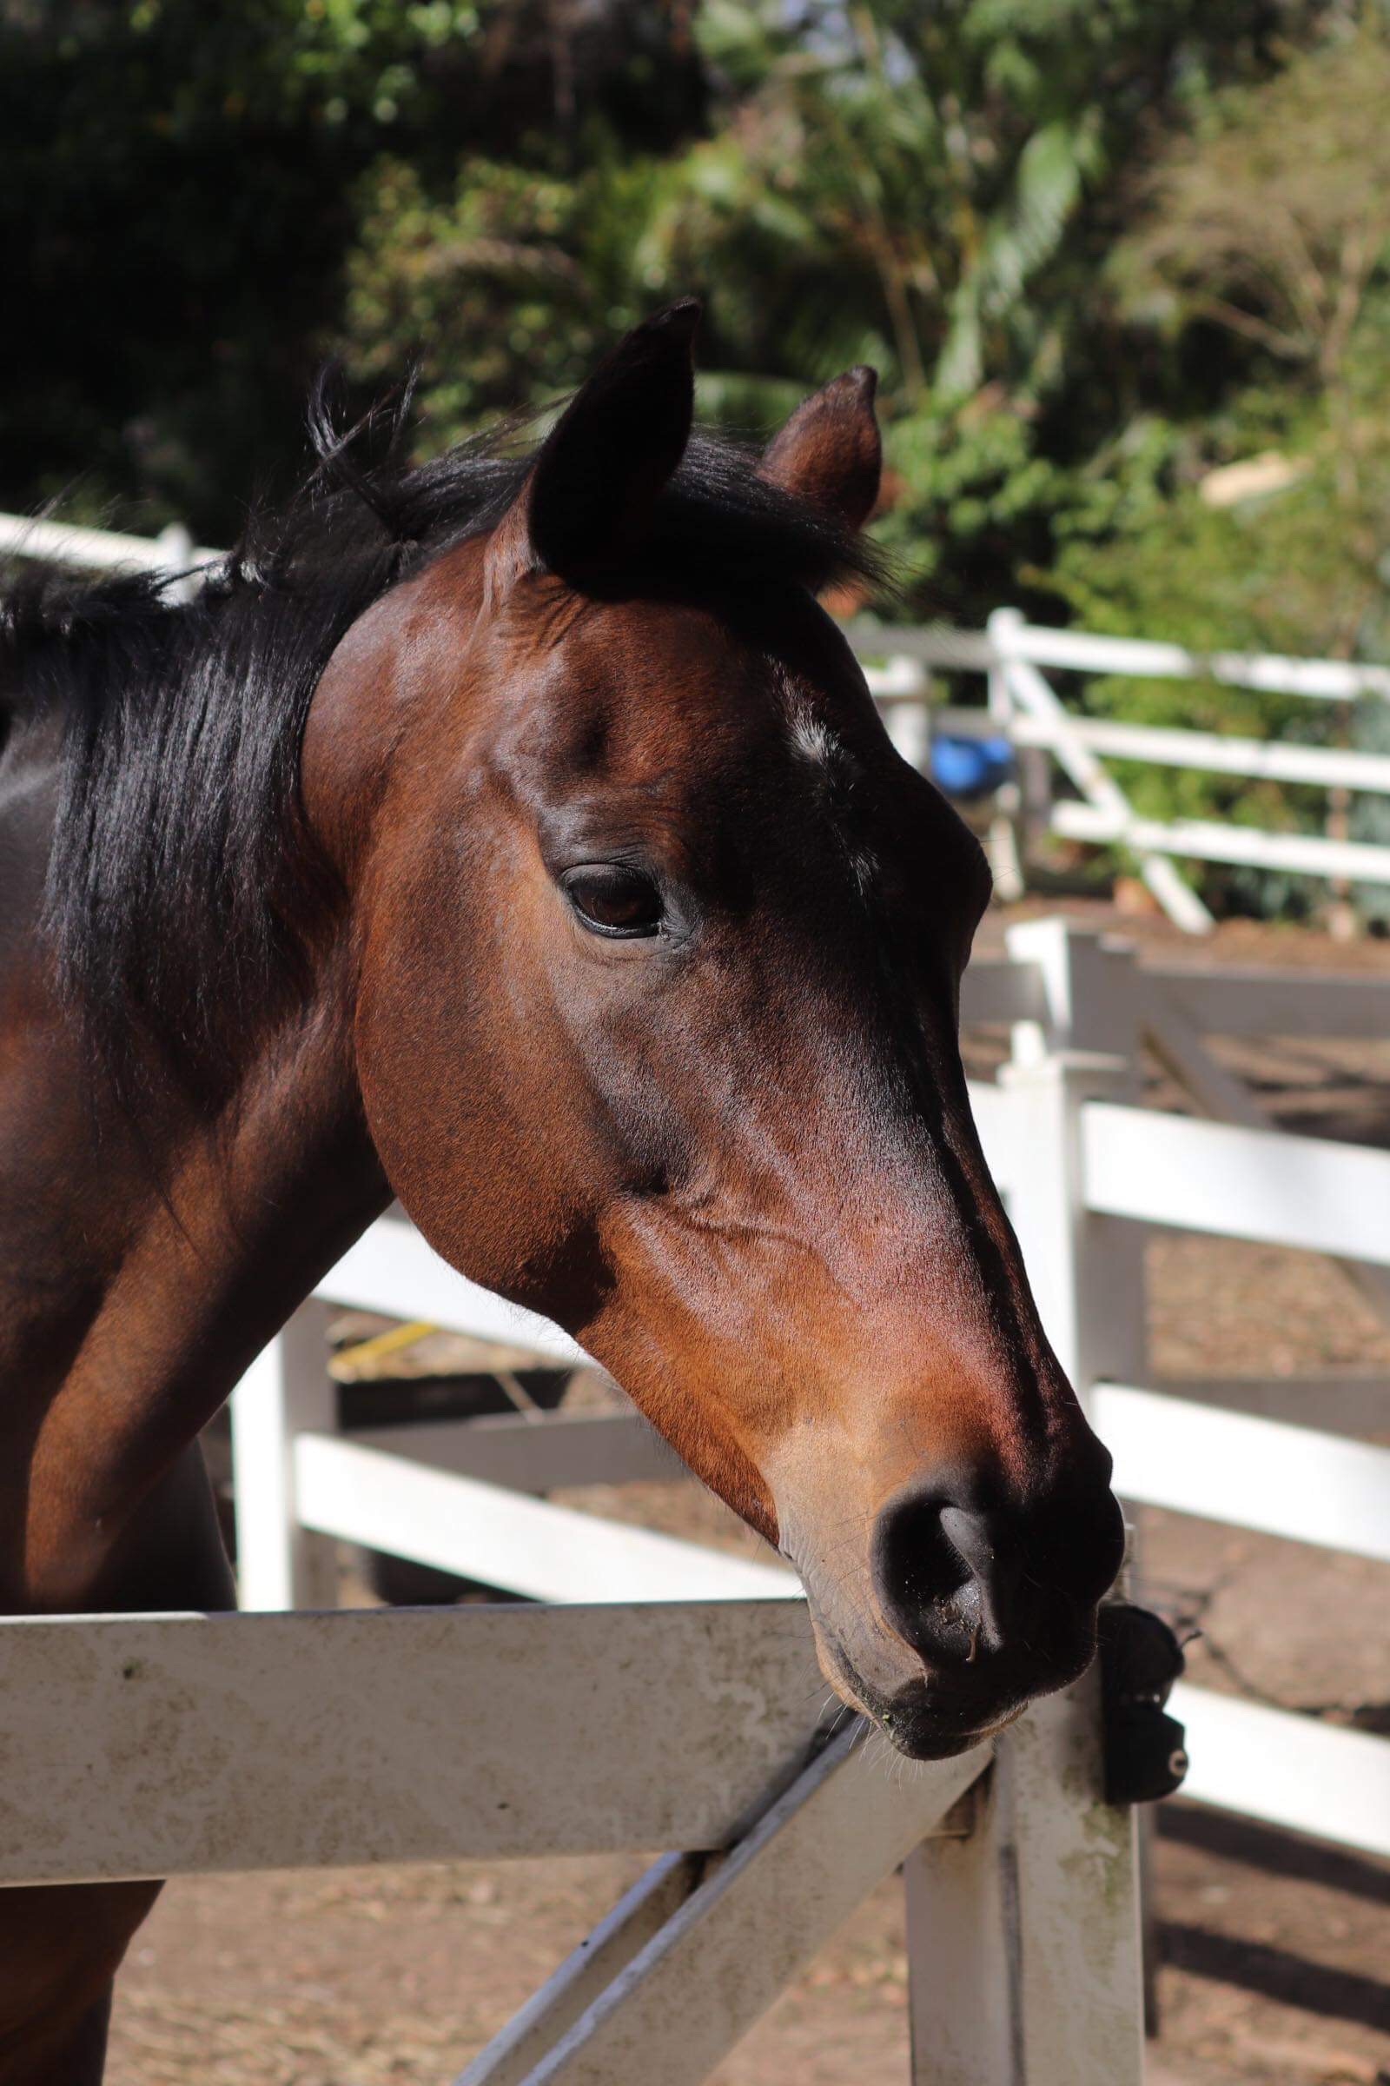

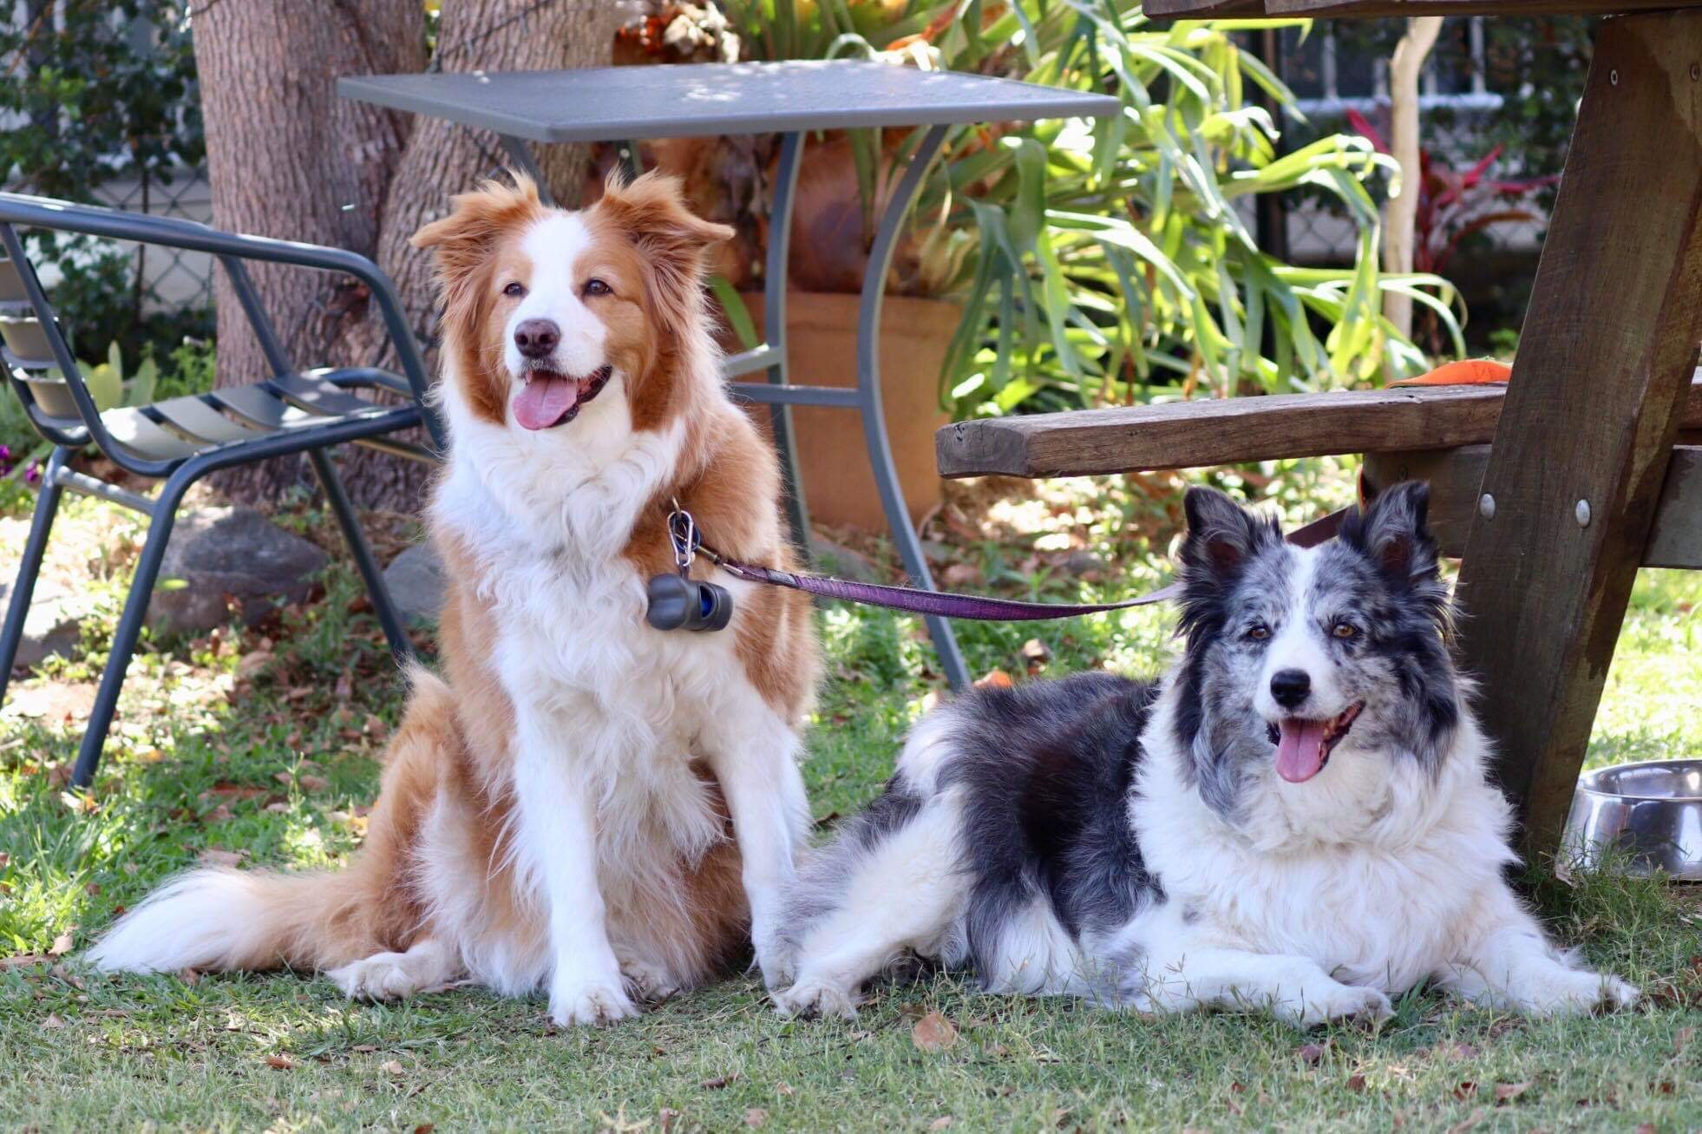
Getting off to a helpful start – every day
Notes:
Think back over the past 24 hours.
What are three things that you have experienced that you would put into a category of enjoyable or pleasant or uplifting? These don’t need to be big things, in fact the little things that we often don’t notice can be the most powerful for what this activity sets out to achieve.
Note your three things here:
1.
2.
3.

Slide 3
What is Leadership really all about?
Leaders focus on self insight and self development
Leaders learn about their people
Leaders do their best to provide access to skills, support and encouragement.
Leaders look to the future.
vision
Insight
Future
Self
Work Flows
Team
Clarity
Connection
Notes:
Leadership is a four part process:
Knowing about self
Knowing our team
Knowing our priorities
Contemplating future needs
Today’s focus will be primarily be on the first one. Because that is where it all starts.

Slide 4
Leaders Manage Their Energy!
Have you ever felt tired?
It’s not just about how we engage with the world – it’s also about how we manage the impact of that engagement.
Notes:
We all gather and burn energy differently. What energises one person, depletes another.
It’s neither right nor wrong – it’s just us.
Understanding ourselves helps to better look after our energy. We can all choose to do any task we want, however some tasks will be more energetically taxing than others.
Leadership requires us to manage our energy. In order to manage our energy it’s essential that we understand what energises us and what de-energises us.
Do you prefer to work alone? – that’s fine, however as a leader you will need to interact with people – what will do you about that?
Is one of the reasons that you come to work to engage in social activity? – that’s fine, however as a leader you need to be mindful of perceptions and perceived bias’s – how will you manage that?

Slide 5
Charging and Draining!
People and activity
Processes verbally
Tends to reveal a lot about themselves
When tired benefits from social activity
When stressed can have tendency to withdraw
Quiet ‘alone’ time
Processes cerebrally
Tends to be private about their out of work life
When tired benefits from ‘alone’ time
When stressed can have tendency to ‘break out’
Notes:
When we know how our energy works, then we also have insight into how to manage it.
If energy is externally focused then it’s people and activity that help build energy stores.
The opposite is true for people whose energy is internally focused.
Knowing ourselves and what works for us helps us maintain the ability to ‘show up and be present’. Managing our energy is our responsibility.
What are some things that you could do to better manage your energy?
How might the COVID restrictions have impacted on the different types?
If you are working more from home nowadays, how might understanding your energy makers/drainers by helpful?
What would be helpful to remember in relation to yourself and your team in terms of this continuum?

Slide 6
Big Picture or Detail?
What do you see when you look at this picture?
Notes:
What words come to mind when you look at this picture?
List them below:

Slide 7
What about this one?
Notes:
Make some notes here:

Slide 8
What we see!
Notes:
Some people see the big picture or the emotions in the picture.
First picture: busy, exciting, frenetic, exhausting.
Second picture: peaceful, tranquil, beautiful, boring, dull, quiet.
Others see the detail in the picture:
First picture: people, lights, Vegas, casinos.
Second picture: 3 people, chairs, sunset, ocean
There is no wrong or right here, however, if we speak to a big picture person using only fine detail language we can lose them and if we give too much fine detail to a big picture person we can confuse them. Understanding our own preference helps us to make strategic changes when necessary.
Detail people tend to see what is (the glorious silky oak timber dinning table) whereas big picture people tend to see where things are going (they are already planning the menu for the dinner party).
Detailed outgoing people see the capacity of the table and start making a guest list.
Big picture more reserved people are already creating a menu for two.

Slide 9
Making Decisions
You have a new neighbour. They are renting the house next door.
Your previous neighbours had lived next door for 15 years (you’ve been living there for 16 years).
Your previous neighbours didn’t socialise much but they were friendly and very quiet (you hardly heard them).
The new neighbours like to party. When they first moved in you hoped it would settle down but they have been there for 2 months now and the parties continue every weekend.
They play loud music (which isn’t music you particularly like) and there are always lots of cars parked up and down the street. The parties go until midnight (they always stop at midnight).
You’ve heard that he was in the army, you believe he did a couple of tours to Afghanistan.
You have also noticed that another adult in the house (believed to be the man’s son) is in a wheelchair.
Another neighbor told you that the man had told her that his wife is currently in palliative care.
Where do you go from here?
Notes:
Make some notes here:

Slide 10
Head or Heart?
It’s not about the decision – it’s about where it comes from.
Notes:
Whether we agree with the decision or not is NOT what makes us a thinker or a feeler.
Rather, it is the reason for our decision that determines what our preference is.
Those who make decisions in their head will cite rules and laws. They will work towards an outcome that is ‘right’.
Those who make decisions in their heart cite emotions and reasons. They will work towards an outcome that is ‘kind’.
We have heads and hearts (we cannot survive without a brain AND a heart), and we will use both. This preference relates to where we go first.
.

Slide 11
What Do You Show the World?
You have decided to go on a picnic!
What’s your process for getting things organized?
Notes:
Note your answers here:

Slide 12
Planned or Spontaneous?
Notes:
This continuum relates to what we show the world.
Do we show our way of seeing the world (detail or big picture) or do we show our way of making decisions (in our head or our heart).
Let’s look further at what I mean by that.
Some of us are planned and organized, we show our decision making strengths (head or heart), while others are more unstructured and spontaneous and show our information gathering strengths (detail or big picture).
People who show their decision making process tend to be outwardly organized (lists, plans, timeframes) whereas people who show their information gathering preference tend to appear less organised.

Slide 13
Learning Styles
Visual - 65%
Auditory – 30%
Kinesthetic/tactile – 5%
Notes:
Visual people use visual language – ‘I don’t see what you mean’. ‘can you draw me a picture?’. Visual people prefer to read instructions and will often choose email or SMS rather than phoning. In meetings they take lots of notes and if they purchase a new appliance they will often read the manual before doing anything else.
Auditory people use auditory language – ‘I’m not sure I heard that clearly’, ‘Could you tell me again please’. Auditory people prefer to listen to podcasts or talk on the phone rather then email or SMS. In meetings they ask lots of questions and when they buy a new appliance they are likely to ask someone to read the instructions, step by step, to them while they set things up.
Kinesthetic using active language - ‘Can I have a go please’, ‘Let’s see what happens if we press this button’. Some kinesthetic people use body movement (they move around a lot or might swing on their chair) and other kinesthetic people fiddle rather than move (we call these people tactile), so they may twirl their hair, play with a loose thread or constantly click a clicking pen. Kinesthetic people often don’t refer to the manual at all, they just get in and start plugging in plugs and pushing buttons.

Slide 14
Add Culture and Mix
Notes:
The definition of ‘culture’ in this context includes:
Your Ethnicity
Your Age
How you identify (for example: gender, sexual orientation/identification).
Your Profession
Your Socio-economic status ( background and current)
Your Lifestyle choices (your social groups, the sports you play, where you choose to live).
Let’s look at some of the potential impact of that mix,

Slide 15
All about others!
Notes:
Meet Alex: Alex is a client who has asked to meet with you today. Their case is quite complex and you want to make sure that Alex has all the details so you have prepared some dot points notes which you take to the meeting. You notice that Alex doesn’t even look at the notes. Rather, repeatedly asks questions about what’s going to happen in the long term. Alex seems disinterested in the details of the case as it stands at the moment. Every time you try to explain the next steps Alex demands to know what might happen in the end. How might you precede with the interview?
Meet Kerry: Kerry is one of your team members. Kerry has always been one of the team top performers and is also the team social organizer. Pre COVID, Kerry would always have something in the planning to encourage the team to get together on a more social level. You noticed during the work from home period that Kerry started to miss some deadlines and make some mistakes. Kerry was also often very quiet in the virtual team meetings. You want to discuss this with Kerry. What might your approach be?
Meet Chris: Chris is your manager and you are wanting to approach Chris about some concerns raised by your staff. There has been a significant increase in difficult calls and your staff are feeling threatened and stressed. Three staff members have gone on sick leave. You have asked previously for some additional resources because you were concerned that staff weren’t coping but Chris said there was no money and no extra people and that you just need to find better ways to do things. What might be your approach to Chris?

Slide 16
Time to consider insights:
Notes:
Leaders know themselves!
Reflection is an important aspect of successful leadership.
In terms of the material we have covered so far today, what insights have you gained so far?
What questions do you have at this point?

Slide 17
Leadership and Management
Leadership is doing the right thing
Management is doing it right
Notes:
In terms of the personality discussion –
Which personality traits might help us with leadership?
Which personality traits might help us with management?
NOTE: while the theory suggests that we all have default positions in terms of how we interact, we all also have the capacity to choose.
Some behaviours will come naturally to us and feel easier, while some behaviours we might need to be more considered or conscious about.
When we behave ‘out of character’ it can be more tiring so being aware of that enables us to also put strategies in place to look after our energy and wellbeing.

Slide 18
Building The Team
Notes:
Some foundation considerations:
Know your team – observe them. Avoid the temptation to label them (it’s not our job to categorise), but rather notice things about their style and their communication.
Check your assumptions – ask questions about how they like to interact at work, what they mean by ‘support’, what tasks do they enjoy, which tasks don’t they enjoy?
Be present! Check in with people.
Encourage team members to raise concerns AND invite them to present solutions.
In this current blended team situation, if you can, have times when the team is together face to face.
Ensure the team is communicating with each other.
Demonstrate the behaviour you want.

Slide 19
Agreements
Notes:
Rule number 1 - Never assume someone knows what you expect of them.
Rule number 2 – Remember rule number 1.
Agreements are set in behavioural language
Agreements are either:
Explained – non-negotiable agreements or
Discussed – negotiable agreements
Agreements are reviewed regularly
Agreements apply to everybody (there aren’t any exceptions)
Agreements are living documents
Behaviour/achievement is assessed against the agreement (not against another staff member).

Slide 20
Outcomes Vs Activity
When leaders and teams gain agreement on:
The What
The Why
The When
Then (and only then) can we let team members decide:
The How!
Notes:
When finalizing agreements ensure that:
All relevant parties agree on The What. Or ‘What does done look like?’ Be specific and detailed about what you expect in relation to a task.
That all relevant parties understand The Why. Where does this fit with the overall business objectives? Why are the timeframes important? How does it help us to meet our objectives/imperatives?
That all relevant parties are clear about The When. Deadlines are specific and include days, times and dates.
When all this is clear then the team member is well positioned to successfully determine The How.

Slide 21
Clear or Unclear?
Look at the scenarios below.
Are they specific enough?
How might the be improved?
Notes:
You ask Alex to complete the annual activity report, noting that you need it in time for the management meeting on Friday. You remind Alex that the report should include an executive summary and note any spending anomalies.
Chris is organizing the catering for the upcoming community consultation. You note that the menu shouldn’t be too decadent (as that can look like money is being spent indiscriminately) but should cater for all dietary requirements. You note that participants only expect a snack.
Pat’s report writing skills are causing you some concern. The documents are too long, contain too much jargon and too many punctuation errors. You are feeling really frustrated because you have discussed this with Pat on 2 previous occasions and nothing has changed.
It’s your housemate’s turn to cook dinner. You let them know that you would be late home from work and you also said you didn’t want a heavy meal as you’d attended a business lunch that day. When you arrive home, a rather burnt casserole and a very annoyed housemate greet you as they have been waiting for over an hour and dinner is ruined.

Slide 22

Setting the Bar
Notes:
It’s important that we discuss and clarify how staff will be assessed.
Whether that’s qualitative – how many get done or
Whether that’s quantitative – how well it gets done.
In the words of Brene Brown – it is important to clarify what ‘done’ looks like.
It’s not as easy as it sounds. Let’s play with that a bit.

Slide 23
Let’s talk about this guy!
Notes:
You might want to take some notes here:

Slide 24
Rewards and Consequences
Notes:
Rewards are what happens when we meet our agreement.
What are some ideas for some rewards?
Consequences are what might happen when we don’t meet our agreement.
What are some ideas for some consequences?
What might we consider before we apply consequences?

Slide 25
Getting off to a helpful start – every day
Notes:
Remember this activity – it’s where we started today.
Well let’s look at how it helps keep us happy and healthy.

Slide 26
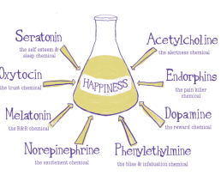
Why is this important?
When we experience good times we produce chemicals that increase our resilience, our creativity, our strategic thinking, our energy, our health, vitality and our happiness.
When we think about good times we produce the same chemicals.
When we talk about good times we produce the same chemicals
Whether we are doing it, thinking about it or talking about it – the level of the chemicals that we produce are the SAME!
Notes:
The chemicals we produce when we are feeling good have a remarkably helpful impact on our physical, emotional and psychological health.
In short, we are healthier when we are happy. Our immune system is strengthened (helping protect us from illness), our resilience and our tolerance are naturally higher (so we can cope with more and bounce back more easily), our creativity and strategic thinking are improved, our digestive system is more supported, our intelligence is optimised - the list goes on and on.
When we are producing chemicals that support ‘comfortable e-motions’ we are supporting our wellbeing.

Slide 27
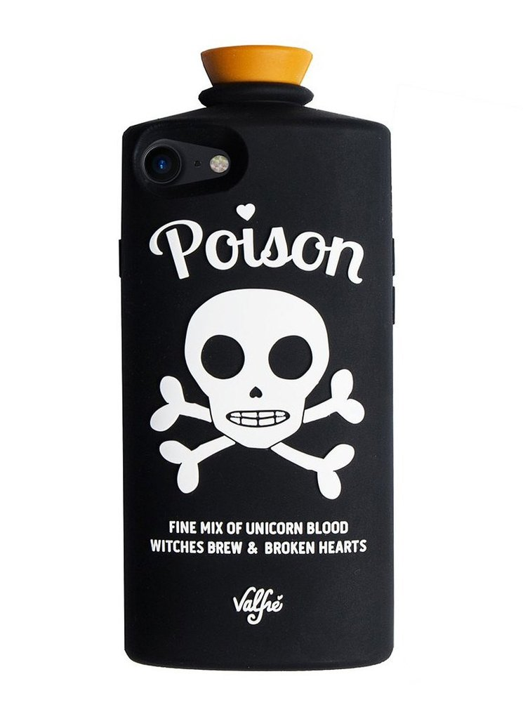
This theory also applies to uncomfortable e-motions (and the chemicals that create them).
Watch how you speak and think about difficult times because each time we re-live them in our thoughts and our conversations we also re-create the chemicals that support uncomfortable e-motions (ie anger, fury etc). And these chemicals are:
Messing with our cardiac system
Retarding our digestive system
Playing around with our reproductive system
Reducing our IQ (more on that soon)
Knocking holes in our immune system
Notes:
We are designed to have ‘uncomfortable e-motions’. They enable us to respond to danger and they protected our ancestors from potentially being wiped out by sabre toothed tigers.
An e-motion such as anger provokes us to act, stress (ideally) encourages us to take stock, sadness invites us to rest or grieve.
All our e-motional responses have a purpose. When we experience uncomfortable e-motions, our system requires us to ACT:
Become Aware of the e-motion you are experiencing (ideally name it).
Find the Cause (whether tangible or perceived)
Take Action – either amend the perception or deal with the tangible situation.
We are NOT designed to wallow in uncomfortable e-motions and, if we do, then we could potentially be putting our health at risk.

Slide 28
Meet the ancestors
Notes:
Our ancestors were geared to look for danger. They had to be, if they didn’t they didn’t survive. It’s that simple.
Those who survived potentially did so because of a developed propensity to expect danger. They also were great at remembering dangerous situations (again, a survival technique). If they forgot that sabre toothed tigers were dangerous, then they were potentially eaten and possibly don’t have any descendants.
We carry this genetic soft wiring. Research into neuroplasticity confirms that our brains are NOT hardwired. We can reprogram our neural network and create new patterns of thinking and responding.
When we adopt a new behaviour we effectively rewire our brains. Rewiring for healthier default behaviour is not only in our best interests, it potentially impacts on future generations as well (we are creating a new genetic blueprint).
In order to change a behaviour (and a neural pathway), we need to consciously practice our new way of being until it becomes embedded. Then it becomes our new default behaviour.

Slide 29
Calm is clever
Understanding the impact of our e-motions on our IQ – calm is clever!
Notes:
Anyone who has ever been angry and reacted in the heat of that anger, or deliriously happy and made a critical decision at the peak of that delirium, possibly understands that high levels of e-motions can have an impact on our intelligence and rationality.
We are generally cleverer when we are calm.
It’s why contracts have cooling off periods, it’s why car dealers often only have top of the range models to test drive, it’s how marketing works and how relationships can be destroyed.
Our aim is not to rid ourselves of e-motions (they are one of the things that differentiate us from robots), our aim is to manage our e-motional landscape and maximise our ability to operate at our most effective levels.
We call it EQ or Emotional Intelligence. It’s about understanding our e-motional triggers, managing our e-motional responses and maximising our success.

Slide 30
How can we apply all this?
Stress
Time
Notes:
It’s hard to be calm when we are burnt out.
Life offers challenges – that is normal. How we work with and manage those challenges determines whether we thrive or are conquered.
As we unpack this model together, you may want to make some notes about:
What are your early warning signs that you are experiencing high levels of stress?
What are things that you can do that help you to feel calmer (and therefore cleverer and healthier).

Slide 31
A powerful little tool
An idea to practice……..
Plus…..
Expect things to go well
Smile more
Remember good things
Breath before you act
Call a time out if you need one
Avoid unhelpful predictions
Be mindful of how you talk about things
Surround yourself with e-motionally intelligent people (it’s contagious)
More ideas??????
Notes:
Box breathing is a powerful, yet simple, relaxation technique that aims to return breathing to its normal rhythm. This breathing exercise may help to clear the mind, relax the body, and improve focus.
The technique is also known as “resetting your breath” or four-square breathing. It is easy to do, quick to learn, and can be a highly effective technique for people in stressful situations.
People with high-stress jobs, such as soldiers and police officers, often use box breathing when their bodies are in fight-or-flight mode. This technique is also relevant for anyone interested in re-centering themselves or improving their concentration.
Read on to discover the four simple steps required to master box breathing, and to learn more about other deep breathing techniques.
The above is part of an article from ‘Medical News Today’ - https://www.medicalnewstoday.com/articles/321805
There is quite a bit of information about square (or box) breathing on the internet.

Slide 32
Think of traffic lights
Red – STOP!! – become aware of your e-motions.
Amber – Establish the cause - what is happening
Green – Respond helpfully to the situation (rather than react unhelpfully).
Notes:
Remember ACT from a few slides ago?
Well here it is represented as traffic lights (I find this a great way to remember).
Remember, we are not seeking to deny or suppress our e-motions, we are working to identify and manage them.
Emotionally intelligent people still experience e-motions. They have just learnt to manage them effectively.

Slide 33
Making it Count!
What are some next steps for you?
Notes:
What are you taking away from this session today?
How will you utilize it?

