Slide 1
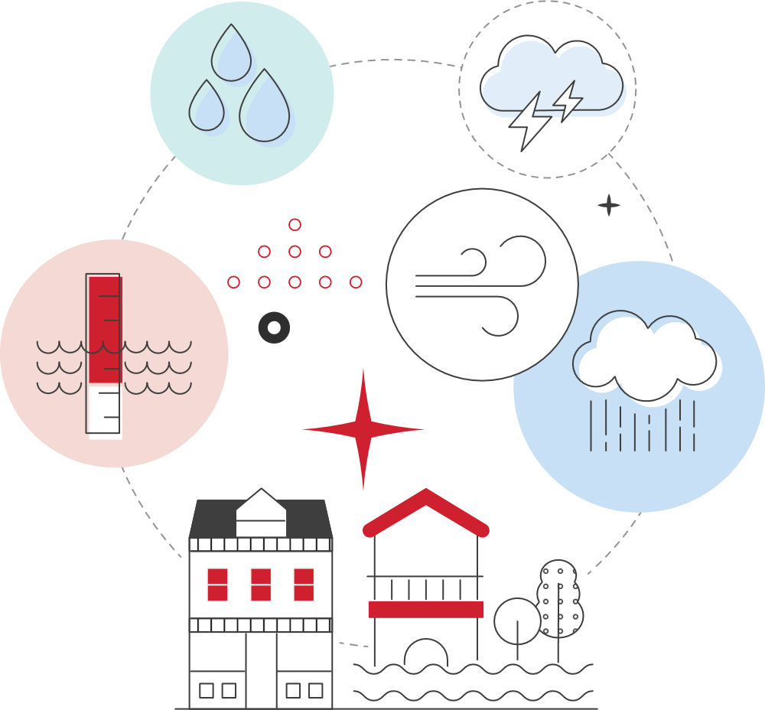
Flood or storm damage? What to do
Take photos of all damage
Write down what happened
Call all your insurers
(home, contents, car)
Read your insurance policy, talk to your insurer.
Even if you don’t have flood cover, you might have cover for damage caused by storms (wind, hail, lightning) or by rainwater (including pooled rain water).
When insurers talk about flood, they usually mean water that has come from a lake, dam, river, creek, canal or something similar, over land that is usually dry.

Slide 2
Tips for making claims after a significant weather event
Be honest with your insurer - only make insurance claims for items damaged by the weather event
Use the checklist on the next page and tell your insurer about those things
If you are unsure whether something will be covered by the insurer, submit the claim anyway
If the insurer declines your claim and what they say does not make sense, contact us or a community legal centre for help

Slide 3
What to check and tell your insurer about
Is everyone safe? | Did a swimming pool overflow and cause damage? | Did any cars, boats or anything else crash into the house?
Did trees cause any damage to house, car or fence? | Was there a landslide or mudslide? | Has anything been stolen?
Has wind knocked off TV aerial or caused damage? | How high did flood water get on your property? | Did any animals end up in your house or yard and cause damage?
Did the power go off? | Did food or medicine in fridge or freezer get spoiled? | Did any electrical goods get damaged?
Did any windows break? | Did the roof or ceiling leak?

