Slide 1
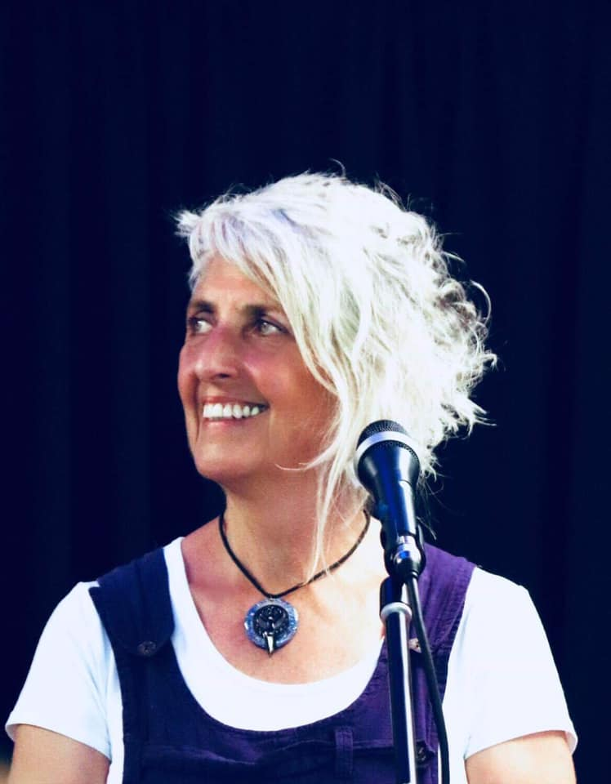
Leading for Team Health, Wellbeing & Excellence!
Presented for Community Legal Centres Queensland
With Joan Wilson-Jones
JwJ Consulting
Brisbane
www.jwjconsulting.com Joan@jwjconsulting.com, 0402 473 173
Notes:
Leading for Team Health, Wellbeing & Excellence!
12th May 2022
Presented for Community Legal Centres Queensland
By Joan Wilson-Jones
JwJ Consulting Brisbane
www.jwjconsulting.com
Joan@jwjconsulting.com
0402 473 173

Slide 2

Let’s start off well!
Notes:
Think back over the past 24 hours.
What are three things that you have experienced that you would put into a category of enjoyable or pleasant or uplifting? These don’t need to be big things, in fact the little things that we often don’t notice can be the most powerful for what this activity sets out to achieve.
Note your three things here:
1.
2.
3.

Slide 3
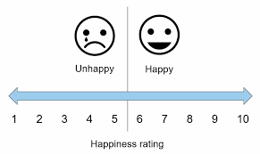
Taking the ‘team temperature’
Notes:
Rate the current culture on a scale of 1 to 10:
The number is an indicator however it’s the next step that is critical.

Slide 4
Make the Ratings Count – its more than a numbers game.
Why not a 1?
Why did you not give your team a lower rating?
Why not a 10?
Why did you not give your team a higher rating?
Notes:
Now note:
What stopped you giving a lower score (assuming the score is higher than 1)
What stopped you giving a higher score (assuming the score is lower than 10)

Slide 5
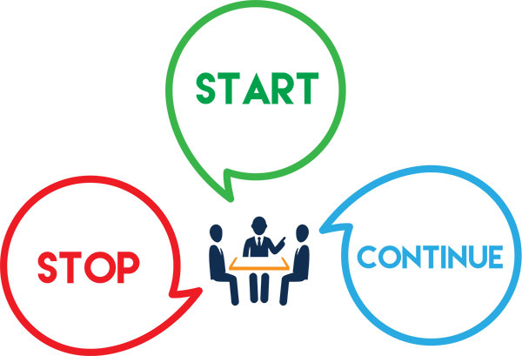
Stop, Start, Continue
Notes:
Naturally our aim is to build and sustain a culture that is as close to a 10 as possible.
The data from the ‘team temperature’ activity is very useful in determining the next three steps:
What do we continue doing? – What is working?
What do we stop doing? – What is eroding our culture?
What will we start doing? – What are some new behaviours that will help us build the culture we want to build?

Slide 6
So let’s take that to the team!
Question 1 – if we asked our clients (internal or external) how they would describe us – what would we WANT them to say?
Question 2 – what behaviours do we need to exhibit to earn those labels.
Notes:
Understanding how we want to be viewed is an important step in achieving our reputation ambitions.
In order to be seen as ‘helpful’ we have to demonstrate ‘helpful’ behaviours in the eyes of the person making the assessment.
Just as we can’t demand respect we have to earn it, so we can’t insist that people see us as ‘professional’. We have to understand what represents professional behaviours to those we are seeking to create an impression with.
NB – our behaviours have to be genuine! Pretending is a façade easily seen through and assessments of us will most definitely plummet.

Slide 7
New Starts! (excellence is a team sport).
Establish vision – what does our perfect team look like?
From rhetoric to reality – ‘what behaviours would our perfect team demonstrate’?
Make it happen – ‘what strategies can we put in place to work towards achieving that’?
Maintain momentum – ‘how will we celebrate success?’
Notes:
So the pathway to excellence is clear:
Establish a vision – ask yourself the question – ‘if this magically all became perfect overnight, what would it look like?’ – that’s what we’re aiming for.
Turn the rhetoric into reality – establish what behaviours the team needs to demonstrate in order to move towards the vision. Without a focus on behaviour, our vision remains just another good idea.
Make it happen! - set some strategies, some time frames, some measures and review dates.
Understand what ‘done look like’ and have a plan to celebrate each milestone (it really helps build motivation).
Remember, a thought is just a good idea, when we write it down it becomes a dream, when we set a plan to achieve it it becomes a goal and when we track and celebrate progress it becomes a reality!

Slide 8

Setting the New Foundations.
Behaviours for our New World!
Notes:
Setting the expected team behaviours means we all have clarity around ‘what is expected here’. In doing this we are remove the potential for different interpretations of the same term. We can all be doing different things and all think we are being ‘professional’ whereas ‘arrive at meetings 5 minutes before the meeting start time’ leaves no room for interpretation.
Naturally we hope that all team members will demonstrate these ‘yes’ behaviours all the time. However, the reality is we all go through difficult times. Times when perhaps we’re are dealing with a loss or a family challenge. Times when we aren’t in a place where we can put 100% effort in all the time. This is the ‘Maybe’ zone. ‘Maybe’ means it’s OK to have times when we aren’t doing as well and we know our team will support us. ‘Maybe’ times are time limted, they have specific reasons and they have end dates. Note: even in the maybe zone, fundamental polite, kind, compassionate behaviour is still expected. I can be sad, but I can’t be mean.
The red zone is the underperformance zone and these behaviours need to be addressed as soon as possible. Failing to address behaviours in the red zone is sending a message that they are acceptable.

Slide 9
It takes a team to cross the finish line
Yes - Reward
Maybe - Support
No – Act!
Notes:
So in short:
We acknowledge and reward green zone behaviours – remember, we will always get more of the behaviour we reward.
We support and discuss behaviour in the blue zone. Seek to offer assistance and work with the team member to get them back to the green zone.
We address behaviour in the red zone. It’s essential that this behaviour is called out (in clear behavioural terms) and that potential consequences are put in place if behaviour isn’t addressed by the team member concerned. Red zone behaviour is contrary to our team agreement and inhibits our team achievement.

Slide 10
From Complaining to Conversing
Have a process for raising concerns
Whole team commits to the process
Whole team follows the process
We all contribute to the culture
We are all responsible for maintaining a healthy culture.
Notes:
All teams need a process for how to raise concerns. If we fail to establish a process then we risk a breakdown in communication processes, which places team productivity and connectivity at risk.
It’s helpful to establish the process in consultation with the team. Some things to consider might be:
What facts/data is needed to support the view that it’s a concern.
What might be some ideas for solutions.
Who is the most appropriate person to escalate a concern to.
What are reasonable timeframes for responses.
What are some of your thoughts around how you would like concerns or issues raised with you?

Slide 11
Courageous Conversations
The agreement is key!
Acknowledge and reward behaviour in the green zone.
Discuss behaviour in blue zone (discuss appropriate time frames).
Call out behaviour in the red zone.
Notes:
Where team members aren’t adhering to the team agreement it’s essential that this is discussed individually. Ideally in person (not virtually).
A helpful 4 step process might be:
Note the actual behaviour. Eg. “this morning I heard you say to Sally, ‘that’s not my job, do it yourself’”.
Align it with the relevant part of the agreement – ‘remember we agreed to discuss any requests for assistance to ensure that all priorities were met, rather than just focusing on our own jobs’.
Enquire – ‘what was happening for you? Why did you respond that way to Sally?’
Set a response:
1st time of discussing, remind the team member of the agreement and request that they follow it.
2nd time of discussing, consider applying a pre-agreed consequence.
3rd time of discussing, consider commencing performance management action.
Where there is no agreement aligning to the behaviour then feedback is not appropriate and this is a prompt to discuss and set an agreement.

Slide 12
Blue Zone Behaviours
Temporary change of behaviour connection due to life circumstances (ie loss, grief etc.)
Blue Zone Behaviours aren’t
  An excuse
  An escape
  An end point
Notes:
When staff are in the blue zone they need, and deserve our support. It might also be that they need some time off or may benefit from some professional support (for example, where the staff member is dealing with major issues or challenges).
What they don’t need is performance management.
However, we need to consider reasonable time frames (determined by the magnitude of the situation they are in) for return to the green zone.
NOTE: the blue zone is specifically about supporting staff through difficult times.
The blue zone isn’t:
a place where we can go permanently
an excuse for bad behaviour (contrary to our agreements).
an escape from undertaking tasks or meeting expectations.
a place where we can hide when we are upset about organisational decisions or work practices (the ‘how to raise concerns’ agreement comes in here).

Slide 13
Wellbeing Counts
The four pillars of wellbeing:
  Diet
  Exercise
  Sleep
  Mindset

Slide 14
The Importance of Balance
Notes:
Consider this wheel – here is my challenge to you.
For the next two weeks, at the end of each day, plot approximately how much time you’ve spend in each of the segments.
At the end of two weeks, consider how balanced or unbalanced your life wheel might be.
Does each segment have sufficient investment from you to support the lifestyle you want to live?
Do you consider your balance wheel is able to hold you up?
Are you happy with how your ‘deposits’ are distributed?
If the answer is yes – keep doing what you are doing.
If the answer is no – do something different.

Slide 15
Behaviours are Contagious
Lead the way – model the behaviour you want.
Put wellbeing on the agenda – share strategies and ideas across the team.
Promote healthy eating when organizing catering for events or meetings.
Monitor work hours and check for unhealthy patterns.
Cease making ‘busy’ a badge of honour.
Encourage team members to come up with ideas and initiatives for increasing knowledge about health and wellbeing.
Incorporate healthy practices into the work day (ie walking meetings, team lunches away from the desk, brain gym, lunch time yoga…..there are heaps more).
Notes:
Our greatest capacity to influence comes through our own behaviour. People will follow what we do.
In order to promote the behaviours we want we need to demonstrate them ourselves. It’s critical that we walk our own talk.
Try this reflection activity:
At the end of the day, consider how your day went and ask yourself -
What went well today? What did I achieve? How did I model the behaviour I want from others? (identify where you succeeded and congratulate yourself).
What could have been better? Set an improvement plan. Resolve to improve it tomorrow.
Remember! None of us are perfect! We will all slip and we will all make mistakes. Setting strategies to address them and improve is much more helpful than giving up.

Slide 16

Can I Really Make a Difference?
The Concept of Critical Mass &
Notes:
The concept of critical mass has been the subject of many studies over the years.
It used to be believed that, in many situations there needed to be more than ½ the people behaving in a new way in order to shift the behaviour of the entire group.
Further research reduced that to 10%, then 3% and most recently to <1% (yes, less than 1 percent).
Which means we are all capable of influencing the behaviour of those around us (and some people do it for good and some people do it for evil).
And then there is the story of the 100th monkey……..

Slide 17
Teamwork – helps the team work!
Put culture on the meeting agenda
1
Normalise talking about culture and culture improvements
2
Reward behaviour consistent with the creation of the desired culture
3
Address behaviour NOT consistent with the creation of the desired culture.
4
Notes:
What have been some highlights for you today?
What are 3 things that you plan to put into action?
How will you ensure that you do that?

Slide 18
Any Questions?
Notes:
Thank you for your time and involvement today.
I hope the information has been useful.
Remember, nothing changes unless we take action.
If you have any further questions following this session, please don’t hesitate to contact me (email is probably best).
I wish you every success in the future.
Joan
May 2022

