Slide 1
Inclusive and Accessible CLE materials
Matilda Alexander
Queensland Advocacy for Inclusion 2022

Slide 2
Acknowledgement
Queensland Advocacy for Inclusion (QAI) respectfully acknowledge the Aboriginal and Torres Strait Islander peoples as the traditional owners of this land and recognize their role in our work, in the disability community and in society.
Notes:
Queensland Advocacy for Inclusion (QAI) respectfully acknowledge the Aboriginal and Torres Strait Islander peoples as the traditional owners of this land and recognize their role in our work, in the disability community and in society.

Slide 3
Diversity of need
Different communications mechanisms
How make materials accessible
Easy vs Plain English
Targeting disability
Further Resources

Slide 4
Communication mechanisms
Video
Print
Online
Face to face
Consider lack of access to technology

Slide 5
AHRC Tips for increasing accessibility of online content
Be aware that material that is presented only in an image-based format such as GIF or TIF will not be accessible to some people with disability.
Use plain fonts that are easy to read. Avoid fonts that are decorative or stylised.
Make sure there is enough contrast between foreground text and background colours so that the text is easy to read.

Slide 6
Do not provide content only in pdf format, as screen-readers generally cannot read these properly. If you include pdfs, provide the same information in Word and/or html format.
Make sure you include text descriptions for all non-text content, including all images and graphs, for example, using the Alt text function.
Avoid scanned pictures of text e.g. a photo of a menu and text boxes, as screen-readers can’t read these.
Provide captions and/or transcript for multimedia (i.e. audio and video) content.
Do not set audio or video content to play automatically when a page is loaded, as this can interfere with the use of screen-readers.

Slide 7
Rather than using a ‘CAPTCHA’ to protect against malicious machine interference with your website (for example wavy letters in an image file which a user must identify and retype), use an accessible alternative such as requiring the user to reply to an email sent to their email address.
Make sure that all the content on your website can be navigated by keys on the keyboard (i.e. it does not require use of a mouse).
Make technical support available for consumers who need assistance using your website, via online chat session, phone or email.
Test the accessibility of your website, and where necessary speak to an accessibility professional.

Slide 8
Other accessibility tools
Auslan translating
Auslan training
Captioning for video, including transcripts available.
Braille

Slide 9
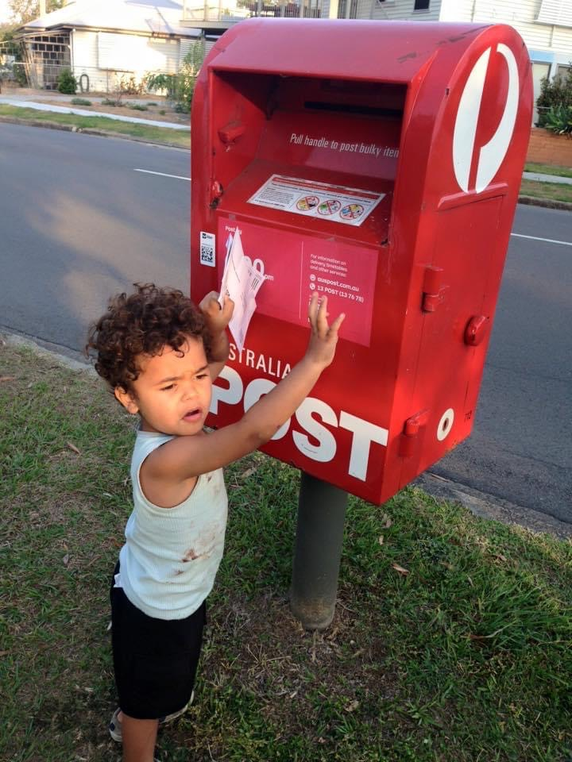
Easy accessibility checkers with Microsoft products
Right click on image for alt text
Flesch-Kincaid readability test

Slide 11
Easy English is a writing style that helps people who find it hard to read and understand English. It is simpler and has a lower reading level than Plain English. Easy English is also called easy-to-read or Easy Read. You’ll recognise this style as it uses short sentences with an image or picture.
Plain English is a direct style of writing for people who can read at a reasonable level. It helps people who want to read and understand information quickly. Plain English is sometimes known as plain language or Everyday English. Plain English looks and sounds like standard forms of writing.
Notes:
ABS 2013: Studies found 44% of Australians between the age of 15 to 74 are functionally illiterate.1 A functionally illiterate person cannot read or write above a basic level to manage their daily living needs or employment tasks.
Abs.gov.au. 2013. 4228.0 - Programme For The International Assessment Of Adult Competencies, Australia, 2011-2012. [online] Available at:
https://www.abs.gov.au/ausstats/abs@.nsf/Lookup/4228.0main+features992011-2012
EE: Low literacy, intellectual disability, ESL
PE For people with reasonable literacy skills, around Year 7 to 9 level (12 to 14 years of age). It is used to reach a general audience.

Slide 12
 | Easy English | Plain English
Other names | Easy Read, Easy Write, Easy Info, Easy Access, Easy to read, Aphasia friendly | Plain language, plain writing, layman terms, layperson terms
What is it? | Easy English is an accessible and alternative form of communication. It has a distinct format that is simple to read. | Plain English is a direct style of writing which is easy and quick to understand. Its goal is to make sure the audience can understand the information the first time they read or hear it.
Who is it for? | For people who have difficulties reading and understanding English. It helps people with: • low literacy • intellectual disabilities • English as a second language. | For everyone. It assumes reasonable literacy skills, around the Year 7 to 9 level.

Slide 13
 | Easy English | Plain English
Who else does it work for? | It is also helpful for people who: Experience a high cognitive load such as a CEO Want quick and summarised information | It should be your baseline style for all information based material, as its direct and to the point.
Key Features | • Short sentences • Simple, everyday words • Key information • Explains hard words • Dot points • Clear sections and headings • Images to support each point • Lots of white space • Large text size (14pt) No acronyms and abbreviations Images: photos preferred, must be clear and universally understood. | • Short sentences • Short paragraphs • Simple, everyday words, avoiding jargon • Clear sections of text • Headings which are easy to understand • Adequate white space

Slide 14
Targeting people with disability
Closed environments
Disability supported accommodation
Sheltered workshops
Support groups

Slide 15
Sample appointment letter easy English
https://cid.org.au/resource/resources-health-professionals-app-letter-eg/
Link to legal appointment letter QAI
Link to QAI resource

Slide 16
Resources
Council for Intellectual Disability
https://cid.org.au/inclusion-services/
Australian Human Rights Commission: Access for all
https://humanrights.gov.au/sites/default/files/AHRC_2016_GPGB_access_for_all.pdf
Centre for Inclusive Design https://centreforinclusivedesign.org.au/wp-content/uploads/2020/04/Easy-English-vs-Plain-English_accessible.pdf

