Slide 1
CLE Disclaimer
This presentation contains information prepared by WLSQ. Whilst all due care has been taken, we do not warrant or represent that the information is free from errors, omissions or that the information is exhaustive. Additionally, information that was accurate at the time of the presentation may become inaccurate at a later time without notice.
Viewers of this presentation are responsible for making their own assessment of the information and should verify all relevant representations, statements and information with their own professional advisers.
The discussion/stories of domestic and family violence may be triggering for some members of the audience. Please be mindful. If you wish to seek further support, please contact 1800 RESPECT (1800 737 732) or discuss it with us further.

Slide 2

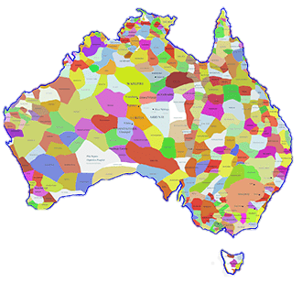
Acknowledgement of Aboriginal and Torres Strait Islander People
Notes:
I would like to respectfully acknowledging our Aboriginal elders – past present and emerging, for their role as the original custodians of the land and waters in the Brisbane region, the Jagera people of Brisbane South, the Turrbal people of Brisbane North and the people of Quandamooka on Moreton Bay and the bay islands.

Slide 3
Temporary Visa Pilot Project

Slide 4
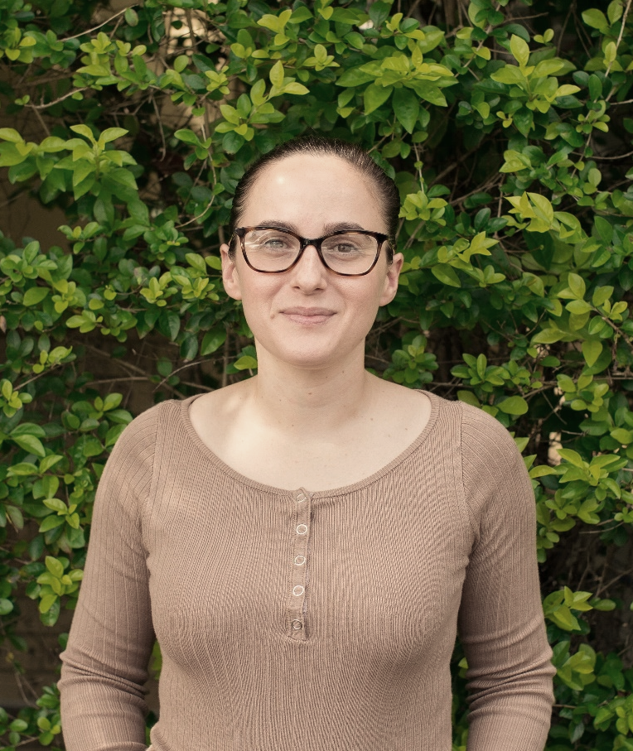
Jennifer McPhie
Domestic Family Violence Solicitor

Slide 5

Bunu Gautam
Migration solicitor

Slide 6
Introduction
Purpose: to deliver targeted support to women on temporary visas who are experiencing family and domestic violence.
This is an extension of the current local, State and Territory based, Emergency Relief.

Slide 7
Why the Pilot became essential
Temporary visa holders are particularly vulnerable because of:
Cultural differences;
Language barriers;
Social isolation; and
Fear of deportation.

Slide 8
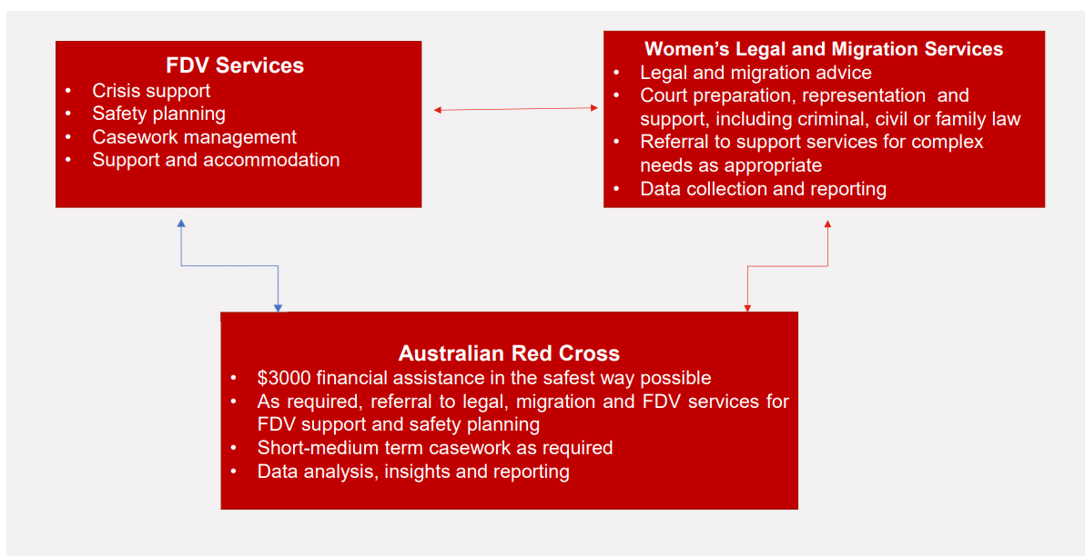
Pilot Framework

Slide 9
Family Violence Provision and Migration Law
FV provision was introduced in the Migration law in 1994
Protecting some DVF victims if they are
Holder of SC 300 visa and have already married to SP
Holder of SC309 visa if they are in Australia
Applicant for SC100 permanent visa
Applicant for SC820 and 801 visa in Australia
Holder of SC445- dependent child visa
Dependent of Global Talent visa SC858 visa

Slide 10
Temp Visa categories
Family violence provisions exclude all the following temp visa holders /their children
The pilot program includes advice and support as much as possible to the following visa:
ETA SC601
eVisitor SC651
Transit visa SC600
Prospective Marriage SC300
Parent (Temp) SC173
NZ Citizen Family SC461
Partner SC408
Sponsored Parent SC870
Contributory Aged Parent (Temp) SC884
Employer Sponsored Regional SC494
Work&Holiday SC462
Working Holiday SC417
Skilled Recognised Graduate SC476
Skilled Regional SC489
Skilled Work Regional SC491
Student Visa SC500
Student Guard SC590
Temporary Activity SC408
Temporary Graduate SC485
Temporary Work (Int. Relations) SC403
Temporary Work (Short Stay Specialist) SC400
Temporary Skill Shortage SC482
Visitor SC600

Slide 11
Other temp visa holders
are being left out
The number of domestic violence victims on temporary visas accessing the Red Cross scheme is increasing. Red Cross data shows:
2% March 2020
8.8% June 2020
10.4% September 2020

Slide 12
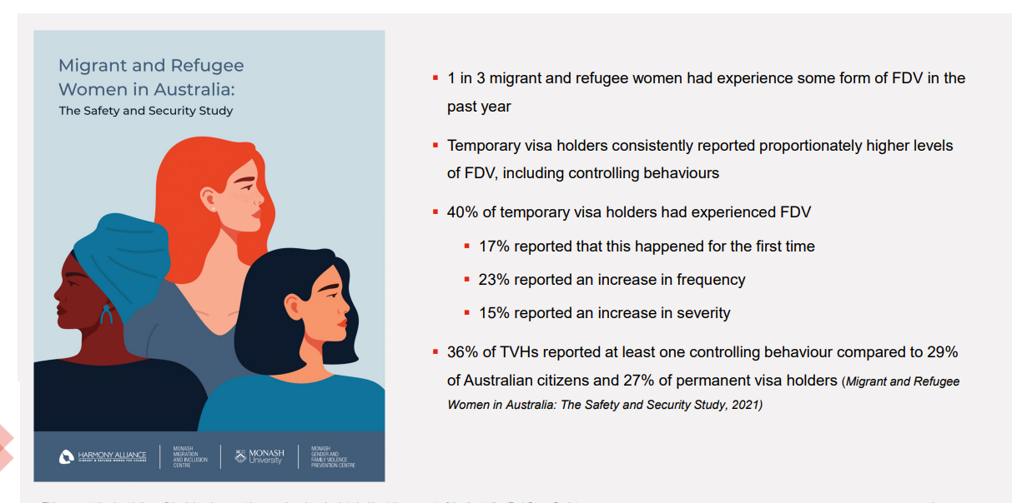
Evidence based research presented by Red Cross

Slide 13
Funding
Federal government announced 10m boost for support for temp migrants experiencing DVF
Funding provided via DSS to:
6.5 million - provided to Australian Red Cross (Red Cross)
To support people on temporary visas who are experiencing family and domestic violence
3.5 million - provided to nine Community and Women’s Legal Centres
- To access legal assistance and migration support

Slide 14
Referral Pathways
The program is available to all women:
On temporary visas or with uncertain visa status
Experiencing or at risk of FDV
In need of financial support
The support Red Cross is able to offer includes the following:
Financial assistance
Financial assistance with short-term support to assist with referrals to FDV organisations
Financial assistance with longer-term support (up to 3 months) where the client is not already working with a family violence service provider.

Slide 15
Pre-implementation of TVPP
By RAILS and WLS
Before end of Financial year 2021, funding announced for Pilot Program
Steering committee was formed between RAILS and WLS
Information sharing Policy and Procedure created
Worked through legal risk aspects and collaborative legal work
Entered into partnership agreement until end of June 2023
Referral process formalised

Slide 16
Referral Pathways
Client referral can be made directly into the TVPP program, instead of making referrals separately for WLS and RAILS
Complete referral form available on WLSQ Website:
https://wlsq.org.au/services/temporary-visa-holders-experiencing-violence-pilot-project/
You can also call WLSQ on 07 3392 0644 or email tempvisa@wlsq.org.au to request a copy of our referral form.
Completed referral forms to be sent to tempvisa@wlsq.org.au
Please note - Clients are not able to self-refer into the program. Any community support service or legal service (in which they are not being represented) is able to refer the client into the program

Slide 17
What work has been done?
Since launching in November 2021, we have assisted clients with:
more than 180 legal advices in Migration law and Family law/domestic violence matters.
14 Legal tasks
19 casefiles being opened.

Slide 18
Outcomes for Clients
DV/Family law casefiles | Migration law casefiles
Successfully assisting vulnerable clients with FCFCOA recovery order applications; Successfully assisting clients with getting final domestic violence Protection Orders; Attending mediations with clients; Assisting with the dismissal of a Police domestic violence protection Order against a client. | If client is on a partner visa pathway; obtaining permanent residency Assisting client get permanent residency based on whether there are: When client is not on a partner visa pathway, but is highly vulnerable and a victim of DFV, providing client with other visa options
Australian citizen children
Judicial Evidence (e.g. DVPO)
Non-Judicial evidence (e.g. Psychologist report, Doctors report, social workers report, hospital discharge summary etc)

Slide 19
Conflict of Interest
When we receive a new referral, a conflict arises for WLS when the other party in the referral has been previously associated with an existing WLS client.
A conflict arises for RAILS when either party in the new referral has been previously associated with an existing RAILS client.
In either of these circumstances, we would be unable to assist the client in the new referral and would refer that client to other relevant CLCs or Private Migration Agents
WLS and RAILS each do a conflict check in CLASS first, and, provided there is no conflict, the Temp Visa Paralegal then contacts the client.

Slide 20
Information Sharing
At the referral stage, the client is made aware that participation in the pilot program will give rise to information sharing on some occasions between WLS and RAILS.
After the client speaks to both Jen and Bunu, Jen’s intake goes into WLS CLASS, and Bunu’s intake goes into RAILS CLASS.
Chinese wall - WLS do not have copies of any of Bunu’s legal advices to clients and RAILS do not have access to Jen’s advice or case files.
Team meeting once per week between Jen, Bunu and Temp Visa Paralegal to discuss advice clients and casefile clients and other outstanding referrals.

Slide 21
Information Sharing- benefits
Benefits
Can streamline legal support processes and allow better collaboration between support agencies
Sharing can lead to better decision-making. For example, Jen may take a certain approach to a family law/DV matter (with the instructions of the client) after consultation with Bunu as to how to progress the migration matter.
Parenting matters can be best prepared when you know the prospects for the clients immigration matters. For example, we may know in advance to make an application for international relocation in the FCFCOA.
RAILS may be able to make an early assessment of the client’s prospects of success
Informed decision on how to proceed from the outset
application can be made with non-judicial evidence. The foundation of the client’s application can be built on an accurate and fulsome picture of the client’s circumstances.

Slide 22
Information sharing - challenges
Legal and professional obligations to client confidentiality.
Client privacy and safeguarding against breaches.
Client authority is needed at initial/advice stage of information sharing as well as at the representation stage. The client is made well aware that information sharing is a possibility and consent is always obtained prior.

Slide 23
Family law challenges
  Inability to get a Permanent Visa
  Hurdles in being able to get permanent when they separate from their husband/partner (and thus losing their visa sponsorship).
  This creates a further challenge when the other party is an Australian citizen/permanent resident and they have a child together.
  If the woman has no other visa options, they face a significant risk that they may have to relocate internationally without their child, unless they have the consent of the other party (which is extremely rare).
  We anticipate representing clients for international relocation matters in the Federal Circuit and Family Court so that women can relocate with their children. These cases are complex and international relocation orders are rare.

Slide 24
Family law challenges
Inability to Receive Centrelink/Work right due to Visa type
  There are certain visa types where women cannot receive Centrelink benefits and/or work right.
  This is a major hurdle for women staying in relationships with children despite experiencing domestic violence.
  If they leave, they have to find housing and financially support themselves and the child/ren.
  We have seen a number of matters where the other party does work for cash and therefore pay minimal child support.
  When/If they do leave, the other party argues that the Mother cannot adequately financially support the child.
  Applications for permanent residency and/or citizenship are extremely expensive and our clients are unable to afford this expense.

Slide 25
Family law challenges
  Jurisdictional Issues
  We have advised clients where the other party has begun divorce or property proceedings in their home country.
  We are unable to then advise regarding these proceedings and direct clients to receive advice from a lawyer in that country which may be at a cost.
  Or, on the other hand, clients have come to us for advice regarding divorce or property proceedings that they have already commenced in another country and they are unhappy with how they are proceeding. We cannot advise in those circumstances.
  Regional assistance
  Funding did not include funding for travel to regional areas for DV or FCFCOA Court appearances.

Slide 26
Domestic Violence Law Challenges
Inability to Receive Centrelink/Work due to Visa
This is also a domestic violence law challenge – women are staying in or returning to violent relationships due to not being able to financially support themselves and/or the child/ren.
Language Barriers
We have seen women file domestic violence order applications that have deficiencies as they did not have support in writing them. This may mean that whilst they may deserve an urgent ex parte Order, they aren’t getting them. This is a significant safety issue if the parties are still residing together.

Slide 27
Domestic Violence Law Challenges
Cultural Differences
We have also seen women excusing violent and controlling behaviour due to it being acceptable in their culture.
This has seen women wanting police Applications for Domestic Violence Orders withdrawn or being coerced in trying to get them withdrawn. Or the order not being followed by the respondent.
In some cultures, our clients will be reliant on the other party’s family for support both with the children and financially and will then feel ‘guilted’ into withdrawing domestic violence order applications. Even when the families are not in Australia.
We have also noticed a pattern of clients wanting to get rid of their final Domestic Violence Orders due to limited family support and connections in Australia. They rely on the other party for that connection.

Slide 28
Migration Law Challenges
Lack of knowledge about visa and process.
Evidence hard to access because of social isolation and sponsor control over documents and finances.
DHA strict deadlines.
Risk of visa cancelled or refused if misleading information, even if didn’t know.
Abusive partners often use false threat of deportation to control.
Notes:
Abusive partners often use a threat of deportation or threat of take custody of dependant (Australian citizen) children as a control tool.
Client needs to be reminded that a sponsoring partner is never the decision-maker– The Dept makes the decision if you fit the criteria for a visa.
Applicant’s remain vulnerable until permanent residency is approved as there’s limited access to financial and housing support

Slide 29
Migration law Challenges
Only applicant’s on Partner visa pathway and dependent of distinguish talent visa have permanent visa pathway
Temporary visa holders can’t exercise Family violence provision
  May end up with initial advice or two or to find other visa options
Lack of finance - not able exercise desired options
Often end up being sad after the advice
May end up staying in an abusive relationship
No access of Medicare, Centrelink and housing
Need to deal with clients’ emotions and sadness

Slide 30
Challenges along the way
Women that we can’t help – E.g. different jurisdiction (Victoria) because the other party has filed there but the client is in QLD.
Funding for travel for hearings – cannot assist with casework for clients in most regional areas.
Capacity issues – unable to take on every client as a casefile. Need to consider their prospects of success
Managing client expectations about the assistance we can provide as a CLC

Slide 31
Managing Challenges
Doing best to assist as much as possible
Legal tasks and legal representation
Liaising with DHA DVF unit to progress visa application
Referring clients to other relevant services

Slide 32
Positive Feedback from Clients
“Hello,
I realized I forgot to respond last month to let you know the court granted the protection order. I submitted the PO to Home Affairs and they had me create a new account. A few days ago they emailed me to ask for the application the police made for a PO on my behalf. I emailed them a copy of the documents the courts gave me.
Last night Home Affairs sent me an 801 grant letter.
I didn't really believe it, but I did a VEVO check and, sure enough, I'm a permanent resident. I wish I could celebrate, but it feels really sad to be on a permanent partner visa with no partner.
Thank you WLS and RAILS, for the support. While I hope I never need your help again, I am grateful you were there for me when I needed assistance and reassurance.”

Slide 33
Joint Case Study 1
E was in a domestically violent relationship with S. E and S have 2 young children together. E fled the relationship with the assistance of the Police to a refuge with the children. The Police made an application for a DVO for E seeking a number of conditions. E is on a temporary visa and S is an Australian citizen. S applied to the FCFCOA for an urgent recovery Order. E was distressed around this and the impending court date. E was also stressed around the status of her visa now that she is separated from S.
The pilot assisted E with filing her material and representation in the FCFCOA. RAILS assisted E to get her application for permanent residency approved. Without the assistance of the pilot it is likely E would have had to self represent in the FCFCOA and her visa status may have been in limbo for some time without a proper representation. E now lives safely with her children without the threat of deportation.

Slide 34
Joint Case Study 2
A was referred to the pilot as she was experiencing DV by D, they have a child together and she was on a bridging visa. A spoke very limited English and required an interpreter. A had experienced domestic violence by D and had a final DVO in place protecting her and the child.
The pilot assisted A with successfully getting permanent residency and negotiating parenting matters and a property settlement. Given A’s language barriers, it is unlikely she would have achieved this outcome in a timely manner without the assistance of the pilot.

Slide 35
Perspectives from front-line lawyers
Increased understanding of the vulnerabilities of women on temporary visas experiencing family violence
Increased understanding the barriers they face in leaving a violent relationship
        Language barriers
        Isolation
        lack of support system in Australia
        Little or no working rights
    Lack of migration law pathways if not already on Partner visa pathway
    Financial barriers to obtaining legal advice
    Threats by PUV/visa sponsor to have victim deported
    Safety concerns when PUV/Visa sponsor manages phone and email
Collaboration with support workers

Slide 36
Key tips if you want to support victims of FV
Be
aware that context and culture may be different – don’t assume or stereotype.
Work
with cultural community groups. Contact community organizations.
Find
legal information in relevant languages.
Use
interpreters when needed.
Use
Plain English.

Slide 37
Law Reform Recommendations
  Immigration law reform is essential to fill the gap for clients that are unable to access FV Pathway to Permanent Residency
  Provide legal provisions to all victims of domestic violence, regardless of the types of visa they hold. This ensures that safety of women and children are made priority
  Provide permanent visa for women who hold a temporary visa but have Australian Citizen Children
  Australian Government needs to allocate more funding to increase volume of casework assistance

Slide 38
Reminder of Referral Pathways
Client referral can be made directly into the TVPP program, instead of making referrals separately for WLS and RAILS
Complete referral form available on WLSQ Website:
https://wlsq.org.au/services/temporary-visa-holders-experiencing-violence-pilot-project/
You can also call WLSQ on 07 3392 0644 or email tempvisa@wlsq.org.au to request a copy of our referral form.
Completed referral forms to be sent to tempvisa@wlsq.org.au
Please note - Clients are not able to self-refer into the program. Any community support service or legal service (in which they are not being represented) is able to refer the client into the program

Slide 39
Any questions?

