Slide 1
knowmore Legal Service
Presenters
Aunty Glendra Stubbs: Aunty/Elder in Residence
Fiona Rigney: Senior Aboriginal and Torres Strait Islander Engagement Advisor
Trish Johnson: Aboriginal and Torres Strait Islander Engagement Advisor (QLD)
John Brady: Aboriginal and Torres Strait Islander Engagement Advisor (QLD)
Jade Johnson: Interim Practice Lead for the Territories Stolen Generations Redress Scheme (TSGRS)
Notes:
Acknowledgement of triggered staff can access these numbers:

Slide 2
Acknowledgment of Country

Slide 3
Content warning
This presentation contains references to child sexual sexual assault. As such, some of the content may be disturbing, upsetting or trigger strong negative feeling for survivors of violence and trauma, and people who work with those survivors.
If you feel triggered or upset by anything in this presentation, we encourage you to use your discretion as to whether you continue watching or listening to this material.
In the event that you need to seek support, the following organisations can help:
Lifeline Australia: 13 11 14
1800RESPECT: 1800 737 732
Blue Knot Foundation: 1300 657 380

Slide 4
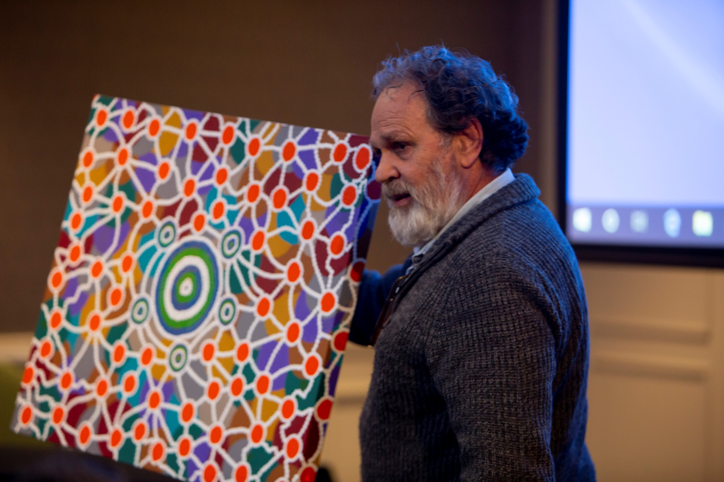

Slide 5
knowmore Legal Service Limited | ABN 34 639 490 912 | ACN 639 490 912. knowmore is funded by the Commonwealth Government, represented by the Attorney-General’s Department and the Department of Social Services, and receives additional funding from the Financial Counselling Foundation.
Image inspired by original artwork by Dean Bell depicting knowmore’s connection to the towns, cities, missions and settlements within Australia.

Slide 6
knowmore Legal Service
knowmore is a free and independent community legal service that provides legal advice and support to survivors of child sexual abuse across Australia.
knowmore is a trauma-informed and culturally-safe service.
knowmore was initially established during the Royal Commission into Institutional Responses to Child Sexual Abuse 2013-2017 to provide specialist legal advice and support to survivors of institutional child sexual abuse.
knowmore has offices in Melbourne, Sydney, Adelaide, Brisbane and Perth

Slide 7
Telling others about the abuse
Many survivors said that speaking up about what happened to them was difficult and not a one-off event. Talking about their experience involved telling parents, partners, families, friends and institutions at different stages of their lives. For those we heard from, it took an average of almost 24 years to tell somebody they had been sexually abused as a child.

Slide 9
Cultural Safety for Aboriginal and Torres Strait Islander People and Communities
Knowledge and understanding about the complexity and impacts of trauma on Aboriginal people, families and communities
Respect for cultural protocol
Specialist Aboriginal Engagement Advisers

Slide 10
Our multidisciplinary approach
Aboriginal and Torres Strait Engagement Advisors
Ensure cultural safety before, during and after legal appointments and the application process.
This may include providing cultural support for clients before, during or after any appointments (legal advice, financial counselling support team) and/or literacy support to read any related documents.

Slide 11
Our multidisciplinary approach
Support Services Team
Prepares people for their legal appointment
Provides support during and after legal appointments
Provides short-term counselling and support to people when speaking to a lawyer
Provides information and advice about ongoing counselling and other local support options in a person’s community

Slide 12
Our multidisciplinary approach
Financial counsellors
Can help anyone considering or applying for Redress with:
understanding the implications of a payout
managing a lump sum
financial hardship support and referrals to other services

Slide 13
Panellist
Aunty Glendra Stubbs: Aunty/Elder in Residence
Fiona Rigney: Senior Aboriginal and Torres Strait Islander Engagement Advisor
Trish Johnson: Aboriginal and Torres Strait Islander Engagement Advisor (QLD)
John Brady: Aboriginal and Torres Strait Islander Engagement Advisor (QLD)
Jade Johnson: Interim Practice Lead for the Territories Stolen Generations Redress Scheme (TSGRS)

Slide 14
Contacting knowmore
Call our intake line on 1800 605 762
Email adminmelbourne@knowmore.org.au
Website: www.knowmore.org.au

Slide 15
Questions?

