Slide 1
Predictable miscommunication: improving legal communication with people who speak English as an additional language
Ben Grimes, 11 May 2022
Ben.grimes@ards.com.au

Slide 2
‘First language interference’
A person’s first language will influence how they speak and understand a second language

Slide 3
‘Contrastive Analysis’
Aboriginal languages
English

Slide 4
Levels of language
Phonology (sounds)
Semantics (words)
Syntax (grammar)
Discourse (conversation, stories, logic)

Slide 5
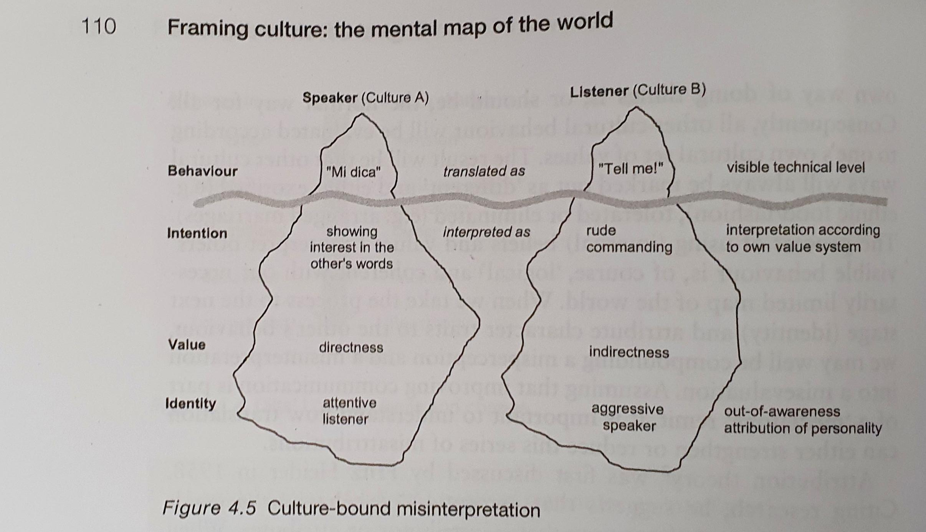

Slide 7
Research design
82 - L1 English speakers
117 – L1 Chinese Mandarin speakers (all enrolled in English language programs at 3 American universities)
66 – L1 Arabic speakers (all enrolled in English language programs at 3 American universities)
All but 4 of the L2 participants had taken English proficiency tests and scored in the advanced – superior range.

Slide 8
Methodology
Task 1 – listening and dictation. Participants listened to a mixture of simple and complex sentences, and wrote down what they heard.
Task 3a – recall (listen and repeat orally)
Task 3b – listen and paraphrase in own words (one sentence at a time)

Slide 9
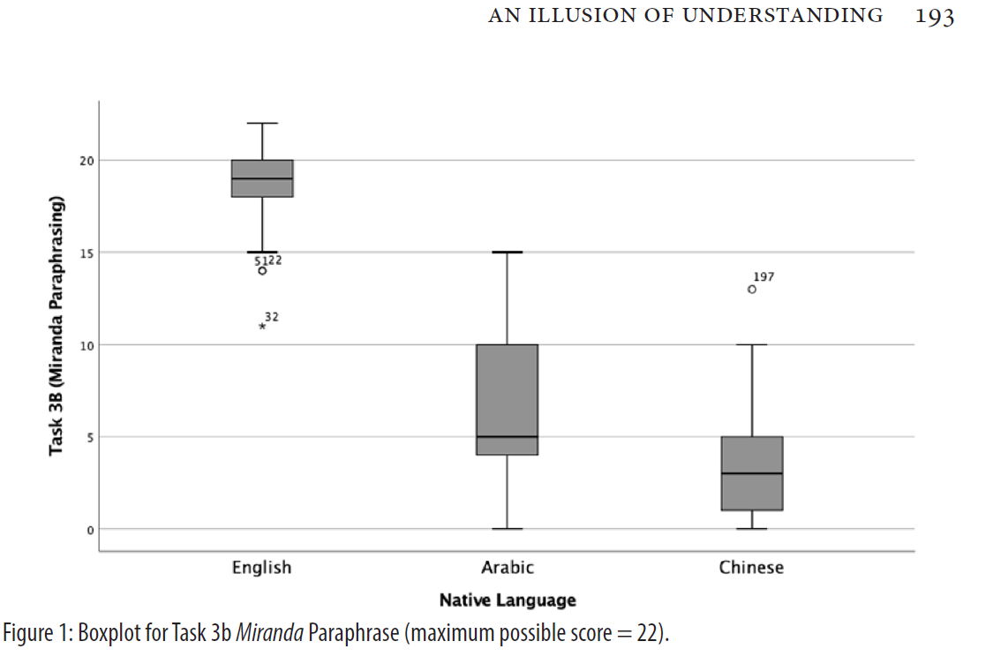

Slide 10
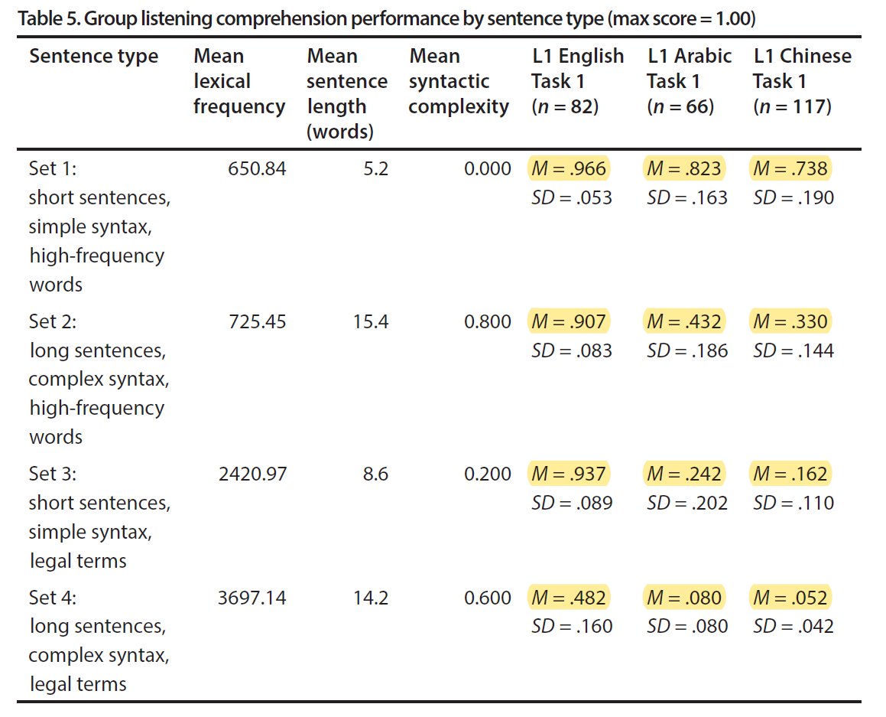

Slide 11
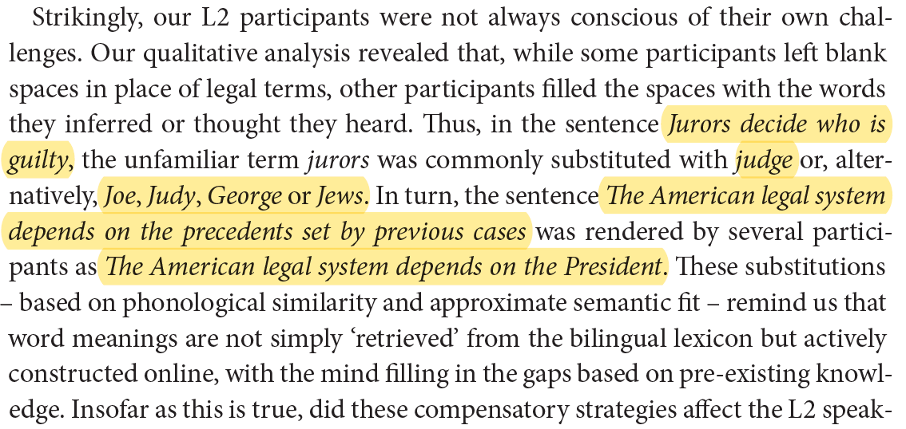

Slide 12
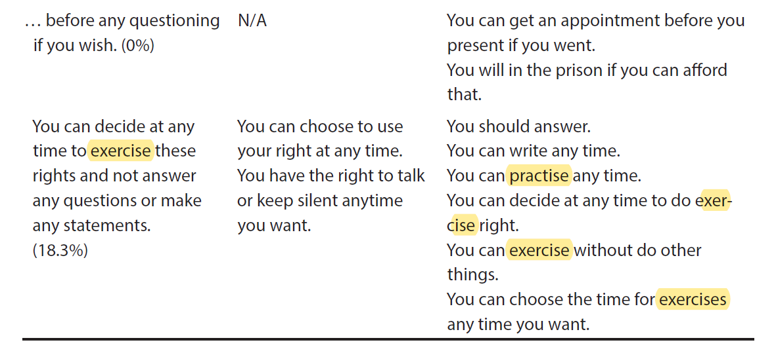

Slide 13
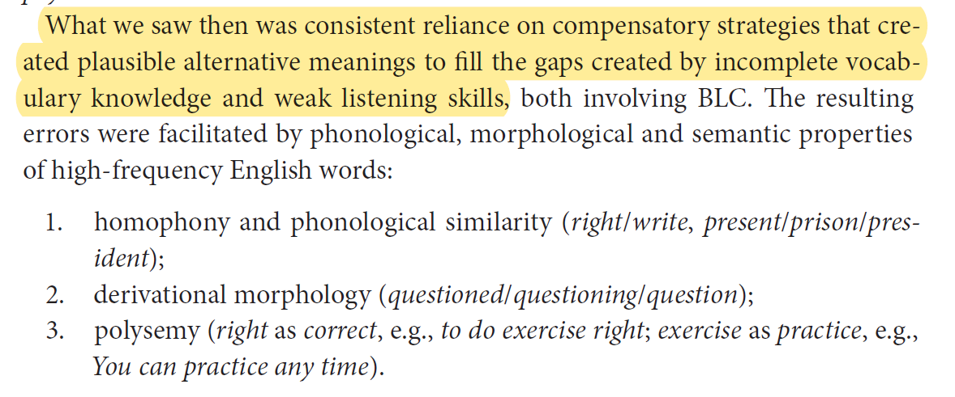

Slide 14
Incidental findings
Increased contact with the criminal justice system does not correlate with increased understanding of rights (>40 arrests did not have greater comprehension than <5 arrests).
Police would increase rate of speech when delivering the caution (average 262 words per minute, compared with 198 wpm in average conversation).
The upper range of most L2 speakers of English is 150-200 wpm.

Slide 15
Language and cognitive load
We become mentally fatigued at a quicker rate when interacting in a second language (approx. 3 times the cognitive load)
https://education.nsw.gov.au/about-us/educational-data/cese/publications/literature-reviews/cognitive-load-theory

Slide 16
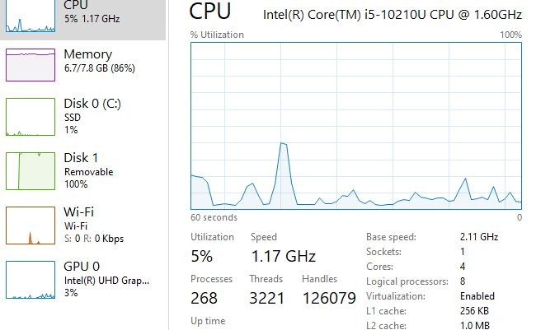

Slide 17
Proficiency can be uneven
“[There is] a tendency in all of us to assume that as we may understand a person who is talking in his second language in a simple conversation in English, his understanding of our conversation is reciprocal.”
- per Muirhead J, R v Jabarula (1984) 11 A Crim R 131 at 137.

Slide 18
Language proficiency is a spectrum
Per Kirby P in Adamopoulos v Olympic Airways SA (1991) 25 NSWLR 75 at 77-78.

Slide 19
1-in-4 exercise (Indonesian)

Slide 20
To what extent can we predict intercultural miscommunication?

Slide 21
Levels of language
Phonology (sounds)
Semantics (words)
Syntax (grammar)
Discourse (conversation, stories, logic)

Slide 22
Different sound systems
z, s, ch, sh → dj/tj
p = b
k = g
t = d
v, f → p/b

Slide 23
Bought = port = bot = pot = board = poured
See Andy Butcher, ‘Linguistic aspects of Australian Aboriginal English’ (2008) 22:8 Clinical Linguistics & Phonetics 625, 628.

Slide 24
Consider a client’s accent as a factor that contributes to unconscious bias.

Slide 25
Words
Words with no close equivalent
Words with partially overlapping meaning
Words with multiple meanings

Slide 26
Ordinary words with multiple meanings
Did you take your medicine?
Are you happy with these conditions?
You can leave after you see the lawyer.
Your nose is running.
How did you feel when she said that?
He was charged.

Slide 27
Buma (v)
Kill (v)
Murder
Hunt
Cause death
Weave
Pinch (a child)
Dolphins jumping
Cause death
Hit

Slide 28
Dia
She
He

Slide 29
Some examples of Aboriginal English terms with different meanings (NT)
Cheeky
Force
Half, half-way
Stop, stopping
Business
Poison
Fight
Country
Relationship terms (mum, dad, auntie etc)
Kill
Deadly
Shame

Slide 30
Common problem words; partial overlap or no close equivalent
Can / Will
If / when
→is allowed →might →has power to →will
→maybe…maybe…

Slide 33
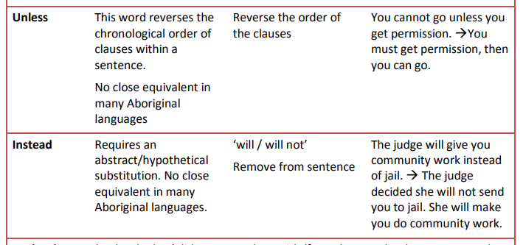

Slide 34
Grammar - Wangurri
Ga milmitjpayim ŋanapiliŋgu
And afternoon-became our/for us (ex)
wapthunma ŋanapu, ŋaykaman ŋanapu,
hop we (ex) go we (ex)
bus-ḻim ŋanapu ŋal’ŋalun bala ŋaykaman
bus-to we (ex) climb then go
ga ŋanapu dhiŋgiŋ’ yana-warri
and we (ex) thinking only-contra
bitjan, “Galki,” bitjana.
like this, “Close,” like that.

Slide 35
Meaning based translation:
And in the afternoon, we hopped (off the plane) and walked to the bus. We climbed on it and went on our way. And we were thinking, “We’re close!” But we were wrong.
- example courtesty of Dr Marilyn Mclellan, ARDS

Slide 36
Warlpiri
“You were sentenced to 18 months imprisonment, suspended after 12 months, with an operational period of 2 years.”
Yilyajangku magistrate-rli jalangu jail-kirra.
Sent-you [the] magistrate today jail-to.
Kapunpa nyina 12 months-ki, ngula-jangka kapunpa wilypi-pardimi.
You will stay for 12 months, after that you will exit.
Ngula-jangkaju, ngurrju-nyinaya jirrama year-ku.
After that, be good for 2 years.
Nyampu jirrama year-puru, kajinpa rdilyki-pinyi law jirrama year-puruju, kapunpa pina yukami jail-kirra 6 months-kariki.
During these 2 years, if you break the law during the two years, you re-enter jail for another 6 months.

Slide 37
“The offender is currently unsuitable for supervision because she has failed to demonstrate an understanding of what supervision would involve. She has a history of non-compliance with orders of the court and a disregard for authority.”
Kulalparnarla nyampuku rdujuku yungkarla order. Nyiya-jangka-wiyi?
I cannot give this woman a order. Why not?
Panu-karirli magistrate-rlu yungu-lurla kamparrurlu-wiyi panu order-patu.
Many magistrates previously gave her many orders.
Kula-ka jungangku milya-pinyi order nyampu-patuju. Manu kula kajana linpangku purda-nyanyi.
She doesn’t truly understand these orders. And she doesn’t obey them.
Wilji-nyayirni nyampuju mina-nyayirni!
She’s persistently belligerent and contemptuously defiant [of the magistrates orders]!
Examples courtesy of Steve Swartz, Aboriginal Interpreter Service

Slide 38
Grammar
passives
tense
Prepositions to talk about time
cause & effect
Negative questions
nominalisation (abstract nouns)

Slide 39
Passives
Her car was stolen.
Someone stole her car.
She was sentenced to imprisonment.
The judge sent her to prison.

Slide 40
3 problems with passives
1. grammatically not possible in some languages
2. Hearer attaches verb to the wrong person; ‘She was assaulted.’
3. Requires hearer to supply missing information; hearer may incorrectly supply missing information. ‘Your application was rejected.’

Slide 41
Abstract nouns
His anger led him to violence.
He was angry. That is why he became violent.
Poor management resulted in insufficient housing.
[The government] did not manage this properly. That is why there are not enough houses.

Slide 42
Cause and effect
She went to hospital because she was sick.
She was sick. So [that is why] she went to hospital.
She saw a lawyer because she had legal problems.
She had legal problems. That is why she talked with a lawyer.

Slide 43
Prepositions to discuss time
Your contract is under review.
They are deciding about your contract.
The course runs from Monday to Wednesday.
The course starts Monday morning and finishes Wednesday afternoon.
(the managers are deciding about giving you a work contract. Next week they will tell you what they decided.)

Slide 44
Negative questions
You never reported, did you?
Did you report?
She was angry, wasn’t she?
She was angry. Is that true?

Slide 45
Tense (and aspect)
I work.
I worked.
I will work.
I did work.
I do work.
I have worked.
I will have worked.
I was working.
I am working.
I will be working.
I had been working.
I have been working.
I will have been working.
www.nt.gov.au/ais

Slide 46
Tense (and aspect)
I work.
I worked.
I will work.
I did work.
I do work.
I have worked.
I will have worked.
I was working.
I am working.
I will be working.
I had been working.
I have been working.
I will have been working.
www.nt.gov.au/ais

Slide 47
“You are going to be imprisoned for 3 months because you didn’t comply with your orders.”

Slide 48
“You are going to be imprisoned for 3 months because you didn’t comply with your orders.”
→
“[Last year] the judge gave you rules to follow. You did not follow those rules. That is why today I am sending you to jail for 3 months.”

Slide 49
There is no way that you can be allowed to attend that funeral. You should accept this reality and focus on dealing with your anger issues.

Slide 50
There is no way that you can be allowed to attend that funeral. You should accept this reality and focus on dealing with your anger issues. →
I will not give you permission to go to that funeral. You cannot change what I have decided. The best thing for you is to think about the things that will help you become less angry. [there is a program that will help you].

Slide 51
A person is guilty of contempt of the court if they do not, in the face of the court, comply with a lawful direction of the court.

Slide 52
A person is guilty of contempt of the court if they do not, in the face of the court, comply with a lawful direction of the court. →
There is a law called contempt of court. This law says that a person in a courtroom must obey what the judge tells them to do. A person who does not obey what a judge tells them to do in a court room might be breaking the law and the judge might punish them with a fine or time in jail.

Slide 53
“Before you can leave, you need to sign your orders.”

Slide 54
“Before you can leave, you need to sign your orders.”
→ “You must sign your name on that paper, then you are allowed to leave the court building.”
“The court orderly will write these rules on paper, called your ‘order’. You must sign your name on that paper. [When you sign your name, you are promising to follow those rules.] After you sign your name, you are allowed to leave [the court building].

Slide 55
“You were sentenced to 2 years imprisonment, suspended after 12 months, with an operational period of 18 months.”

Slide 56
“You were sentenced to 2 years imprisonment, suspended after 12 months, with an operational period of 18 months.”
→
“Today I am sending you to jail for 12 months. After that, you will come out of jail. After you come out of jail you must [follow these rules / not break the law] for 18 months. If you break the law/rules during those 18 months, you will come back to court. A judge will decide about sending you back to jail for 12 months, or maybe longer.”

Slide 57
“There are 4 things you must remember/understand;
1. How long you are going to jail for, starting today.
2. what rules you must follow after you come out of jail.
3. How long you must follow those rules.
4. How long you might go back to jail for if(when) you break any of those rules.”

Slide 58
“You can only go to the football game if the corrections officer approves it.”

Slide 59
“You can only go to the football game if the corrections officer approves it.”
→
“You must ask the corrections officer about going to the football game. Maybe she will say yes, maybe she will say no. You must do what she says.”

Slide 60
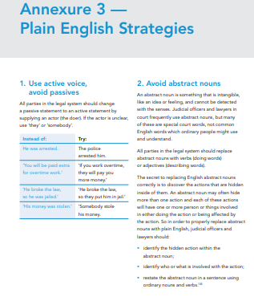
Additional resources

Slide 61
Factors contributing to linguistic vulnerability in the legal system
L1 – dominant v non-dominant language
Language family – closeness to English
Similarity of home legal system to Aust legal system
Understanding and assertiveness re language rights
Availability of professional interpreters
Availability of legal education resources

Slide 62
Some linguistic considerations
‘National’ language
‘minority’ language
Standardised language variety
‘non-standard’ variety

Slide 63
https://www.scmp.com/infographics/article/1810040/infographic-world-languages

Slide 64
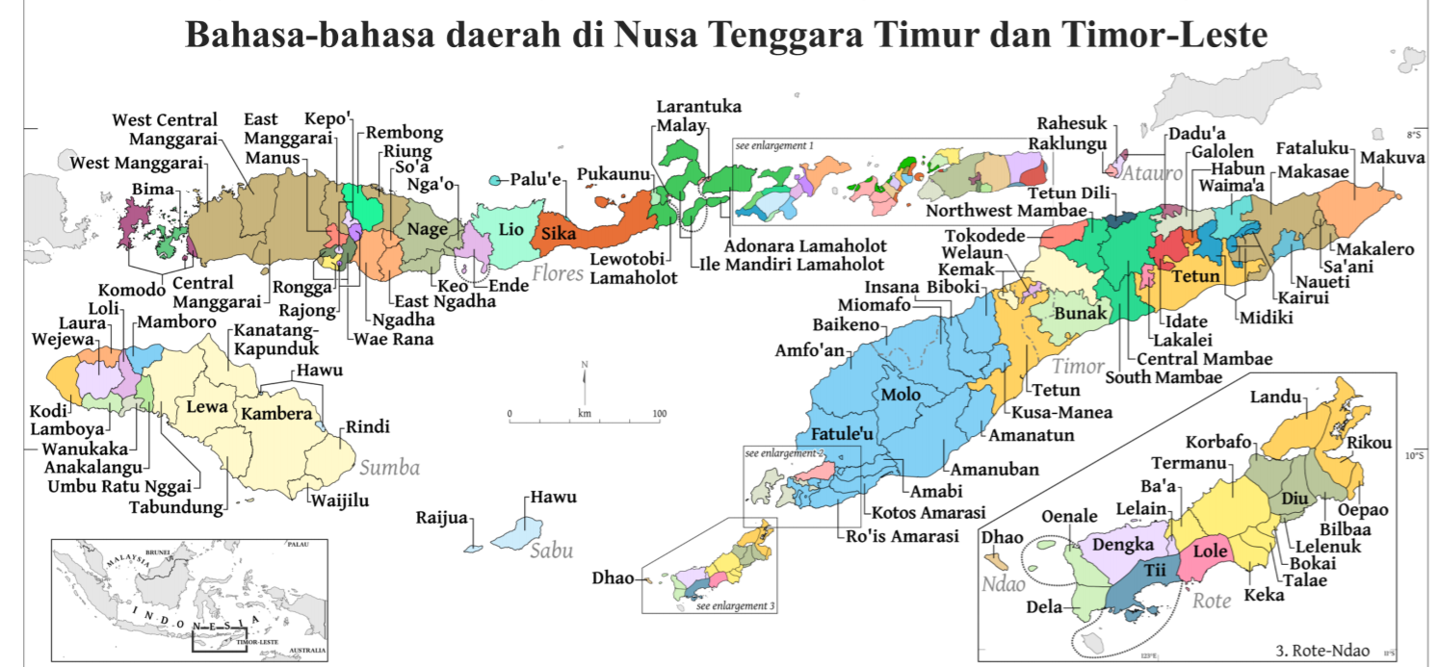
A fairly typical ‘language profile’
https://ubb.or.id/download/peta-bhs-ntt-tl/

Slide 65
A fairly typical ‘language profile’
Local language
Regional trade language
National language
Dela
Kupang Malay
Indonesian

Slide 66
Identify potential communicational vulnerabilities
French
Japanese
Dela
Yumplatok / TS Creole
Aboriginal English

