Slide 1
Tenants Queensland 2022 Flood Response
A chronological Community Education report

Slide 2
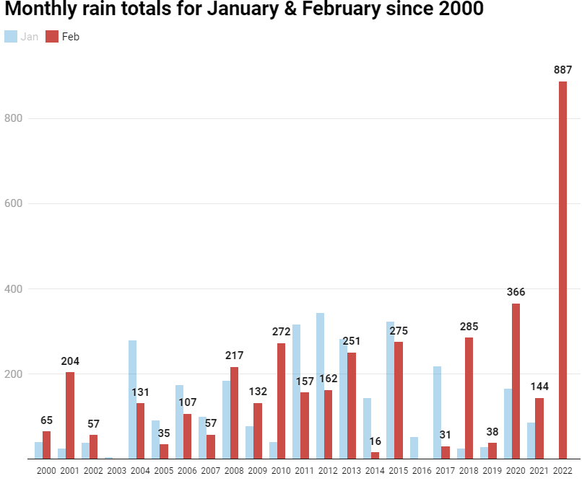
887 Millimeters of rain for February 2022
Premier Annastacia Palaszczuk said on March 1. In three days alone, Brisbane received 80 per cent of its annual rainfall

Slide 3
The affect
Brisbane:
Approximately 2,770 streets were impacted by floods.
129 suburbs (35 more than 2011) out of Brisbane's 188 suburbs were affected by the floods – more than 68 per cent of Brisbane suburbs.
Logan:
147 streets were impacted by floods.
59 suburbs out of Logan's 70 suburbs were impacted by the floods – that's more than 84 per cent of Logan suburbs.
Ipswich:
All across the city were impacted, but particularly the suburbs of Bundamba, Churchill, Goodna, North Booval, Karalee, Barellan Point, Raceview, West Ipswich, One Mile and Sadlers Crossing.
Moreton Bay:
Approximately 400 streets were impacted by floods.
The council said every suburb, all 94, were impacted by the floods, either by "inundation, flooding, road closures or power loss" in Moreton Bay.
Gympie:
Approximately 29 suburbs were affected by the floods.
Approximately 20 main road and 28 local government area roads were impacted by the floods - more than 100 roads and bridges went under due to flash flooding.

Slide 4
The affect
Brisbane:
23,200 residential homes and commercial properties were impacted by the floods.
Logan:
265 homes and 54 businesses were impacted by the floods.
Ipswich:
890 properties were impacted by the floods, 214 are classified as having severe damage.
Moreton Bay:
200 homes and more than 120 businesses were impacted by the floods.
Gympie:
246 properties were inundated and declared uninhabitable after severe damage, and 98 properties had moderate damage.

Slide 5
The response –
Step 1 – Information an outreach
The immediate response was to provide information
Information for Tenants affected by floods and storms in QLD fact sheet was reviewed and updated to be placed on the TQ website.
Additional information on support available to those affected by flooding was added to the website, this was not just focusing on tenancy advice
Our goal was to provide targeted and up to date information to those affected by the floods
BNC Staff members attended both Chermside and Chandler Evacuation Centers as they opened to speak with staff and tenants affected by floods.

Slide 6
Examples of Information
Information on available Evacuation centers – On February 28th - 26 Evacuation centers were listed across SEQ – This increased to 30 and 15 places of refuge by March 1st.
THE FOLOWING EXAMPLES OF INFORMATION AND LINKS FOR SUPPORT ADDED INCLUDE
Mud Army 2.0 | Brisbane City Council
Available grants offered through Queensland Government – Services Australia
Financial relief from Banks and financial institutions.
List view of affected roads – QLD Traffic
Australian Government Disaster Recovery Payment - Services Australia
Recovery Connect | Recover from a Flood information provided by Service Connect)
Disaster recovery replacement certificates | Queensland Government (www.qld.gov.au)
Replacing lost or destroyed documents | Queensland Government (www.qld.gov.au)
Housing help after a disaster | Homes and housing |) | Queensland Government (www.qld.gov.au)
Emergency hardship assistance | Community support | Queensland Government (www.qld.gov.au)
Returning to affected buildings | Community support | Queensland Government (www.qld.gov.au)
Utilities contacts | Emergency services and safety | Queensland Government (www.qld.gov.au)
Home - Disaster Dashboard (logan.qld.gov.au)
Food Safety During Power Outages

Slide 7
Step 2 – Planning and DATA
To assist those tenants flood affected across SEQ. Research was conducted to identify all flood affected locations across SEQ. These locations/suburbs were then broken into Region/ Local Government areas .
Using the Rental Vulnerability index a list of the total number of rental dwellings within flood affected areas was developed by entering each flood affected suburbs post code into the RVI
The total number of rental dwellings was compared against the list of the suburbs that had been flood affected .
The purpose was to focus on most affected suburbs, location with highest rental tenancies, to then priorities our engagement
Some of the Local Government areas had been completely flood affected so we could assume that those areas were in high need of support

Slide 8
The total listing of rental dwelling of the floods affected area of the Logan Local Government Area | Bannockburn Beenleigh Buccan Carbrook Cedar Creek Cedar Grove Chambers Flat Cornubia Daisy Hill Eagleby Flagstone Glenlogan Greenbank Jimboomba Kingston Logan Village Loganholme Marsden Meadowbrook Mount Warren Park Mundoolun Munruben New Beith North Maclean Park Ridge South South Maclean Stockleigh Tamborine Waterford Waterford West Windaroo Wolffdene Yarrabilba | 19587 19587 19587 1042 19587 4983 6680 1042 8496 19587 2665 2665 3954 2665 15485 15485 1761 12062 5043 19587 4983 1088 3954 2665 1088 2664 2664 400 6680 6680 19587 19587 19587

Slide 9
During the engagement planning stage ,evacuation centers began closing and the announcement of Recovery HUBS opening began on March 4 ,updated regularly as more Recovery HUBS opened.
South East
Beenleigh pop-up hub
Beenleigh PCYC, 20-38 Alamein St, Beenleigh
9am to 5pm, 7 days a week
Jimboomba pop-up hub
Caddies Community Centre, 19-33 South St, Jimboomba
9am to 5pm, 7 days a week
North Coast
Caboolture
Level 1 of the Learning and Business Centre, Caboolture Town Square, 4 Hasking St, Caboolture
9am to 5pm, 7 days a week
Gympie
Gympie Civic Centre, 32 Mellor St, Gympie
9am to 5pm, 7 days a week
South West
Ipswich
Ipswich Trades Hall, 4 Bell St, Ipswich
9am to 5pm, 7 days a week
Goodna

Slide 10
Step 2 – Engagement planning
Data collected that highlighted most affected areas, plus the opening of Recovery HUBS provided the areas for the engagement focus to be.
Organisational Statewide correspondence and planning with all the Tenants Queensland Regions affected for proposed strategies regarding:
Roster / list / dates and times etc. some advice workers / community education workers could attend and work from these recovery centers
Liaison with QSTARS Partners and seek their support and input to providing QSTARS services at these recovery centers also?
Arranging for sufficient TQ QSTARS Fact Sheets, Flyers and Direct Referral Forms for distribution to all centers
ENGAGEMENT WITH COMMUNITY RECOVERY HUBS WAS BROKEN INTO 3 STAGES

Slide 11
Stage 1- March 1 - 11
Important to understand that the recovery HUBS were very crisis responsive initially, so our initial response was that of introduction and information dissemination
Community Education staff attended as many Community Recovery HUBS AS POSSIBLE. The objective was to meet with the team leader/manager of the Community HUBS -
Provide TQ QSTARS resources, flood fact sheets and information to staff at the Community recovery HUBS.
Which lead to impromptu community education sessions, where Community Recovery HUB staff were provided an overview of the TQ QSTARS service

Slide 12
Stage 1 CONTINUED
TQ QSTARS Southern QLD Community Education worker established contact with Executive Director/s with The Department of Communities, Housing and Digital Economy. Resulting in efficient and effective distribution of QSTARS resources to all Community Recovery HUBs.
By March 7th there were 18 recovery Community Recovery HUBS operational
Tenants QLD QSTARS Community Education staff visited and provided resources and information to 12 Community Recovery HUBS during the period of March 1 - 11

Slide 13
Stage1 Continued
The dissemination of TQ QSTARS resources and flood resources to Community/Neighborhood Centre's in flood affected areas was identified as a priority. Community Education staff contacted Community Centres across the affected regions, discussing with staff if flood affected tenants were presenting and offering resources. An example of centers contacted by the Brisbane North Community Education worker includes but is not limited to,
Aspley Care
Gurudwara Singh Sabha – Taigum
New Farm Neighbourhood Centre
Belong Community Centre
St David's Neighbourhood Centre Coopers Plains
Wynnum Community Centre

Slide 14
Stage 2 March 21 -30
TQ identified the need to revisit and attend Community Recovery HUBS, to again speak with staff regarding TQ QSTARS and flood support.
The initial state of crisis had passed, and we believed now would be the moment where people would require Tenancy support and or information.
( Staff changes at Recovery HUBS meant that that re-engagement with new staff was required,)
To provide additional resources, discuss Tenancy issues, gather contact details for further digital resources dissemination and discuss any further support TQ could provide.
Revisiting the Community Recovery HUBS again provided the opportunity for spontaneous Community Education information session on TQ QSTARS.
10 Community Recovery HUBS were revisited
We received information that flood affected individuals and families were presenting to Housing Service Centres. There was a need TQ QSTARS Community Education staff to visit the HSC’s meet with staff to gather information on presenting flood tenancy issues, themes, how we can assist staff and tenants and to provide the Housing Service Centres with resources.
5 Housing service centres were visited.
The Tenants Queensland Dealing with Mould fact sheet was developed and uploaded onto the TQ website

Slide 15
STAGE 2 CONTINUED
We received information that flood affected individuals and families were presenting to Service Australia offices. There was a need for TQ QSTARS Community Education staff to visit and discuss with staff if flood affected tenancy issues were presenting.
Provide resources for flood affected Tenants and information to staff about Tenant Queensland and the QSTARS program.
The following Service Australia offices were visited during this week, Goodna, Ipswich, Gympie and South Brisbane.
March 25th TQ QSTARS Community Education staff visited Gympie, met with Community Recovery Staff, Support Staff located within the Community HUB, Gympie Community Action Youth and Homelessness Services, Gympie Regional Council, Neighbourhood Centre and Gympie Services Australia, and the Sunshine Coast Housing Service Centre and met with Community Recovery HUB staff.

Slide 16
STAGE 2 Continued
We identified the need for further Information dissemination of flood related fact sheets and resources to be sent to Statewide Organisations and Support agencies including,
QLD Homeless Hotline
QLD Health Social Work Department
QLD Emergency and Fire Service
QLD Education Youth Services
QLD Indigenous Justice Programs
TAFE QLD AMEP
TAFE QLD Community Services

Slide 17
STAGE 2 Continued
Guidance Officers Queensland Department of Education
Logan Housing & Homeless Network,
Multicultural Families Organisation
Gold Coast Multi Cultural Communities Council
Kingstone East Neighbourhood Centre
Fassifern Interagency
Gold Coast and Brisbane Local Level Alliance.

Slide 18
STAGE 3 April 4 – Present.
Community Recovery HUBS began to close and move into an outreach model of support.
Scheduled visits to all Community Recovery HUBS before closing dates , to again meet with staff, to discuss tenancy issues that were presenting, how we could support and provide additional resources.
Revisit Housing Service Centres in affected areas to discuss flood affected tenancy issues that were arising.
Visit/ correspond with Homelessness and Support Services to discuss increases in flood affected tenancy support requests and disseminate flood/mould fact sheets, rent decreases template and direct referral forms to be used for tenants affected by floods that may require support from TQ QSTARS.

Slide 19
STAGE 3 Continued
The last Community Recovery HUB still operating in Ipswich, it closed on 29th April
Support Service Centers are available for flood affected individuals and families to attend for support.
Tenants Queensland Community Education staff will continue to engage with these Support Service Centers whilst they remain open.

Slide 20
MARCH
The following provides total phone calls received and website views for February 2022 and March 2022.
Total phone call received | Tenants Queensland Website views | QSTARS
February 22 - 9033 | February 22- 19,648 | February -9480
March 22 – 14,017 | March 22 – 24,456 | March 22 – 12,729

