Slide 1
Community Legal Centres Queensland Webinar 2 June 2022 Climate change and legal need: What do we know? Where are the gaps?
Monica Taylor QUT School of Law | Faculty of Business and Law
monica.taylor@hdr.qut.edu.au

Slide 2
Webinar overview
First… what do we know?
Civil law need and climate impacts (disasters and slow onset)
Social science literature and CLC priority clients
Extreme heat as a likely factor in generating civil legal need
The role of geography in estimating climate-induced legal need
Where to from here?

Slide 3
Legal need surveys establish ‘problem clustering’ for vulnerable cohorts of the community. Australia’s most disadvantaged people experience multiple and intersecting legal problems that often go unaddressed.
2012
Australia-wide LAW Survey, Law and Justice Foundation of NSW
2014
Inquiry into Access to Justice Arrangements in Australia, Productivity Commission, (September 2014)
2018
Justice Project, the Law Council of Australia
2019
Legal Needs Surveys and Access to Justice, OECD and Open Society Foundations

Slide 4
Multiple, intersecting drivers and responses
Legal problems
Climate change impacts
People and communities most at risk
Common legal issues…
Tenancy, employment, credit/debt, consumer, disability, mental health, insurance, administrative, domestic violence
CLC clients are…
Children and young people
Indigenous Australians
Older people
People at risk of family violence
Homelessness
Prisoners & people in custody
Rural and remote
People with disability
People with mental illness
Culturally linguistically diverse
Single parents
Low education levels
A3 National Priority Client Groups, NLAP
Climate change brings…
Floods, bushfires, storms, extreme heat, air pollution, reduced water quality, drought, food insecurity, environmental depletion, allergens

Slide 5
Recent timeline of some extreme weather events in Queensland and other parts of Australia
2009
Black Saturday Bushfires (Vic)
2010-2011
Queensland floods
2019-20
Black Summer Bushfires
2022
Queensland and Northern NSW floods
2019
Townsville flood
2011
Cyclone Yasi
March 2020
Covid-19 National Cabinet established
Oct 2020
Royal Commission into National Natural Disaster Arrangements (“Bushfire Royal Commission”) Report released

Slide 6
Civil law need and climate impacts?
Civil law issues arising from extreme weather events
Some evidence from the Bushfire Royal Commission
Some evidence from program delivery in Queensland and Victoria (Disaster Legal Help)
International evidence i.e., USA, New Zealand, Japan
Increasing awareness through current affairs and media stories e.g., ABC Law Report
Civil law issues outside the disaster cycle
Legal issues arising from slow onset climate change are harder to spot
No framework for the sectors to understand what the hidden legal need is, when it is likely to arise, how to best service that need
Extreme heat may be an important contributing factor (employment, tenancy, administrative)
Structural climate vulnerability underpins disasters
Climate justice responses address underlying social, economic and political drivers that make people susceptible to the impacts of climate change

Slide 7
Climate impacts on priority groups
Look at the social science evidence of climate change impacts on priority client groups, and their climate adaptation needs.
Emphasis on intersectionality, and tailored responses for each community.
Caution about language and labelling of certain groups as ‘the most vulnerable’
Essential that impacted people and communities have a voice in adaptation responses (procedural justice, and justice-as-recognition)

Slide 8
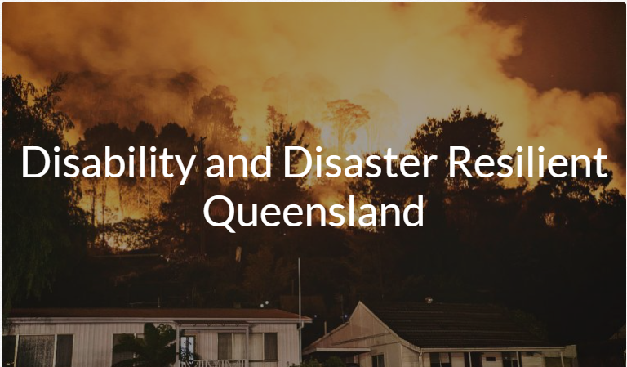
People with disability (PWD) and their carers?
Inclusive planning in times of disaster
Interrelated issues increase the vulnerability of PWD and their support networks to disaster: transport, living situation, social connectedness, assistance animals, everyday discrimination, assistive technology needs.
Michelle Villeneuve et al, ‘Applying a Person-Centred Capability Framework to Inform Targeted Action on Disability Inclusive Disaster Risk Reduction’ (2021) 52 International Journal of Disaster Risk Reduction 101979.
International evidence that PWD experience greater challenges during recovery and require more support post-disaster (Hurricane Katrina)
Laura M Stough et al, ‘Barriers to the Long-Term Recovery of Individuals with Disabilities Following a Disaster’ (2016) 40(3) Disasters 387.
https://collaborating4inclusion.org/

Slide 9
Children and young people?
56% - humanity was doomed
75% - the future is frightening
83% - people have failed to care for the planet
52% - family security will be threatened
39% - hesitant to have children
Elizabeth Marks et al, Young People’s Voices on Climate Anxiety, Government Betrayal and Moral Injury: A Global Phenomenon, The Lancet, 7 September 2021.

Slide 10
Extreme heat
Heatwaves are a ‘silent killer’ causing more deaths than any other extreme weather event.
Defined as ‘Three or more days in a row of unusually high temperatures relative to the local long-term climate and recent past.’
South-East Queensland is a recognised climate change ‘hotspot’ (Garnaut, IPCC)
Brisbane is vulnerable due to its high humidity. Urban areas are particularly heat vulnerable due to the ‘heat island effect’
Image by geralt on Pixabay
Yuming Guo et al, ‘Projecting Future Temperature-Related Mortality in Three Largest Australian Cities’ (2016) 208 Environmental Pollution

Slide 11
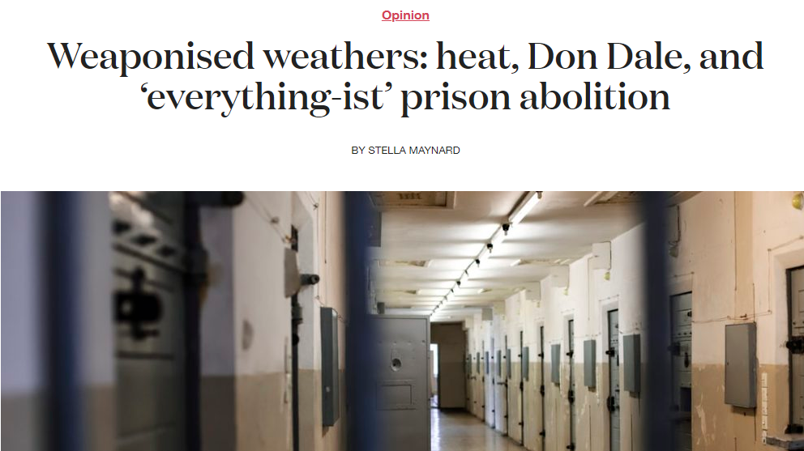
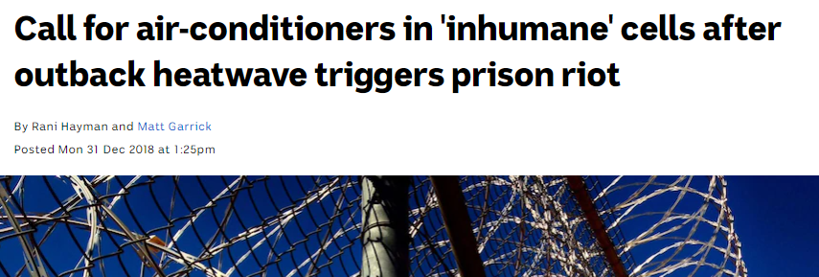
Extreme heat
Heatwaves are described as inherently unfair as they prey on the vulnerable
Children, the elderly, PWD, people experiencing homelessness, people living with energy poverty/poor ventilation.
Evidence that extreme heat can be weaponised against vulnerable people, e.g. prisoners, DFV.
Evidence of high heat across employment law, tenancy law, administrative law.
Coroner’s Court of Queensland decisions underscore the danger of working in extreme heat
Inquest into the death of Glenn Richard Newport (Brisbane) 20 April 2016
Non-inquest findings into the death of Oliver Max Caramin (Cairns) 20 August 2021
Links to: Guardian article 1 Feb 2022, Weoponised weather blog (author Stella Maynard) 2019, ABC article 31 Dec 2018

Slide 12
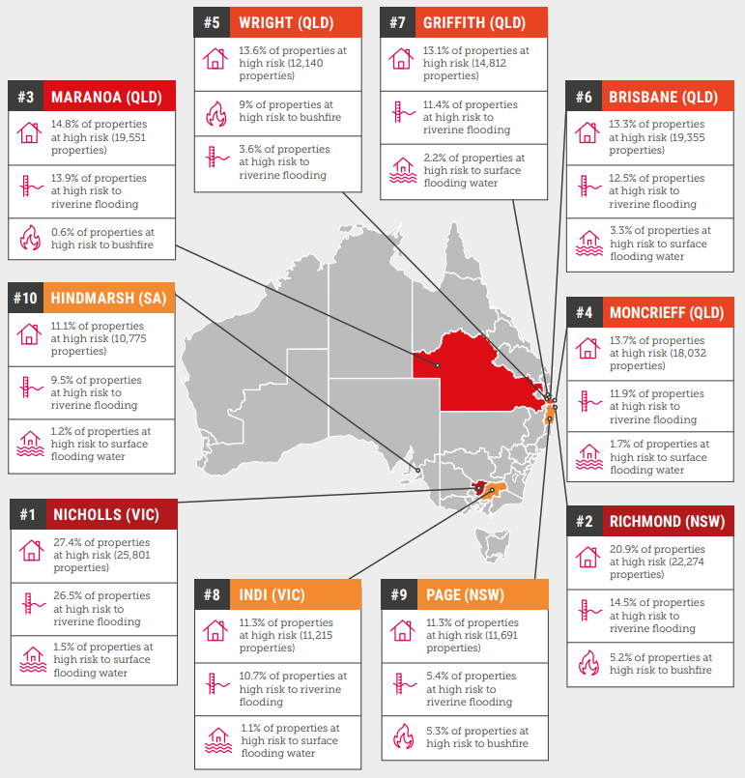
The role of geography in considering climate change-impacted legal need
Climate Council has profiled Australia’s most climate-vulnerable places
Climate Risk Map (interactive)
https://www.climatecouncil.org.au/resources/climate-risk-map/

Slide 13
In summary
Increasing, professional ‘on the tools’ understanding about civil legal need in disasters
Backed up by limited (but growing) evidence through industry reports
Gaps in our understanding about civil law needs outside the disaster cycle
Extreme heat is a likely significant climate factor, but we need empirical research
Importance of climate literacy for our specific communities of interest

Slide 14
Takeaways
What does a climate justice response look like for your clients?
Distributive, procedural, justice-as-recognition
Legal work that is more preventative, less reactive?
There is a need to avoid ‘climate adaptation privilege’ (Anguelovski and Pellow, 2020)
An opportunity to build your climate consciousness
Climate conscious lawyering - Justice Brian Preston
Subscribe to Climate Council updates
CLCQ webinar archives, lots of useful information
ABC Law Report archives: Legal needs of flood victims (March 2022), Bushire smoke, air pollution and the law (Feb 2020) Legal Aid in bushfire zones (Dec 2019)
Consider local adaptation efforts and alliances
Local government?
Human Rights Act 2019 (Qld) to advocate for climate adaptation response that are non-discriminatory, fair and just

Slide 15
Thank you for your time
Monica Taylor| QUT School of Law | Faculty of Business and Law
monica.taylor@hdr.qut.edu.au

