Slide 1
Building capacity and creating meaningful engagement with First Nations people

Slide 2
Acknowledgement of Country
YFS respectfully acknowledges Aboriginal and Torres Strait Islander people as Australia’s first peoples and the traditional owners/custodians of the land on which we meet and work. We recognise the important role they have within and country, and we pay our community respects to the Elders of this land
past and present.

Slide 3
Step 1: Needs analysis
The project was implemented by a team of First Nations researchers
The research involved a survey, stakeholder consultations and site visits

Slide 4
Step 2: Developing the Toolkit
Working group analysed the data and developed the content
Three topic areas
Your rights with police
Wills and EPOA
Discrimination

Slide 5
Step 3: Engagement

Slide 6
Cultural safety

Slide 7
Acknowledgment of Country
Notes:
Click to play video

Slide 8
Resources

Slide 9
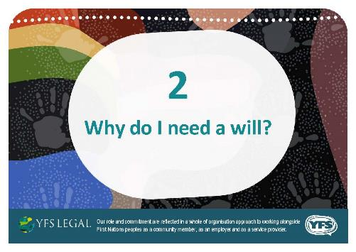
Resources

Slide 10
Resources

Slide 11
Student clinics

Slide 12
Student clinics
The speakers talk about
Their journey into the legal profession
The current position / role
Their experience with First Nations people in the criminal justice system
The importance of being an ally to mob
Their advice to future lawyers entering the legal profession about supporting and representing First Nations people

Slide 13
Get in touch
Download the toolkit and resources at
https://www.yfs.org.au/first-nations-legal-education-toolkit/
Address
Contact us
Social Media
2 Rowan Street
Slacks Creek, QLD 4127
Direct Line: 07 3826 1500
Via contact form: www.yfs.org.au
Email: yfslegal@yfs.org.au
Facebook: yfslogan
Linkedin: yfs-ltd
Twitter: yfslogan

