Slide 1
Understanding AFCA: How effective is our ‘One Stop Shop’?
Craig Parrish, Principal Lawyer & State Litigation Leader
(NSW, QLD, WA, and SA)

Slide 2












Maurice Blackburn Lawyers
Abuse Law
Employment
Law
Public Place Injuries
Superannuation & Insurance Claims
Asbestos, Silica
& Occupational Diseases
Financial Advice Disputes
Road Accident Injuries
Wills Disputes
Class Actions
Medical Injuries
Social Justice
Work-Related Injuries

Slide 3
Our Focus Today
Legal foundations of AFCA
What does the data tell us about AFCA?
Latest legal developments
What can we learn about AFCA from the case law and Determinations?
Practical tips

Slide 4
Legal Foundations of AFCA
Genesis
Vision
Mechanism
Oversight
The Ramsay Review:
Review of The Financial System External Dispute Resolution and Complaints Framework
The new “One Stop Shop” for financial services complaints and disputes from 1 November 2018
Replaced the Financial Ombudsman Service, the Superannuation Complaints Tribunal and the Credit and Investments Ombudsman.
Treasury Laws Amendment (Putting Consumers First - Establishment of the Australian Financial Complaints Authority) Act 2018 authorised the Minister administering the Corps Act to establish an EDR scheme
= AFCA is born
Regulated by ASIC

Slide 5
Legal Foundations of AFCA
Legal Framework
The Rules
Determination
Enforcement
Governed by:
  A Constitution; and
  The “Complaint Resolution Scheme Rules”;
  approved by ASIC under the Corporations Act
The Rules form part of a tripartite contract between AFCA, Financial Firms and Complainants.
AFCA has less creative scope with superannuation complaints – limitation imposed by s. 1055(7) of the Corporations Act
Therefore, once a Determination is made under the Rules and accepted by the Complainant = a binding and enforceable contract between the three parties
If a Financial Firm fails to pay in accordance with a Determination = breach of that tripartite contract

Slide 6
What does the data tell us?

Slide 7
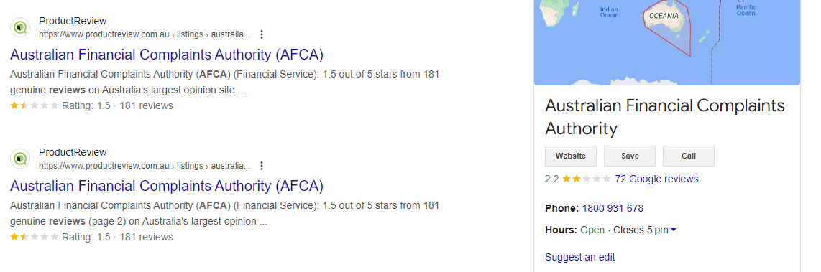
An unfair measure of effectiveness?

Slide 8
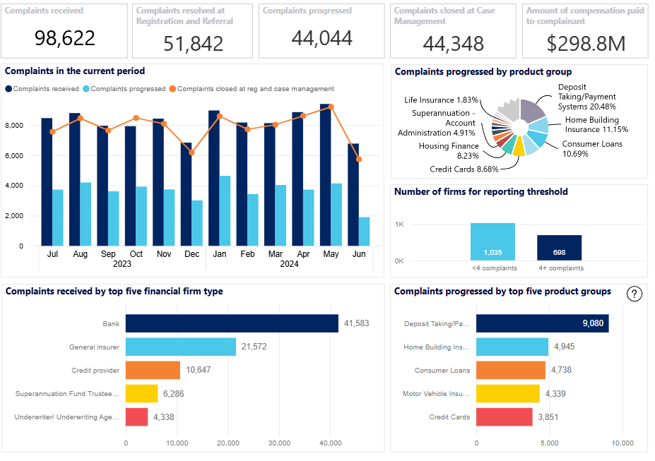
AFCA's 'Data Cube'

Slide 9
Latest Developments

Slide 10
Treasury review of AFCA
In August 2021, Treasury released a review of AFCA: has AFCA been effective in resolving complaints in a way that is fair, efficient, timely and independent?
01
Took feedback from participants in the AFCA ecosystem: consumers, businesses, and financial firms.
02
Reported AFCA was ‘performing well’ in a “difficult operating environment” and that its decision making was fair, independent, and efficient.
03

Slide 11
Treasury Recommendations
AFCA should address poor conduct by paid advocates
AFCA should consider what is “fair in all the circumstances” having primary regard for legal principle, industry codes, good industry practice and previous decisions
AFCA should not advocate for, nor act in a manner that otherwise advantages, one party such that impartiality of the complaints resolution process is compromised.
AFCA Determinations should continue to not be subject to merits review on appeal
Clearer guidance on circs in which a further issue identified during the complaint process can be raised
AFCA should be more transparent in its public reporting of systemic issues, including on a de-identified basis when appropriate
AFCA’s funding model should not disincentivise financial firms from defending claims they do not consider to have merit
AFCA should improve transparency of its fees for financial firms and how these are being used
AFCA should continue to publish data on its timeliness and start publishing data on all complaints, and better manage expectations

Slide 12
AFCA’s Significant Event Response Plans
Declared 6 times since December 2023:
March 2025 - Tropical Cyclone Alfred;
February 2025 – North Queensland Floods;
April 2024 – severe storms in NSW;
February 2024 – Valentine’s Day storms in VIC;
January 2024 – Christmas storms across QLD, NSW & VIC;
December 2023 – Tropical Cyclone Jasper.

Slide 13
What can we learn about AFCA from the case law and Determinations?

Slide 14
QSuper Board v AFCA [2020] FCAFC 55
Did the “vibe” of AFCA’s Determination offend Ch III of the Constitution?
Dr Lam, a member of QSuper, was unhappy because, he alleged, he had overpaid premiums for his Death and TPD Cover over a two and a half year period. He says that his correct occupational rating entitled him to a lower premium and, accordingly, he was now entitled to a refund
QSuper said that it has provided Dr Lam with the requisite notification about this feature of the policy and he failed to make the proper application to qualify for the lower premium
Dr Lam complained to AFCA and ACFA ultimately found in his favour
The Board of QSuper appealed to the Federal Court - argued that AFCA had impermissibly exercised the judicial power of the Commonwealth under Ch III of the Constitution by finding that the notification to Dr Lam was inadequate
Facts

Slide 15
QSuper Board v AFCA [2020] FCAFC 55
Findings
The Court held that even if AFCA found that the refusal to refund premiums was unfair or unreasonable because of a breach of the Corps Act, it did not follow that AFCA impermissibly exercised judicial power – reaching conclusions or making decisions about legal rights as steps taken whilst making an administrative decision, do not involve the exercise of judicial power.
AFCA’s power is to “consider the operative effect of a trustee’s decisions in relation to a member and determine whether it operates “unfairly or unreasonably or both” in relation to the member.” [184]
AFCA does not exercise judicial power because its Determinations:
  1. lack conclusiveness - AFCA cannot enforce a Determination and its decisions are open to collateral attack;
  2. create new rights rather than determining/adjudicating existing ones; and
  3. do not involve an exercise of sovereign power because of the parties’ voluntary submission to the AFCA scheme.

Slide 16

Case Study: The G Family Home
Family home burnt down due to a wiring defect; insurance claim initially declined on the basis that home was “unoccupied”.
Claim contested with multiple rounds of submissions and no offers made before or during AFCA process.
AFCA determined old policy terms applied.
Evidence showed property was “occupied” prior to the fire.
Final Determination: $450k plus interest

Slide 17
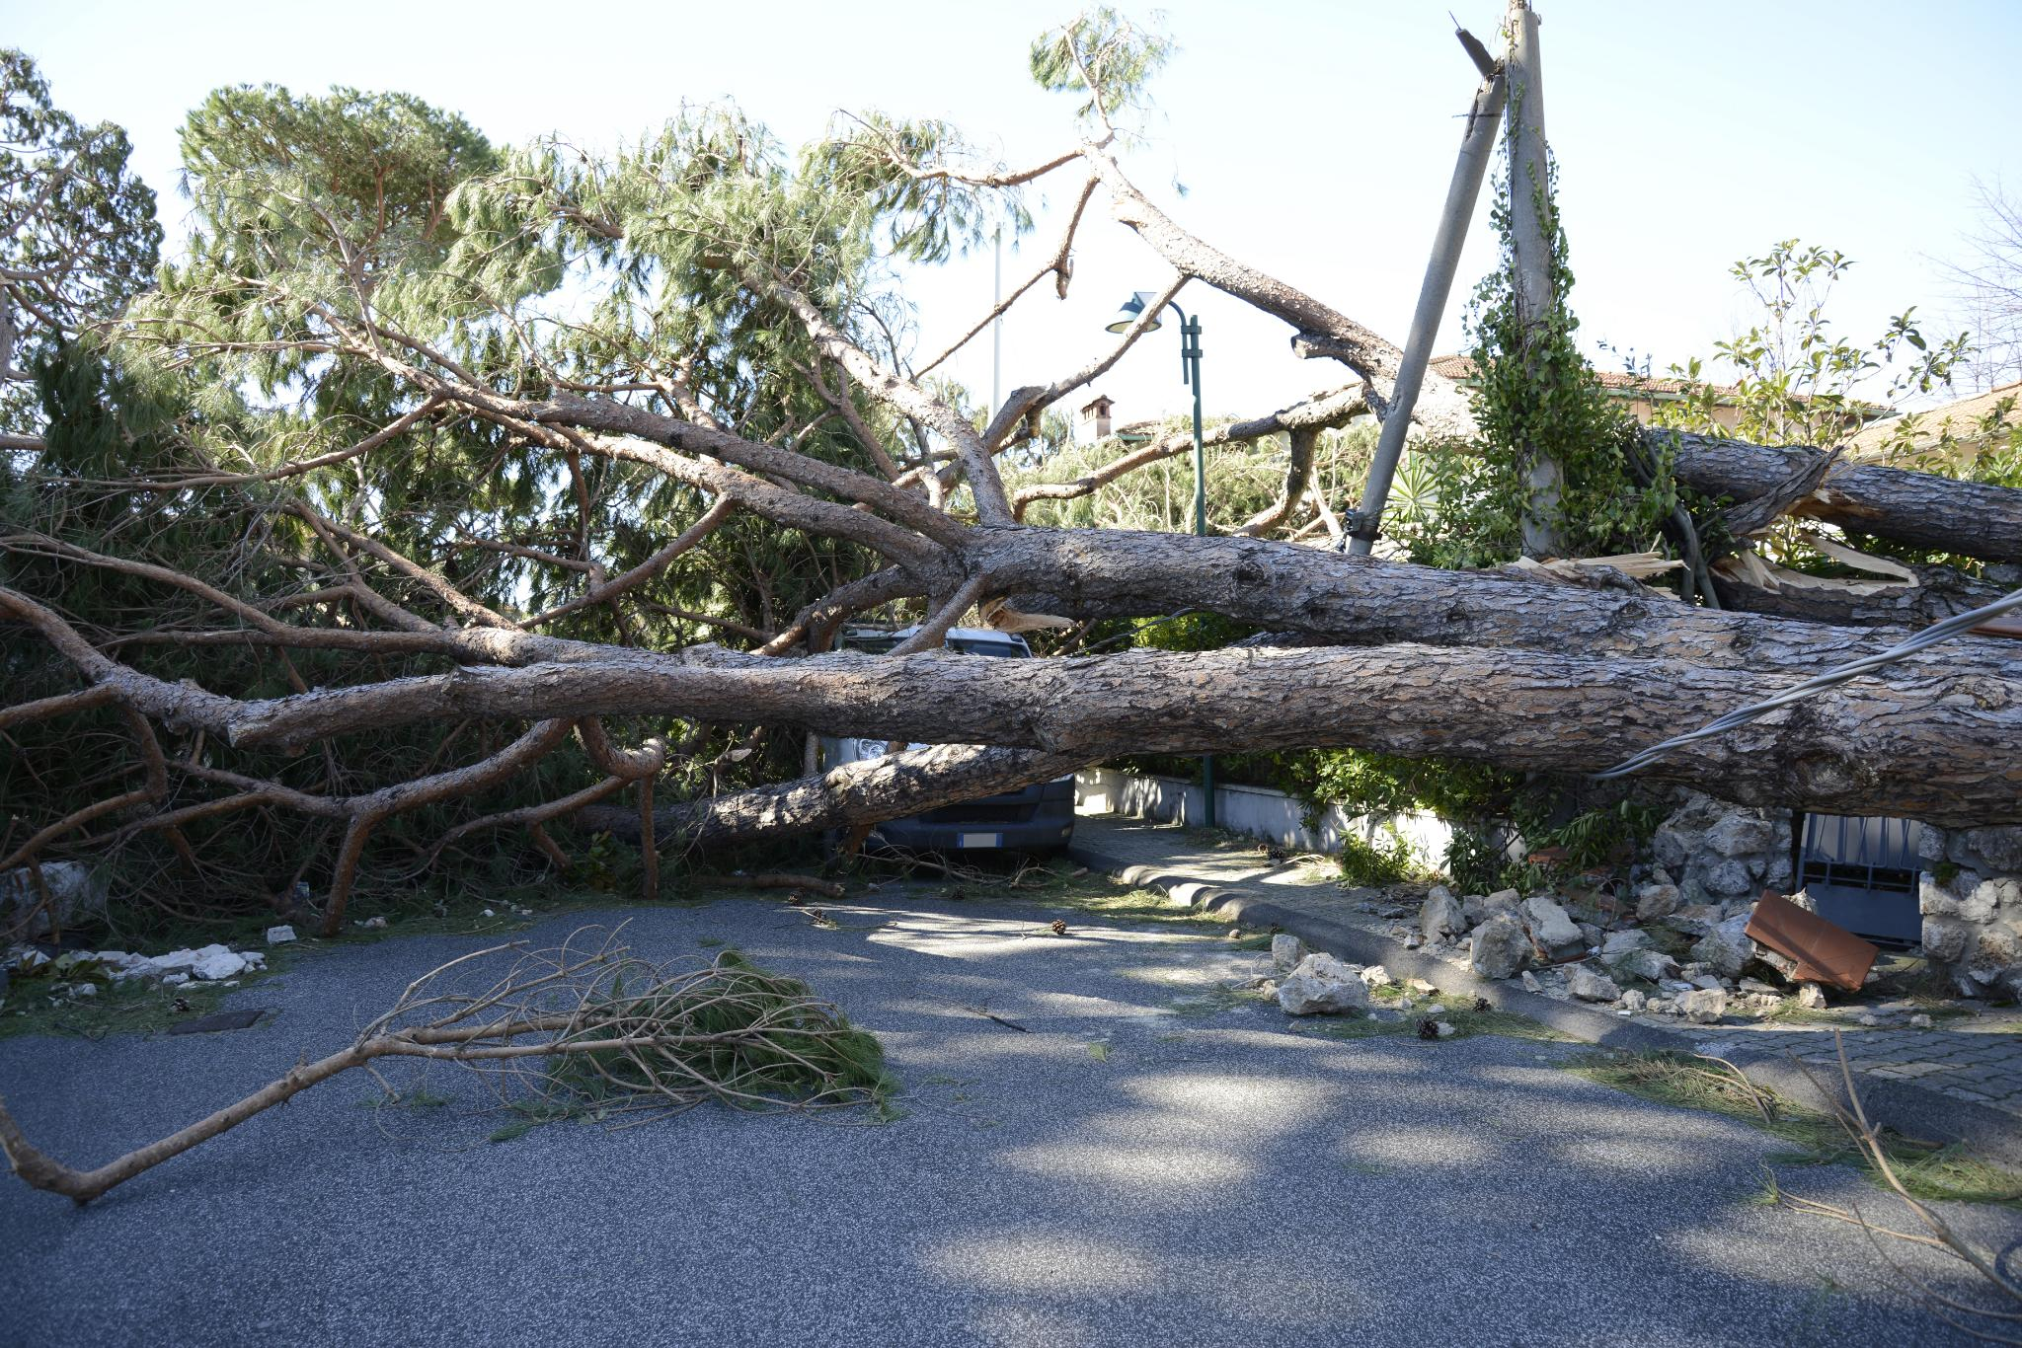
Case Study: Smith's Building Claim
Family home sustained significant storm damage and the insurer dragged its feet in assessing and responding to the claim, resulting in mould damage.
We succeeded at AFCA – the Insurer was required to rectify the damage.
Further delay – resulting in further complaints to AFCA about the insurer’s non-compliance.
Client awarded full building sum insured, 12 months emergency accommodation costs and interest.

Slide 18
Determination 12-24-148499 (15 January 2025)
Storm damage to a home in February 2022
Claim accepted in 2024 - insurer paid a cash settlement for the contents, and had started repairs on the home in August 2024
Insurer then decided it also wanted to cash settle the outstanding repairs because of a breakdown in the relationship between the insured and the appointed builder
AFCA was not satisfied that the insurer’s approach was fair and reasonable – must complete the remaining repairs, remediate mould damage, pay emergency accommodation and pay non-financial loss of $6,300

Slide 19
Do consumers need to be represented?
Strictly speaking, no...
AFCA’s Engagement Charter: individuals and small business can tell AFCA if they have specified communication needs, would like each step of the AFCA process to be explained, or if they aren’t able to provide information within requested timeframes.
AFCA still expects all complainants to act fairly, co-operate with investigations, cooperate with requests for information and evidence within specified timeframes, actively participate in the complaint process, genuinely consider possible remedies offers, and not contribute to delays.
May be difficult where a complainant lacks legal knowledge, or is experiencing stress, financial hardship, unemployment, illness, injury, or disability. Difficult to objectively assess offers made.
Requires a consumer – or their advocate - to assess prospects, gather, present and explain evidence, and make legal and factual arguments.

Slide 20
Practical Tips
Do:
  Consider AFCA if:
      relatively low sum of money in dispute;
      consumer wants the insurer to repair the damage or a remedy other than a lump sum payment;
      consumer’s evidence is lacking and/or unlikely to be admissible in court; or
      the financial firm is threatening legal proceedings against the consumer to recover a debt – see rule A.7
  Obtain further evidence (especially contemporaneous evidence) and put it before AFCA – the rules of evidence do not strictly apply, so you/consumers can get creative;
  Carefully assess AFCA Recommendations, Determinations and offers made – binding if accepted by a consumer;
  Remember time limits – for GI complaints, it is 6 years from awareness of loss, or 2 years from insurer’s IDR response

Slide 21
Practical Tips
  Don’t:
  Assume a consumer can accept an offer and just come back later if required;
  Assume AFCA will gather further evidence or assist the consumer in doing so – the consumer or their advocate will likely have to be proactive;
  Necessarily recommend AFCA if the sum in dispute exceeds the AFCA compensation cap of $631,500, or if the client is looking to recover indirect or non-financial losses greater than $6,300 – litigation is likely to be a better avenue

Slide 22
Final Thoughts
AFCA is a curious beast – part statute, part tripartite contract and empowered to make decisions with often profound impacts on consumers (without exercising judicial power)
Life insurance disputes only account for a small proportion of AFCA’s overall work – many more GI disputes on AFCA’s plate.
AFCA can be an effective dispute resolution forum for consumers, particularly where amount in dispute makes it difficult to litigate and with unfair and unreasonable conduct by general insurers
AFCA Determinations are difficult to appeal to the courts, but only binding on the parties once accepted by the Complainant.
Complainants need to be aware that a settlement, accepted Recommendation or Determination will be binding on them!
Problems arise for consumers when Financial Firms refuse to comply with AFCA Determinations or go bust – difficulties with enforcement.
CSLR is important public policy
Still a relatively young and developing organisation, so provide feedback and seek continuous improvement in the experience of consumers using the scheme

Slide 23
Questions?
Spreclaims@mauriceblackburn.com.au
1800 196 050

